Slide 1

Tek-Alert® Integration
Manager

Slide 2
Introduction
Our Tek-ALERT Integration Manager allows your facility to seamlessly integrate calls and activities from your various systems and route those calls to the appropriate staff member. The Tek-ALERT Integration Manager uses your systems’ Serial, HL7, COMP2 and TAP outputs as input.
Tek-ALERT integrates hard-wired nurse call, wireless nurse/emergency call, fire alarm, security and access control systems. Its reporting, paging, remote monitors and other messaging options provide you with a single point to manage staffing, patient safety and maintenance.

Slide 3
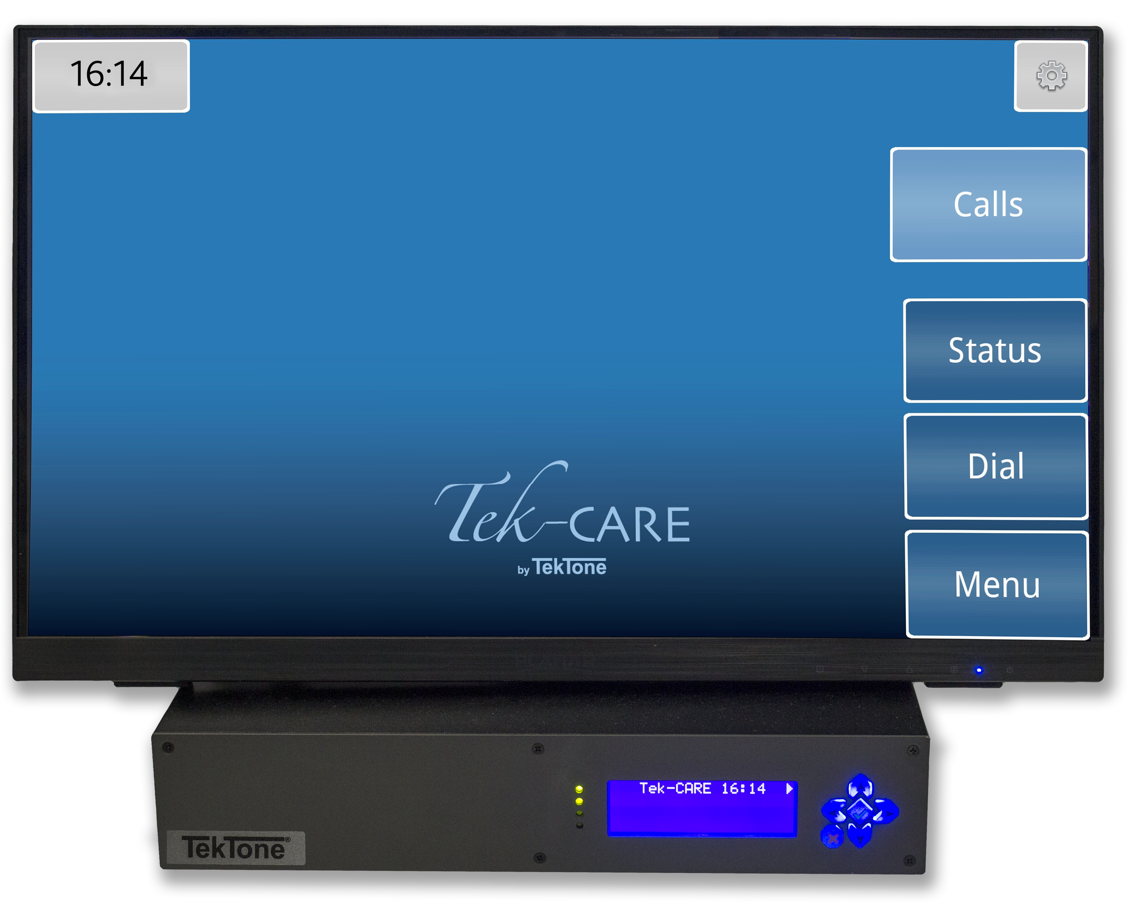
Platforms
Our Tek-ALERT software is designed to work both as a standalone system, and in conjunction other TekTone® platforms.
NC475DESK Tek-CARE® Appliance Server

Slide 4
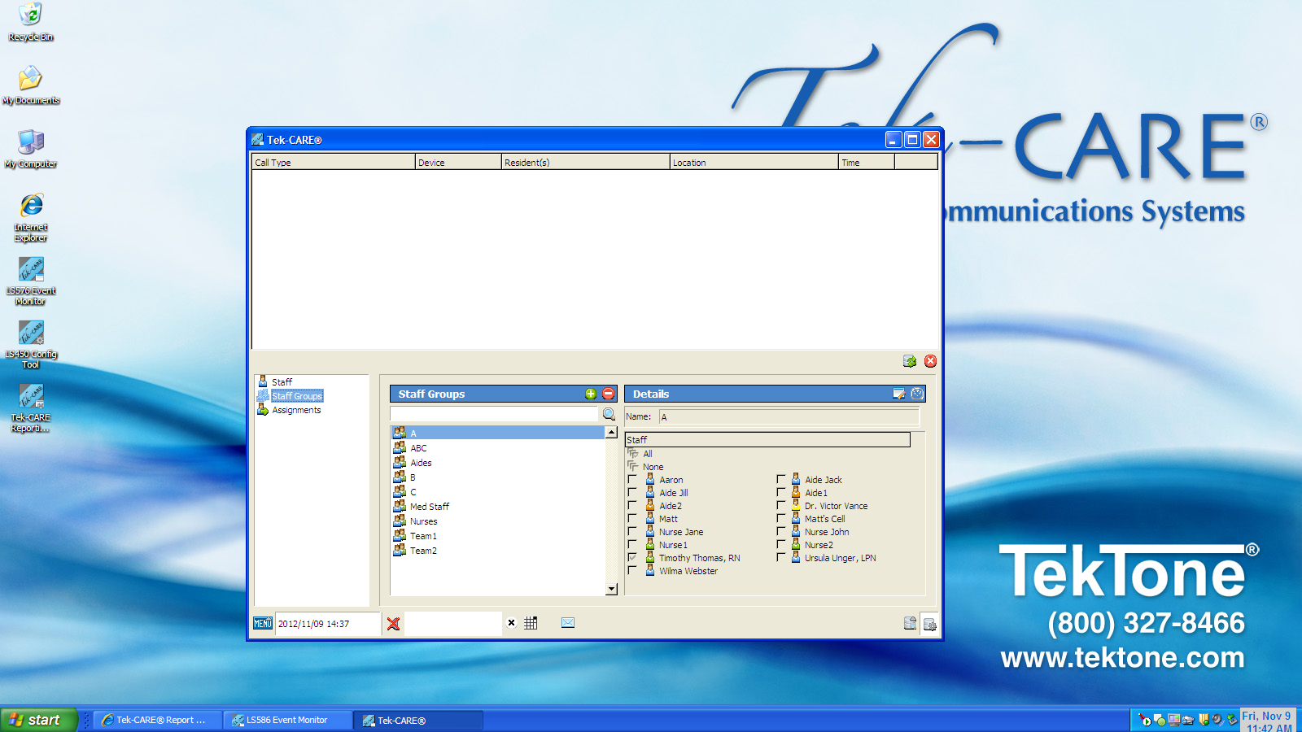
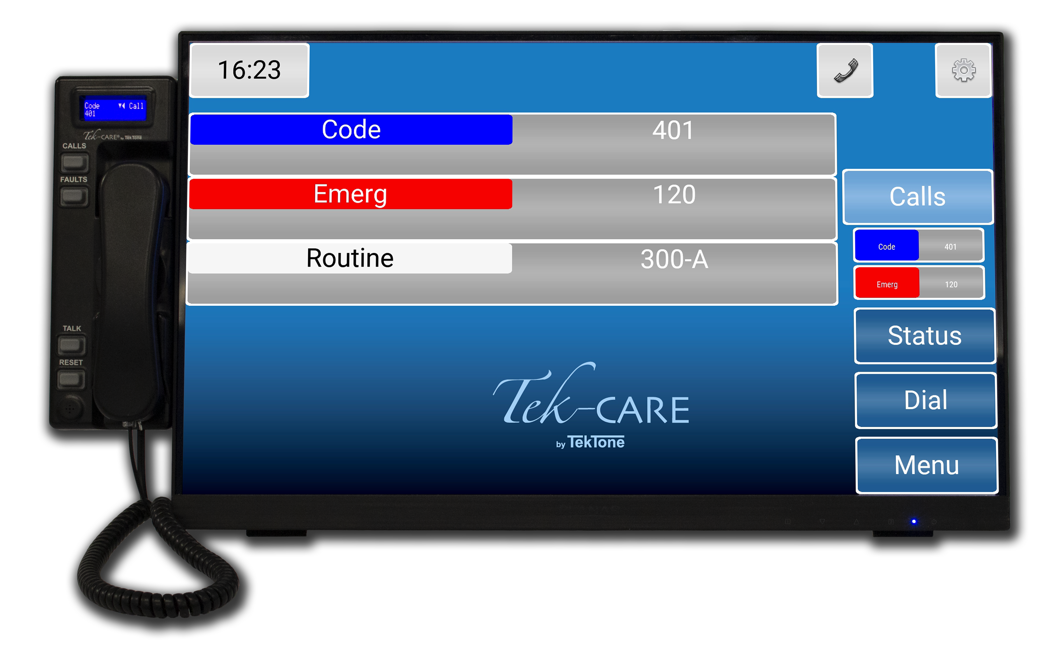
Event Monitor
The core of the system was developed as part of our Tek-CARE400 nurse call system, which is UL® 1069 listed and designed to rigorous life-safety standards. All events can be displayed on a nurses’ master station, and/or on a remote event monitor running on any networked PC on the facility’s LAN.

Slide 5
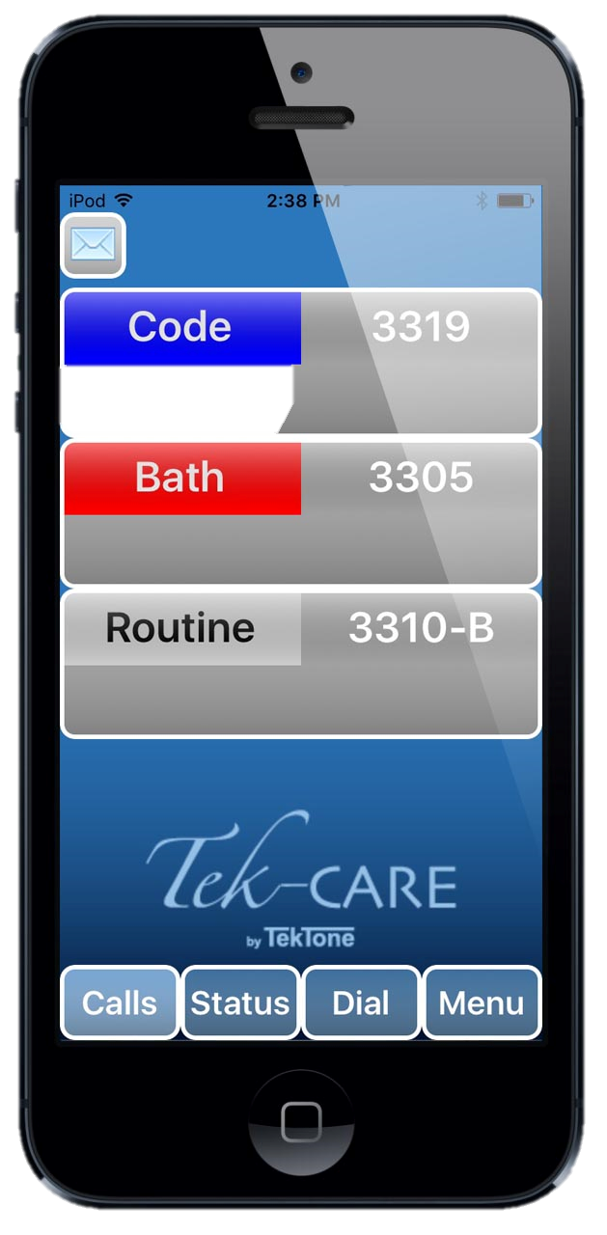
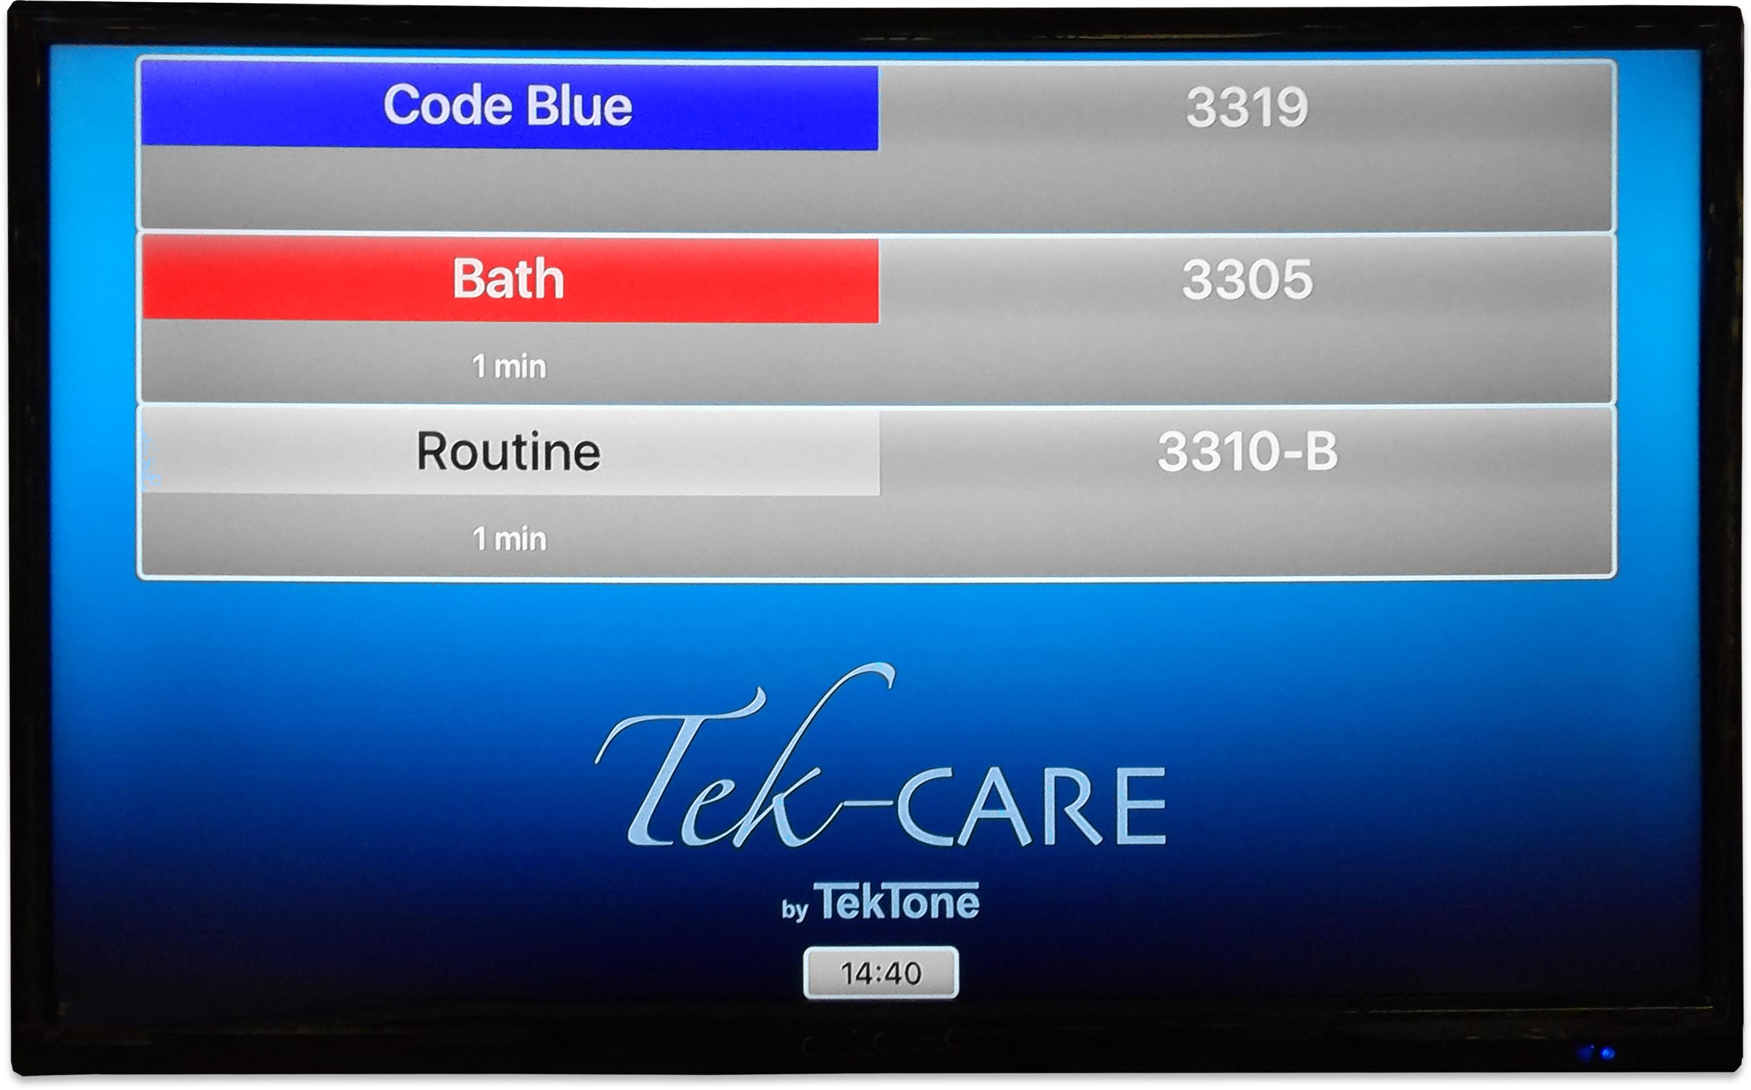
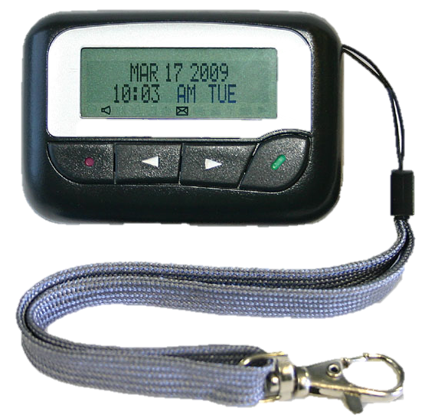
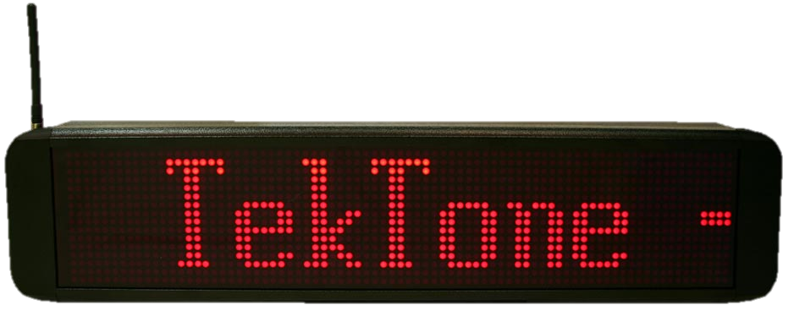
Messaging & Notifications
Tek-ALERT integrates with smart phones, pagers, LED marquees, Tek-CARE TV for Apple TV, email and the Tek-CARE Staff App for iOS and Android—ensuring the right staff member receives the right notification at the right time.

Slide 6
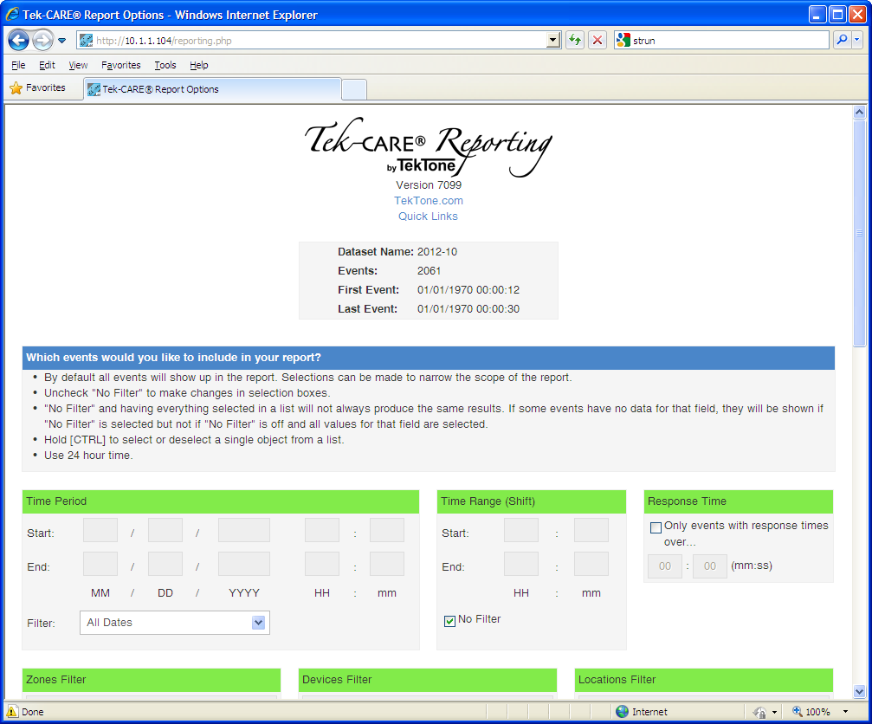
Reporting
Tek-ALERT can generate reports for any system connected to it. Reports can be itemized by device, time and day, location, and event type. Reports can also be automatically sent via email. In addition, the data can be easily exported to a spreadsheet.

Slide 7
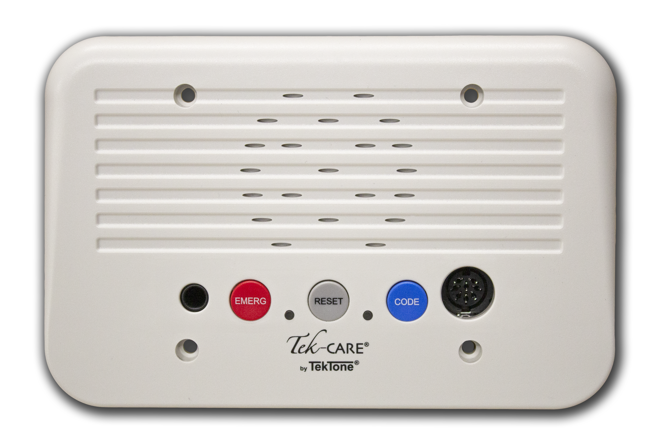
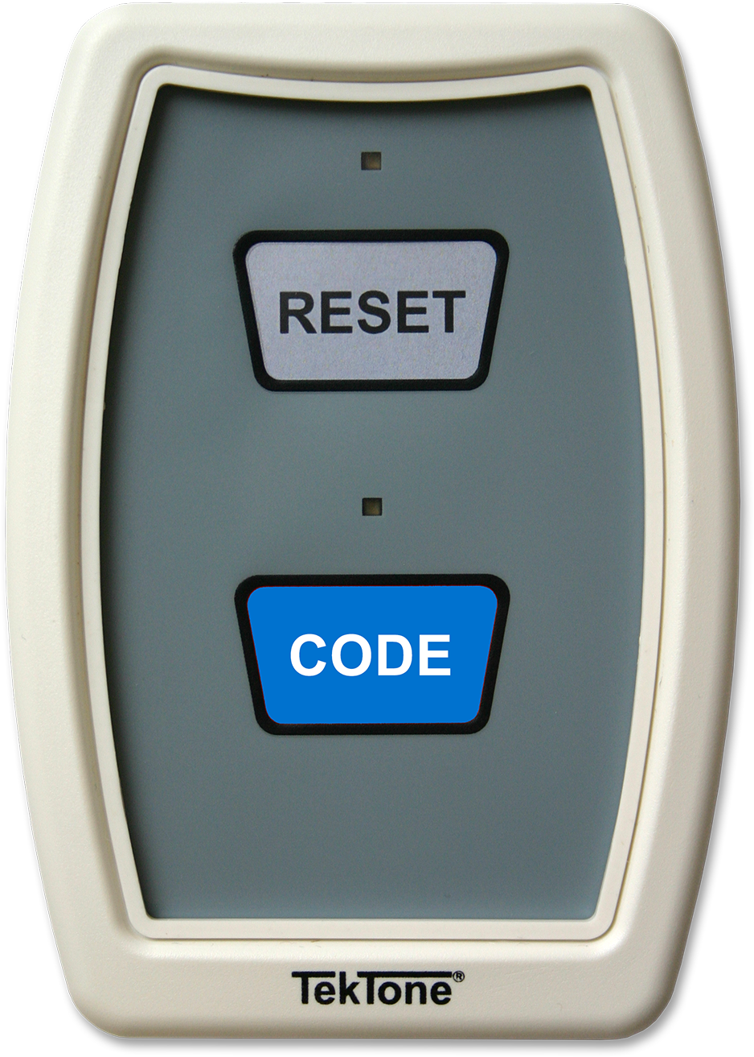
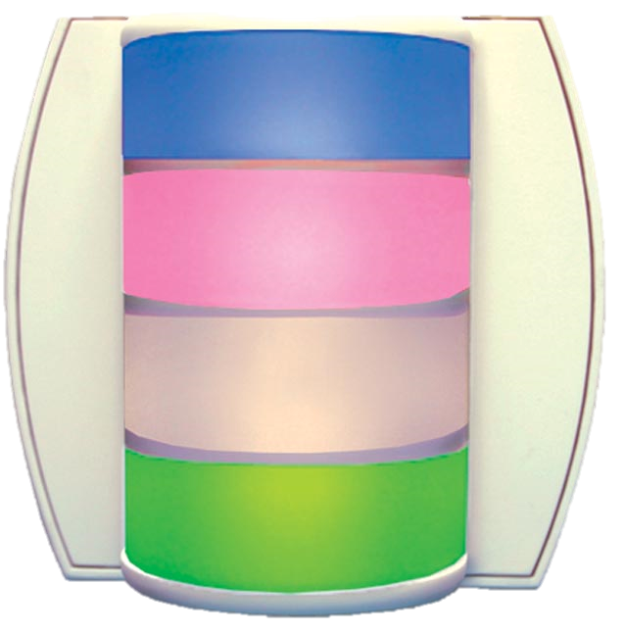
Tek-CARE®400 P5+
Tek-ALERT seamlessly integrates with the Tek-CARE400 nurse call system, enabling the nurse master station to display activity from all connected systems. This reduces the number of monitors required at the nurses’ station, freeing up valuable desk space.

Slide 8
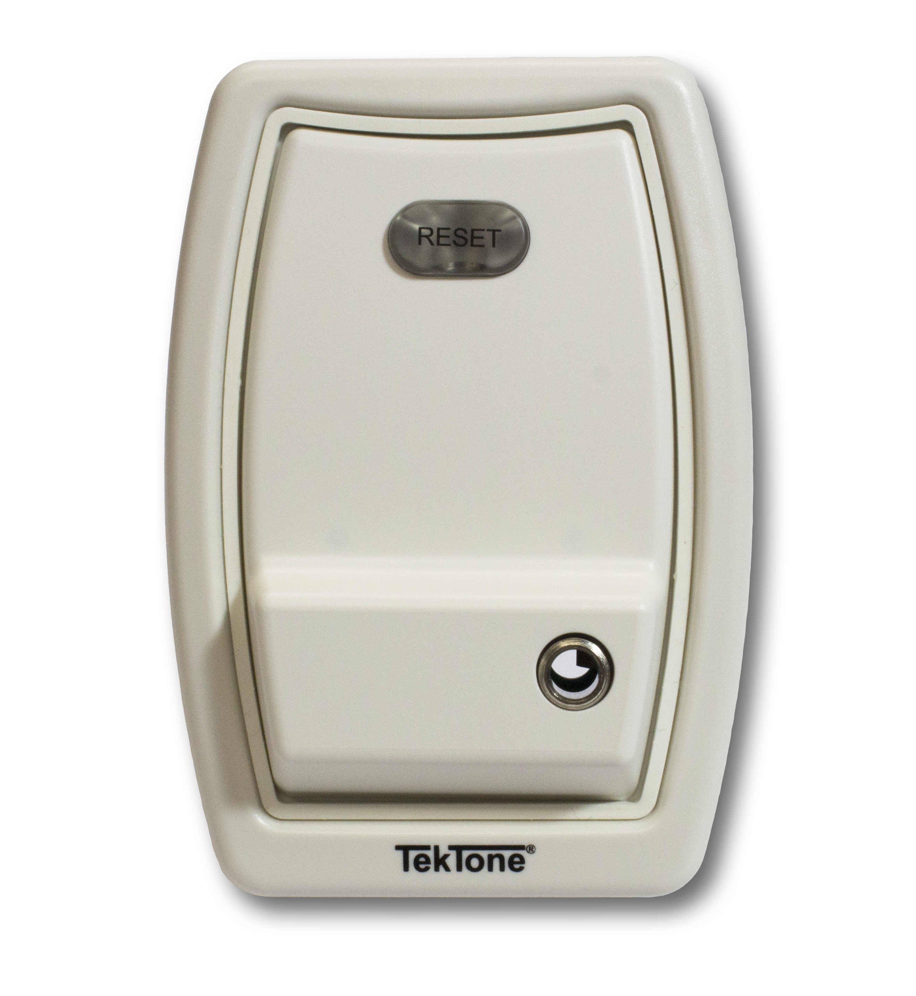
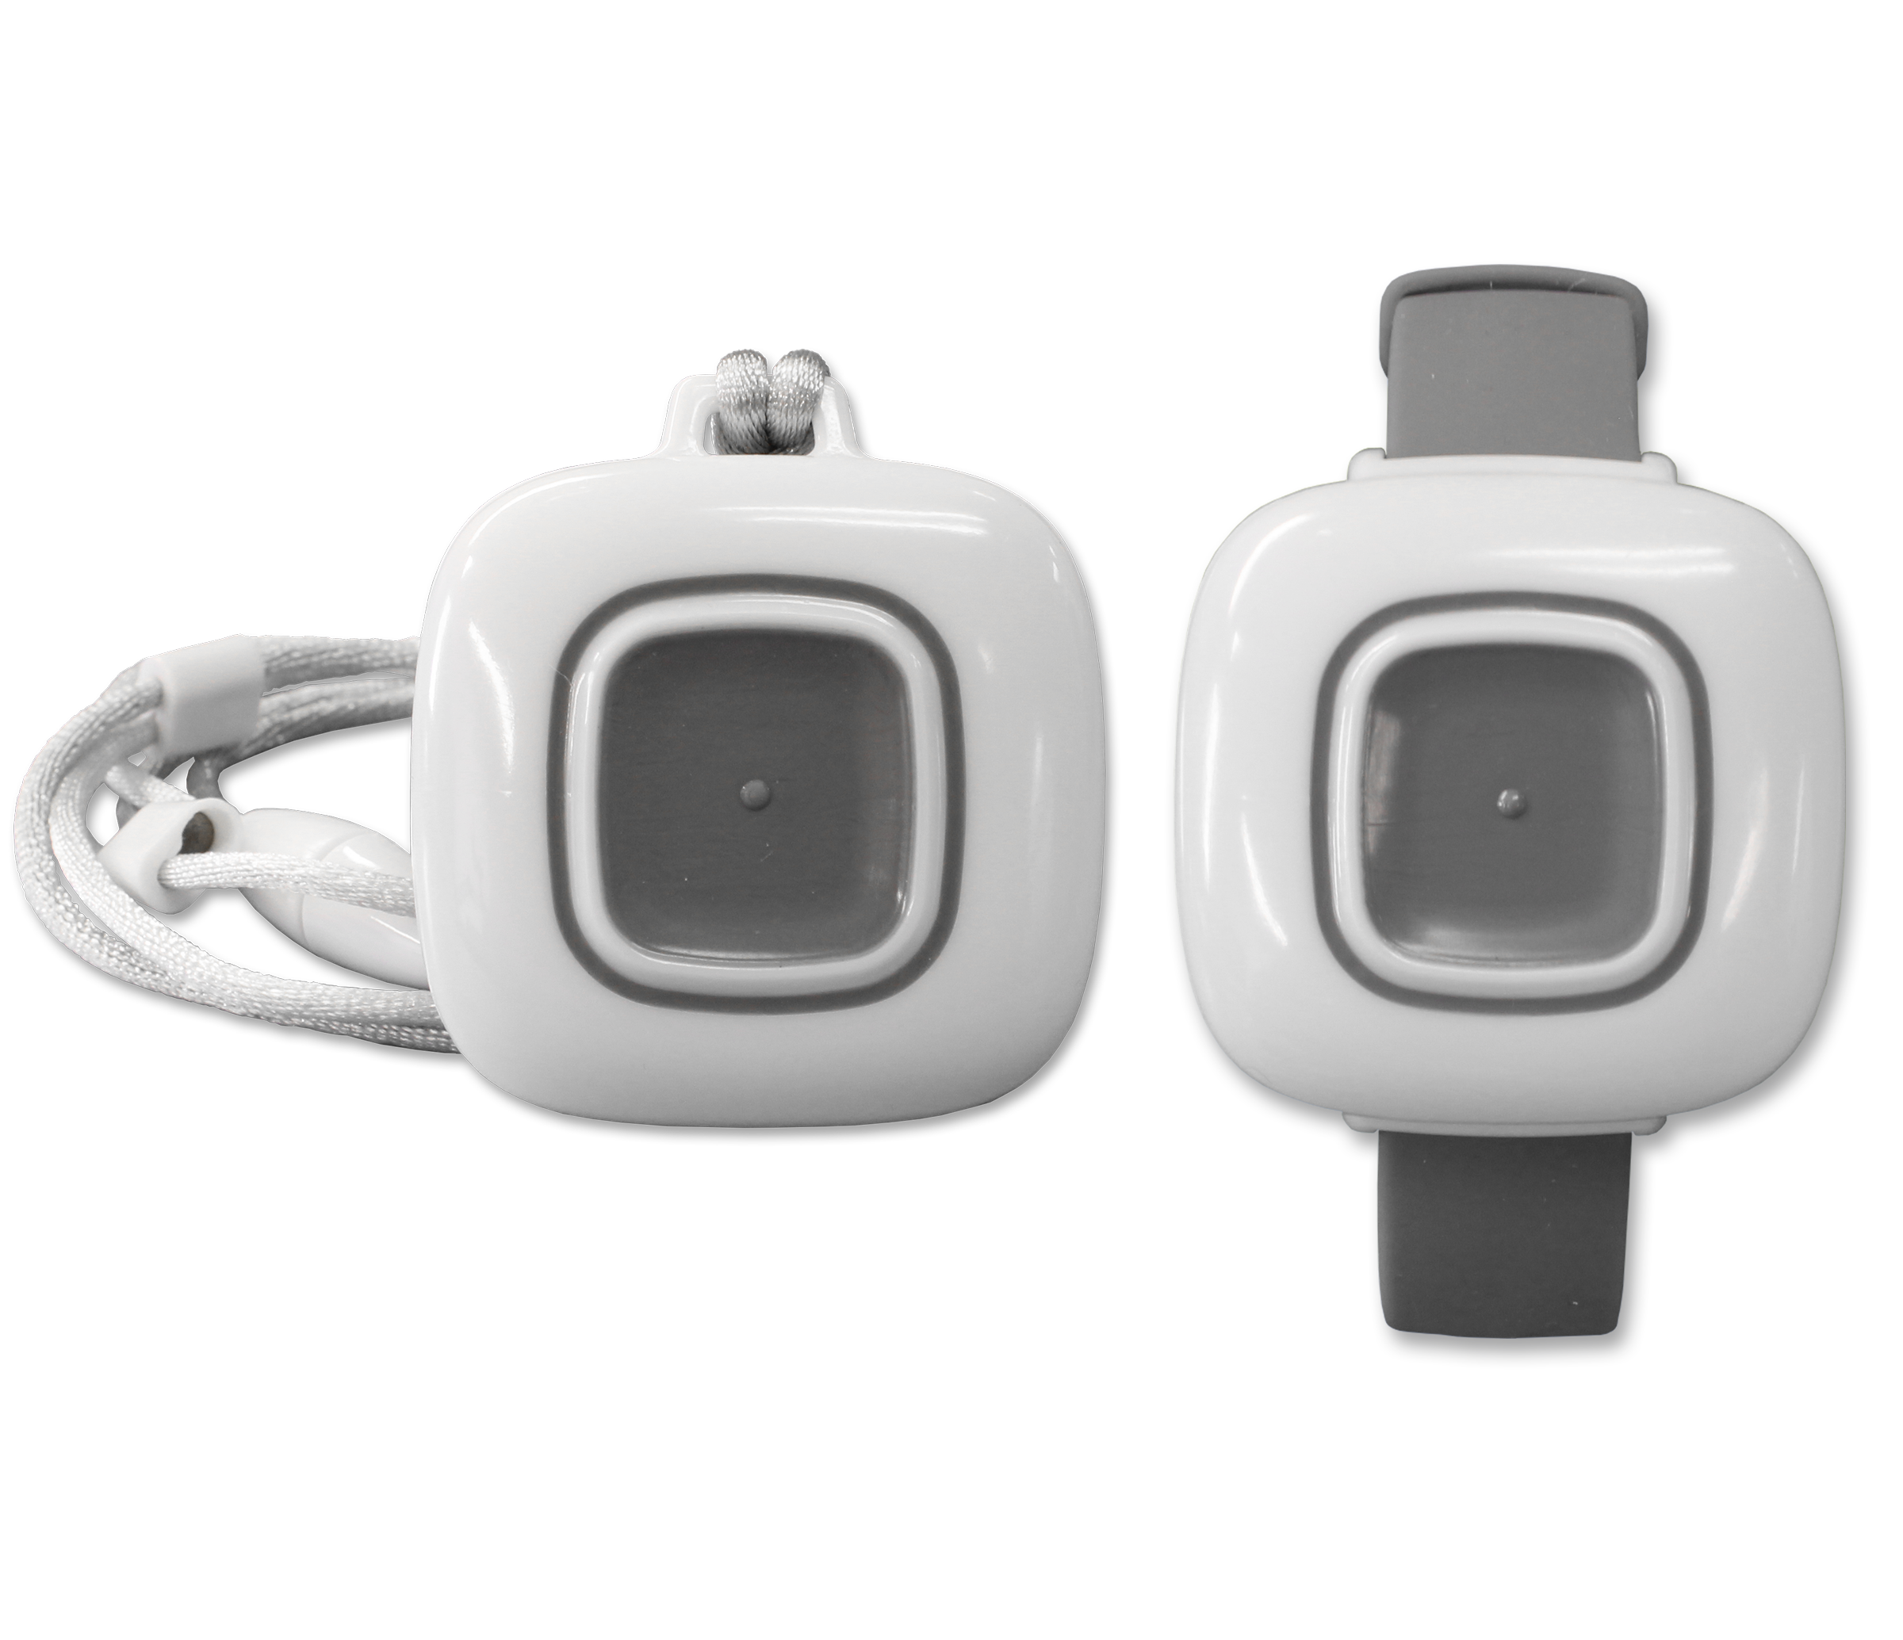
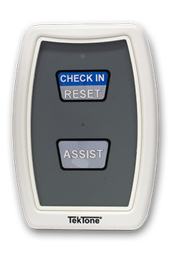
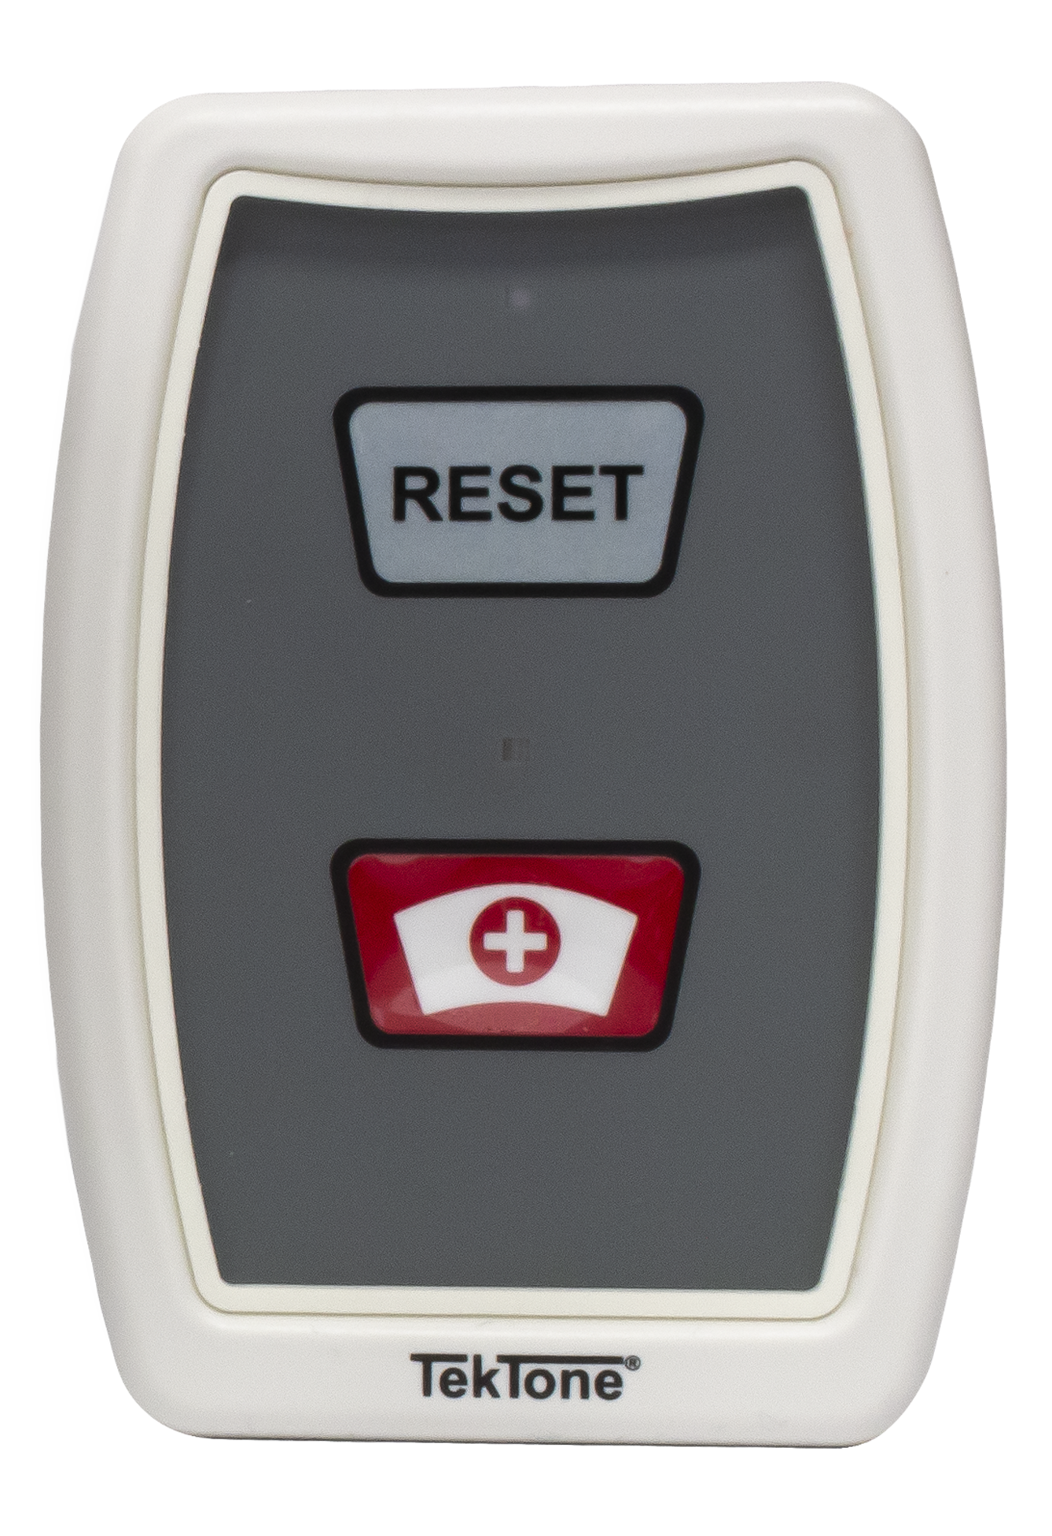
Tek-CARE®500
Tek-ALERT also seamlessly integrates with the Tek-CARE500 system, allowing your facility to add pendants and emergency call devices to the system.

Slide 9
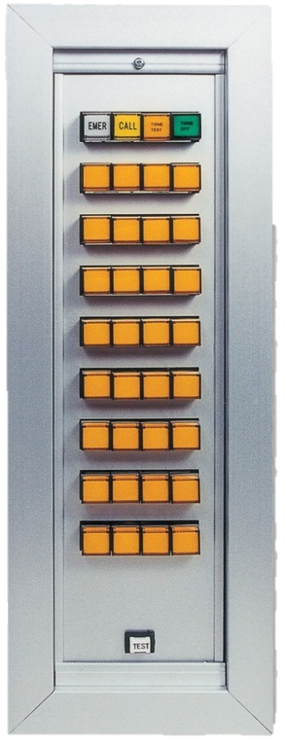
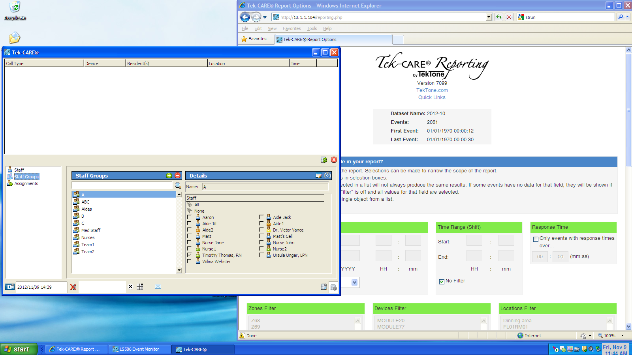
Non-Addressable Systems
Many facilities are still using non-addressable systems that are in good working order. In the past, these systems have not had reporting capabilities and had only limited messaging. Tek-ALERT provides event monitors, reporting and messaging with call escalation for these systems.

Slide 10







Integrations
Tek-ALERT was designed to be flexible so that you can monitor the systems that you have.

Slide 11

Support
Support after a system is installed is one of the most important factors that a facility has to consider when selecting a system. Our highly qualified network of TekTone Elite Partners, along with our 40 years of experience, ensures that you receive the highest level of support.

Slide 12
Thank you!
If you have any questions about Tek-ALERT, please feel free to contact us.
Visit the Where to Buy page (www.tektone.com/reps.php) of our website to find a Sales Representative or TekTone Elite Partner near you.
You can also contact our sales department directly by calling (800) 327-8466, or by visiting our website, www.tektone.com.

Slide 13
TekTone History
Founded in 1973, TekTone designs and manufactures UL Listed nurse call, wireless nurse/emergency call, apartment entry, area of rescue assistance systems, and alert integration systems. TekTone has grown rapidly — TekTone now serves these markets both nationally and internationally.

Slide 14
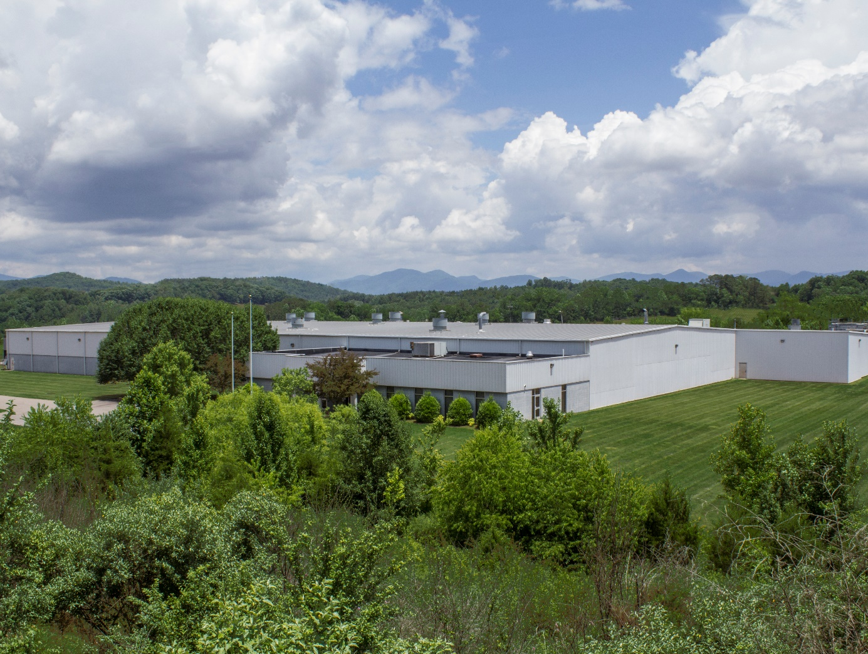
  TekTone’s North Carolina facility now serves as our world headquarters and production plant
  ISO 9001 Certified quality management system
  More than 75% of TekTone’s products are made in North Carolina

Slide 15
324 Industrial Park Road
Franklin, NC 28734
www.tektone.com

