Slide 1



Wireless Nurse Call System

Slide 2

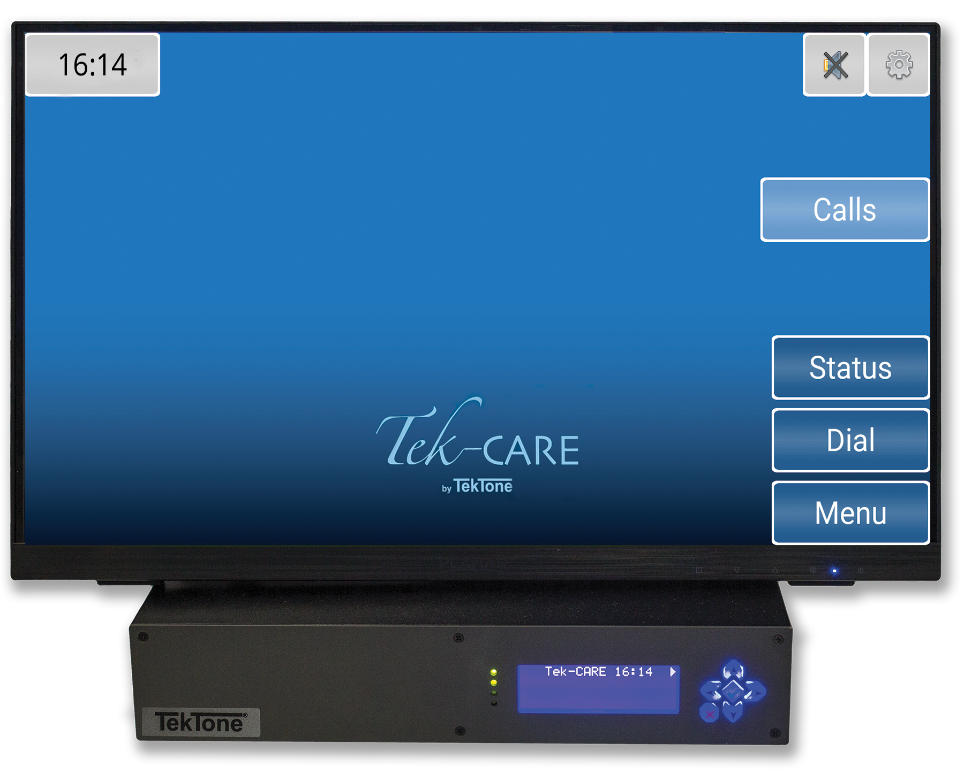

NC475DESK Tek-CARE Appliance Server
(Keyboard and mouse not pictured)
  UL® 2560 Listed.
  Superior Range—EchoStream® can cover large areas using frequency-hopping,
  spread-spectrum technology.
  Reliable—Self-testing for increased confidence.
  Flexible—Residents and transmitters can be added quickly and easily by facility staff.
  Enhanced location option available.
  The Tek-CARE500 is warranted to be free from defects of material and
  workmanship under normal use and service for three years.

Slide 3
Features
Supervisory Signal—Sent by transmitters and repeater/locators; includes battery status.
Resident Check-in—Reduces staff labor for manual “up & about” checks.
Resident Information—Creates custom fields for residents’ details.
Portable Pendant Call Transmitters—Plus wall-mounted call transmitters.
Radio Pocket Paging—Quickly and automatically notifies staff of calls, or send custom messages.
Integration—Seamlessly integrates with other hardwired technology while blending into a residential environment. Other nurse call systems, fire alarm, and security can all send alerts to one convenient place
Tek-CARE500 can handle UL® Listed (UL), EchoStream® (ES) and Frequency Agile (FA) transmitters at the same time.
Tek-CARE® Staff App for iPhone, iPad, iPod touch, Android devices and Tek-CARE TV for Apple TV.

Slide 4

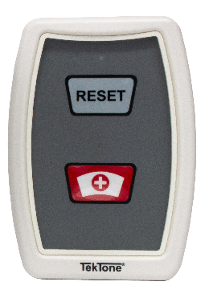
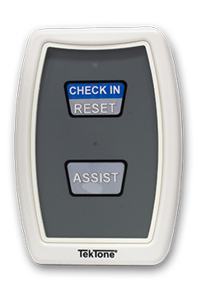
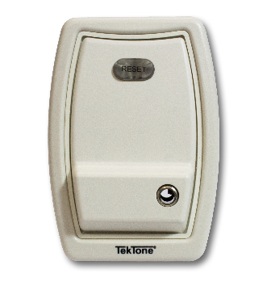
UL® 2560 Requirements
UL® 2560 is the standard for Safety of Emergency Call Systems. Introduced in 2011, this standard applies to emergency call systems used in assisted living facilities, independent adult living centers and other non-acute care settings that are within close proximity to healthcare providers.
At a minimum, UL® 2560 emergency call systems must include the following components:
Central notification stations—At least one central station at a fixed location that receives all calls processed through the system.
Emergency call stations—At least one permanently fixed emergency call station located in every resident room or living unit.
Back-up power—A backup power supply so that system operation is maintained in the event of a power loss.
SF523UL
Room Station
SF523UL
with Check-In Insert
SF521UL
Room Station

Slide 5
UL® 2560 Requirements
Additional requirements include:
Call indicators—All emergency call stations and pendants must have call indicators to confirm that a call has been placed.
Origination reporting—The central station must display the specific location of the emergency call.
Timing of call notification—All emergency calls must be received by the central station within 60 seconds of being initiated.
Call cancellation—Emergency calls can only be cancelled from the device that initiated the call.
Pendants—If included, pendants and wrist bands must comply with the standard’s performance requirements. However, these devices are not a substitute for the fixed emergency call station requirement.
Repeater/Locators—If included, they must comply with the standard’s performance requirements.
Low battery power—Wireless transmitters must report low battery power at least seven days before loss of power.

Slide 6
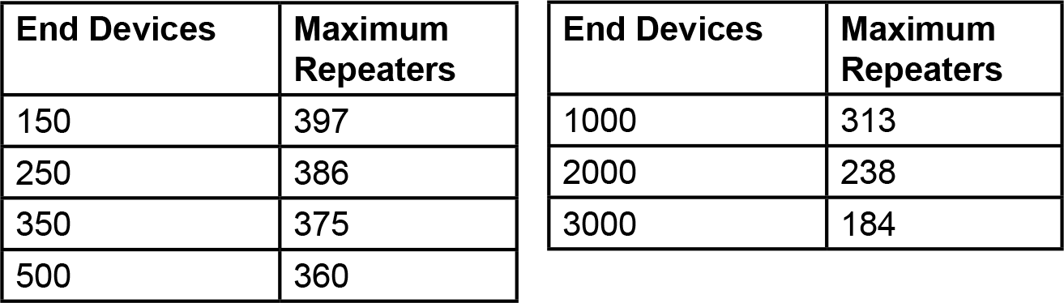
UL® 2560 Requirements
In order for Repeater/Locators to comply with the UL® 2560 standard’s supervision and alarm transmission requirements, this device/repeater matrix must be followed.

Slide 7
System Components
Central Notification Station
The NC475 Appliance Server with LS500 license processes and displays transmitter call information from the system’s receiver. Many programmable options are available to customize a facility’s system.
The NC475 Appliance Server includes pre-installed Tek-CARE software. Ordering appropriate licenses such as LS500, central monitoring, reporting and text messaging capabilities will provide the desired features.
NC475DESK Tek-CARE Appliance Server
(Keyboard and mouse not pictured)

Slide 8
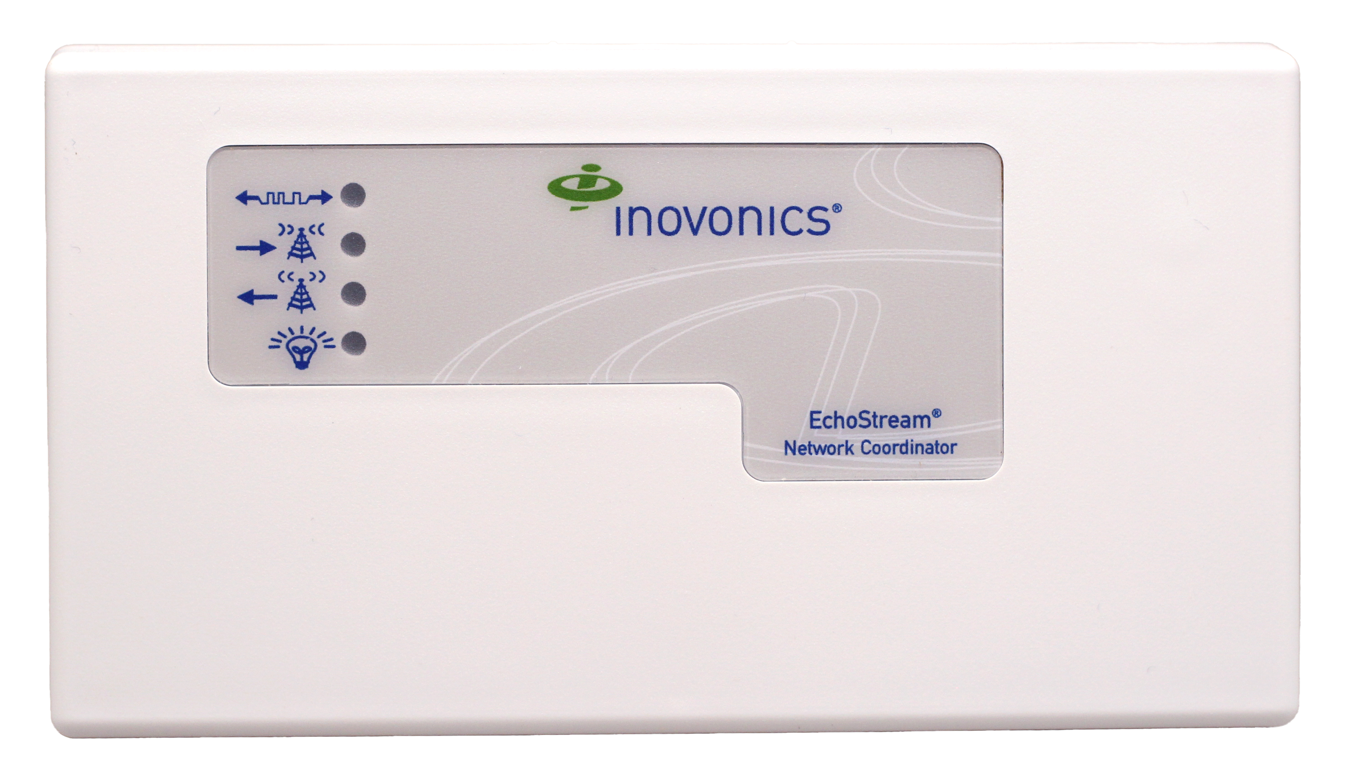
System Components
Central Notification Station
The Receiver collects signals from the transmitters, repeater/locators in the field and then transfers that information to the NC475 Appliance Server.
NC510UL
Receiver
NC475DESK Tek-CARE Appliance Server
(Keyboard and mouse not pictured)
The NC510UL Receiver is connected directly to the NC475 via the supplied cable. The receiver transfers information received from the transmitters in the field to the NC475.

Slide 9
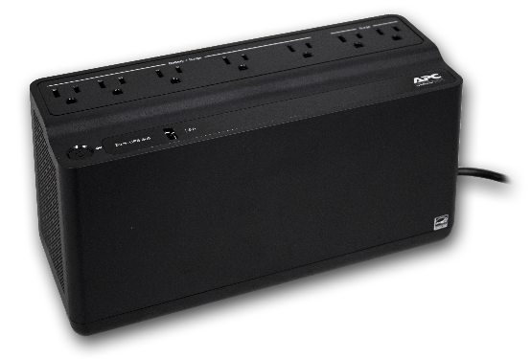
System Components
Central Notification Station
The Uninterruptible Power Supply provides uninterrupted power for the Appliance Server and Receiver in the event of utility power failures, brownouts and blackouts.
NC475DESK Tek-CARE Appliance Server
(Keyboard and mouse not pictured)
PK250B
Uninterruptible
Power Supply
When power is interrupted, the PK250B immediately cuts in to provide power until an emergency generator is activated or power is restored. Battery backup for the NC475 is rated for 10 minutes.
NC510UL
Receiver

Slide 10
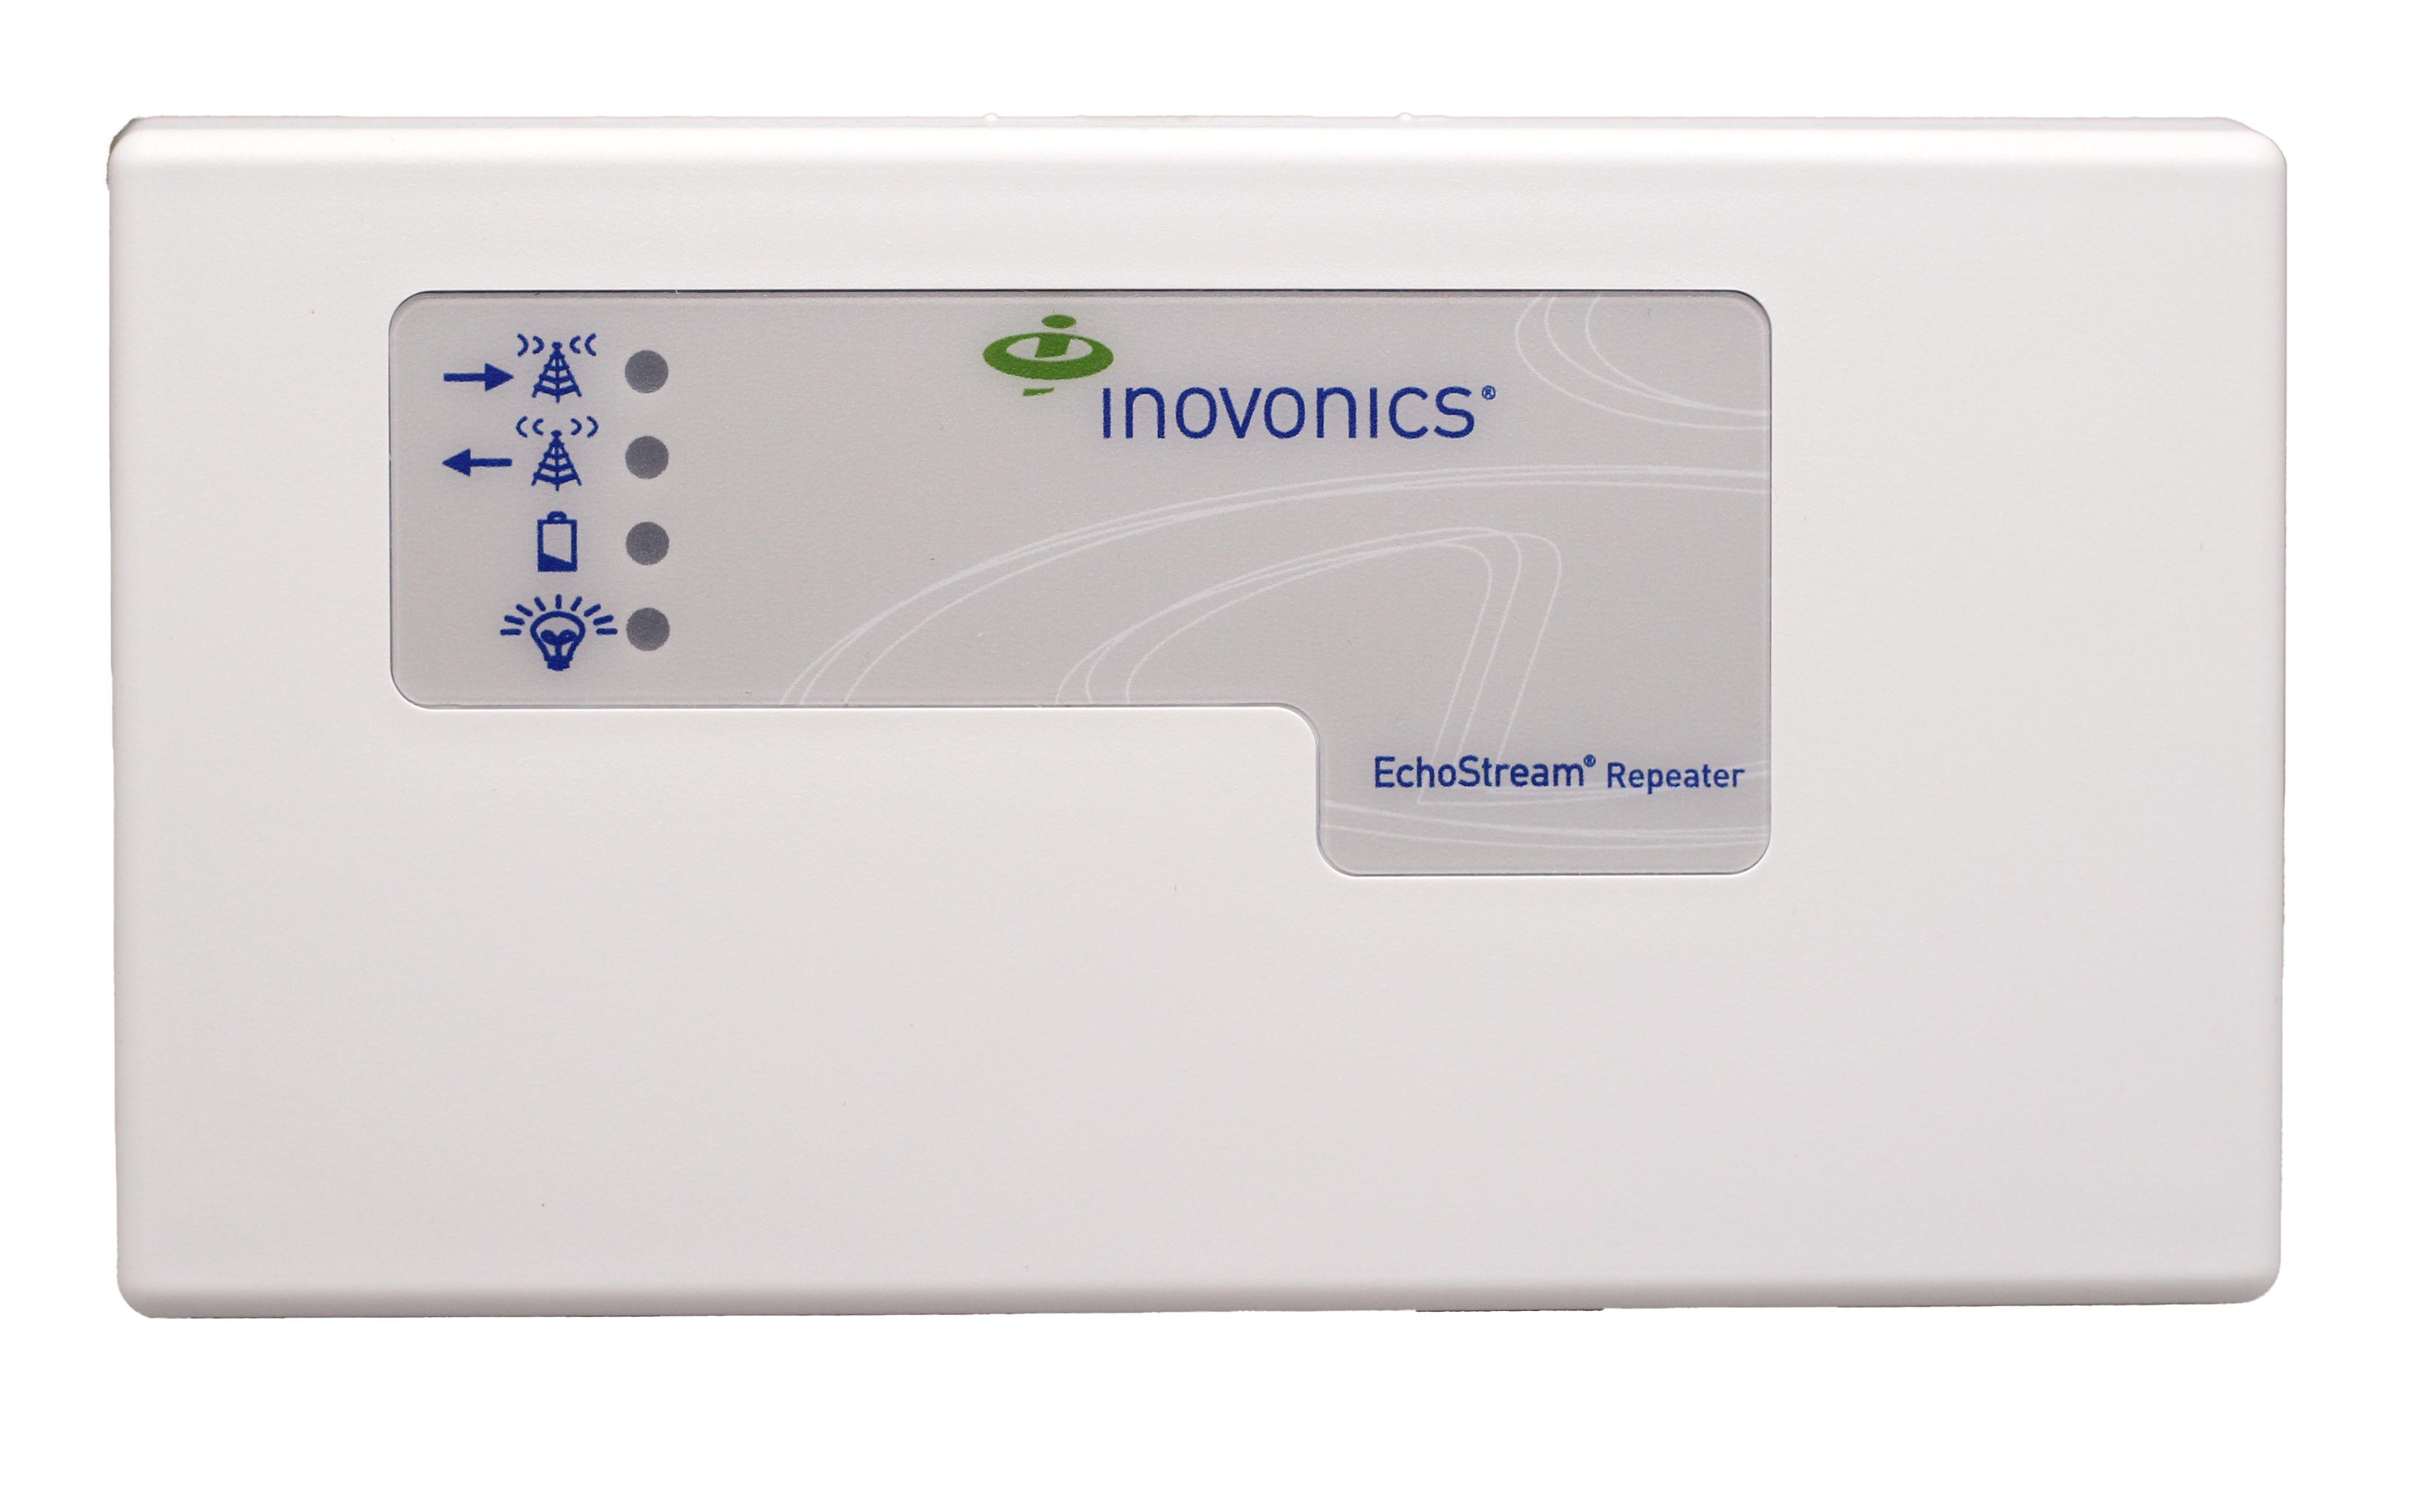
System Components
Repeater/Locators are strategically placed throughout the facility to collect and re-transmit signals from transmitters and other repeater/locators to the receiver. Repeater/Locators also provide general location information.
NC510UL
Receiver
NC511UL
Repeater/Locator
NC475DESK Tek-CARE Appliance Server
(Keyboard and mouse not pictured)
Repeater/locators operate on AC power, and include internal battery backup for power outages.
PK250B
Uninterruptible
Power Supply

Slide 11

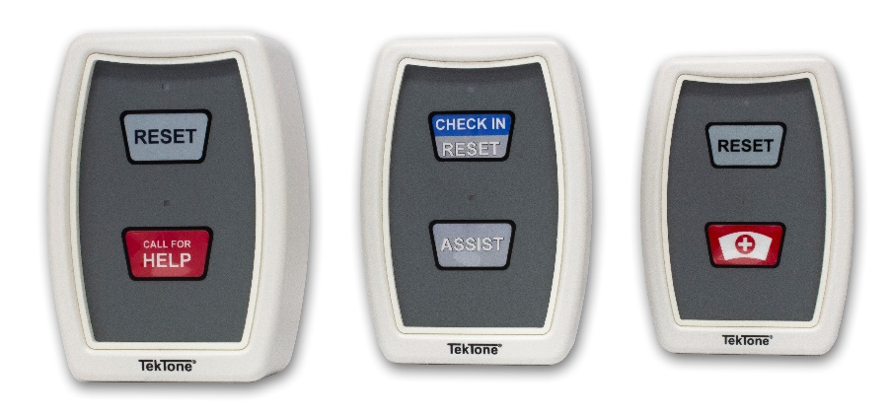
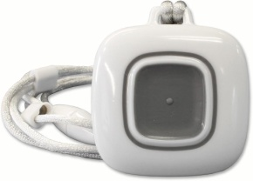
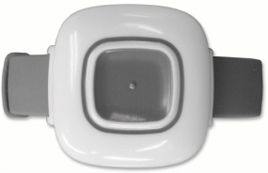
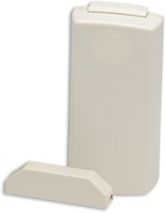
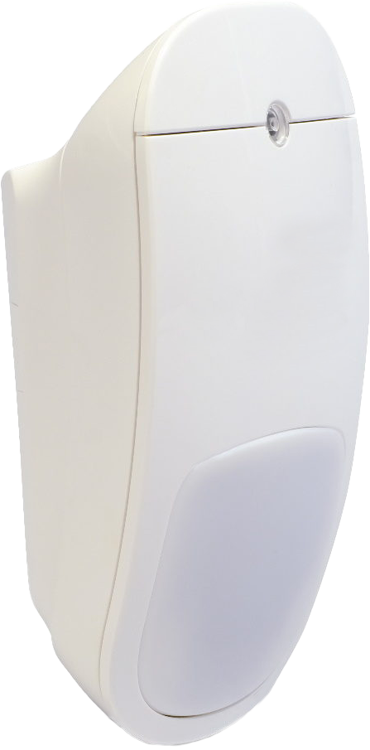
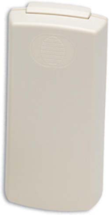
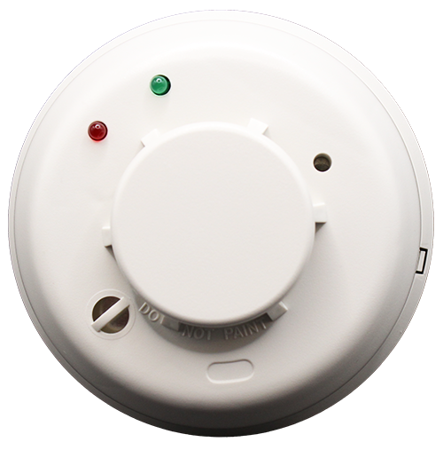
UL® 2560 Listed Transmitters
SF521UL
Room Station
SF523UL Room Station w/ optional pull cord and waterproof gasket
SF503UL & SF504UL Pendants
SF515UL
Wireless PIR Activity Sensor
SF520UL
Door/Window
Egress Transmitter
SF506ES Wireless Smoke Detector
(built to meet UL2560 specs)
SF525UL & SF525/2UL
Universal Contact Transmitters

Slide 12
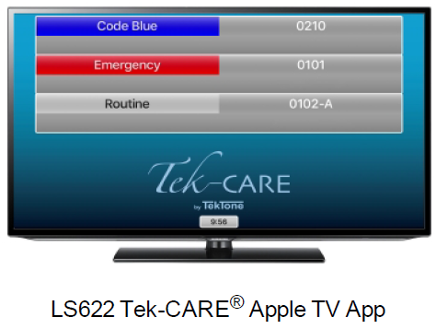
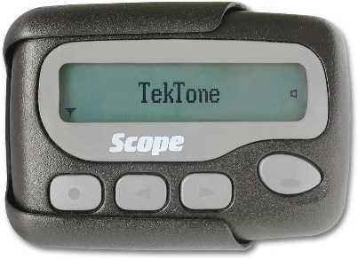
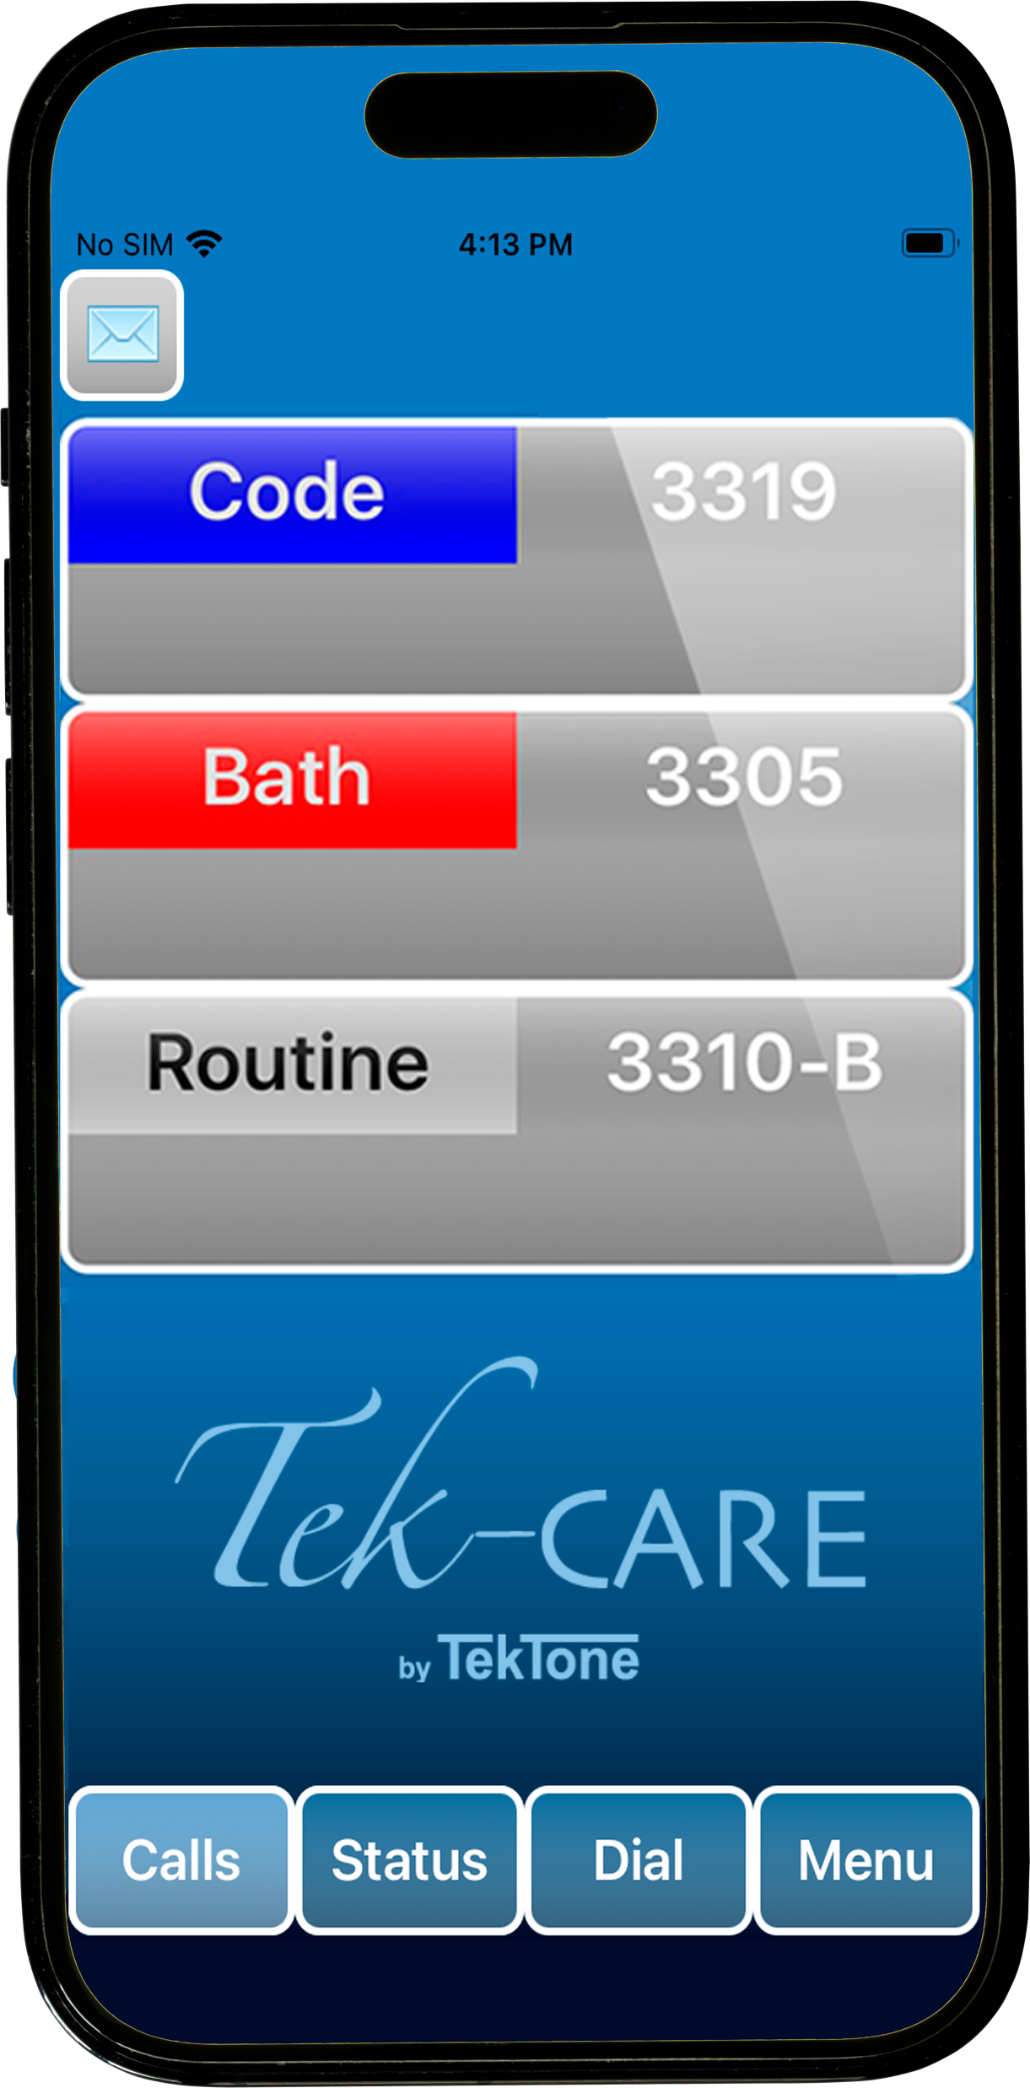
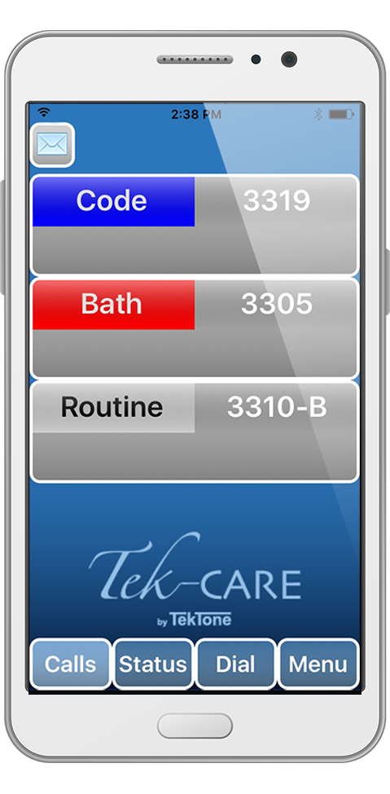
Ancillary Annunciation Options
Options include:
NC403TS
Remote Event Monitor
Apple TV
Mobile Apps
  Android and iOS
Radio Pocket Paging

Slide 13
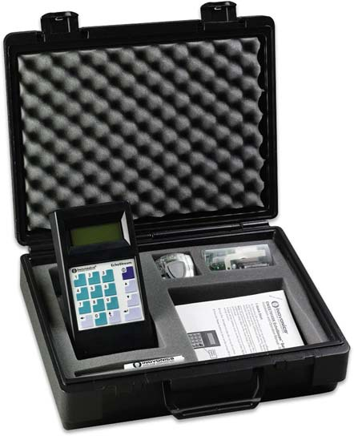
Pre-Bid Site Survey Kit
Before beginning installation of the Tek-CARE®500 Wireless Emergency Call System ensure that a site survey has been done by a qualified TekTone representative using the appropriate site survey kit. This is a necessary step to correctly determine what equipment is necessary and where it should be located.
NC500ESSK
Site Survey Kit

Slide 14
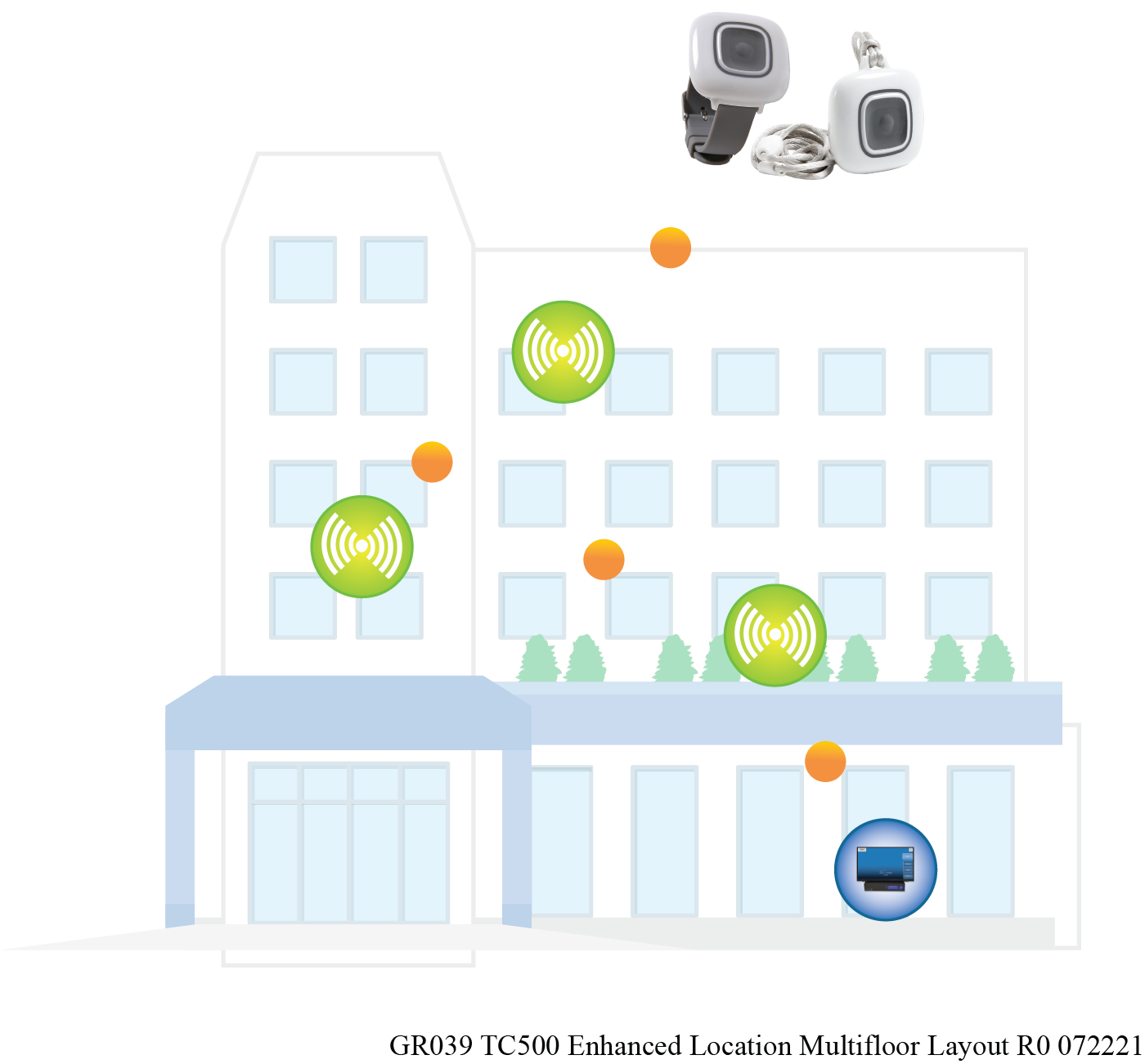
Enhanced Location
The Tek-CARE500 System also has enhanced location capabilities. Enhanced Location communicates with RF signals through the transmitters, network coordinators, and repeaters to provide a more detailed scope to determine where a mobile transmitter has placed an emergency call within a facility.
NOTE: The approximate location is within a 40’ radius in all directions. Enhanced Location is currently applicable for single- and multifloor facilities as a convenience feature, not a UL Listed feature of the system. The facility must have at least three repeaters within the area that will be using enhanced location.

Slide 15
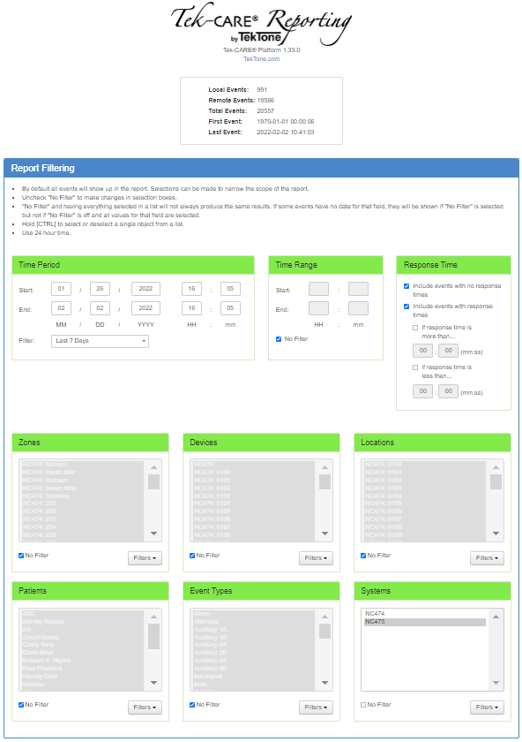
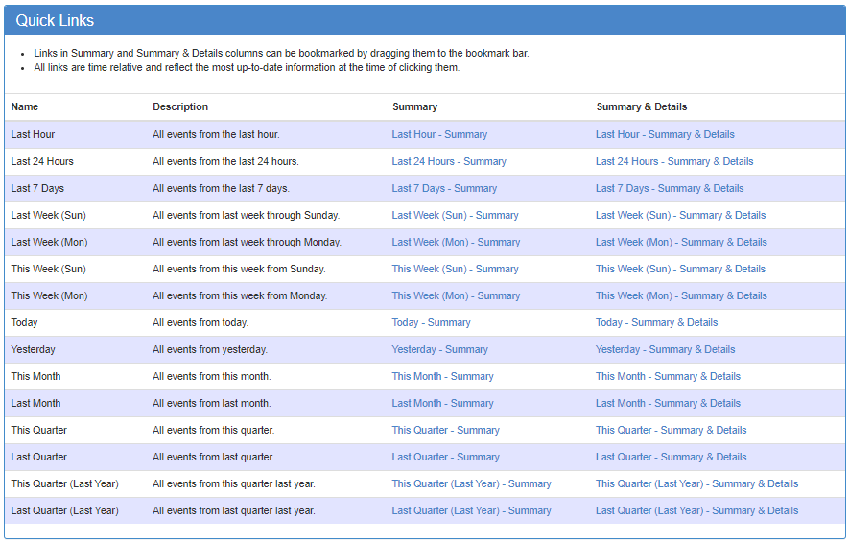
Reporting
The Tek-CARE500 Reporting System produces custom reports about events that have occurred on the system. These reports provide valuable information to evaluate and optimize staff efficiency.

Slide 16
Resources
Training videos are available at www.youtube.com/user/TekToneNurseCall
Support literature is available at https://www.tektone.com/products/nurse-call-systems/tek-care500/

Slide 17
324 Industrial Park Road
Franklin, NC 28734
828.524.9967
www.tektone.com

