Slide 1



Slide 2

Tek-CARE®570 Introduction
The Tek-CARE570 Wireless Nurse Call System uses the latest wireless technology using a high-frequency network with long-range wireless signaling. Call points and sensors may be added and configured with ease.
UL®2560 Listed
Utilizes transmitters, repeaters, and a receiver to communicate calls
Tek-CARE network displays calls and faults
Can be a stand-alone system with NC475 or part of a larger Tek-CARE network
Products are CE and FCC compliant

Slide 3
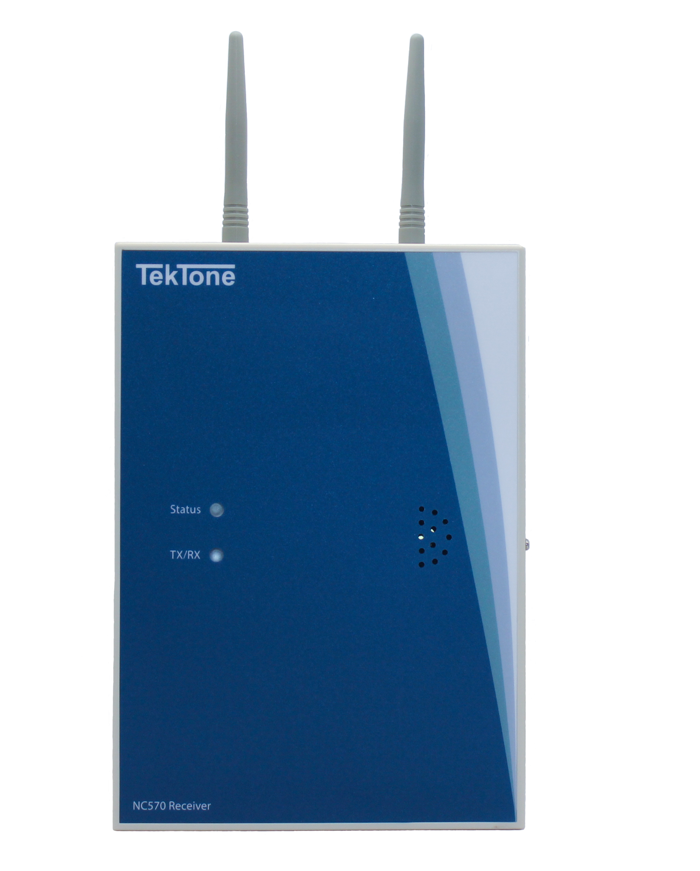
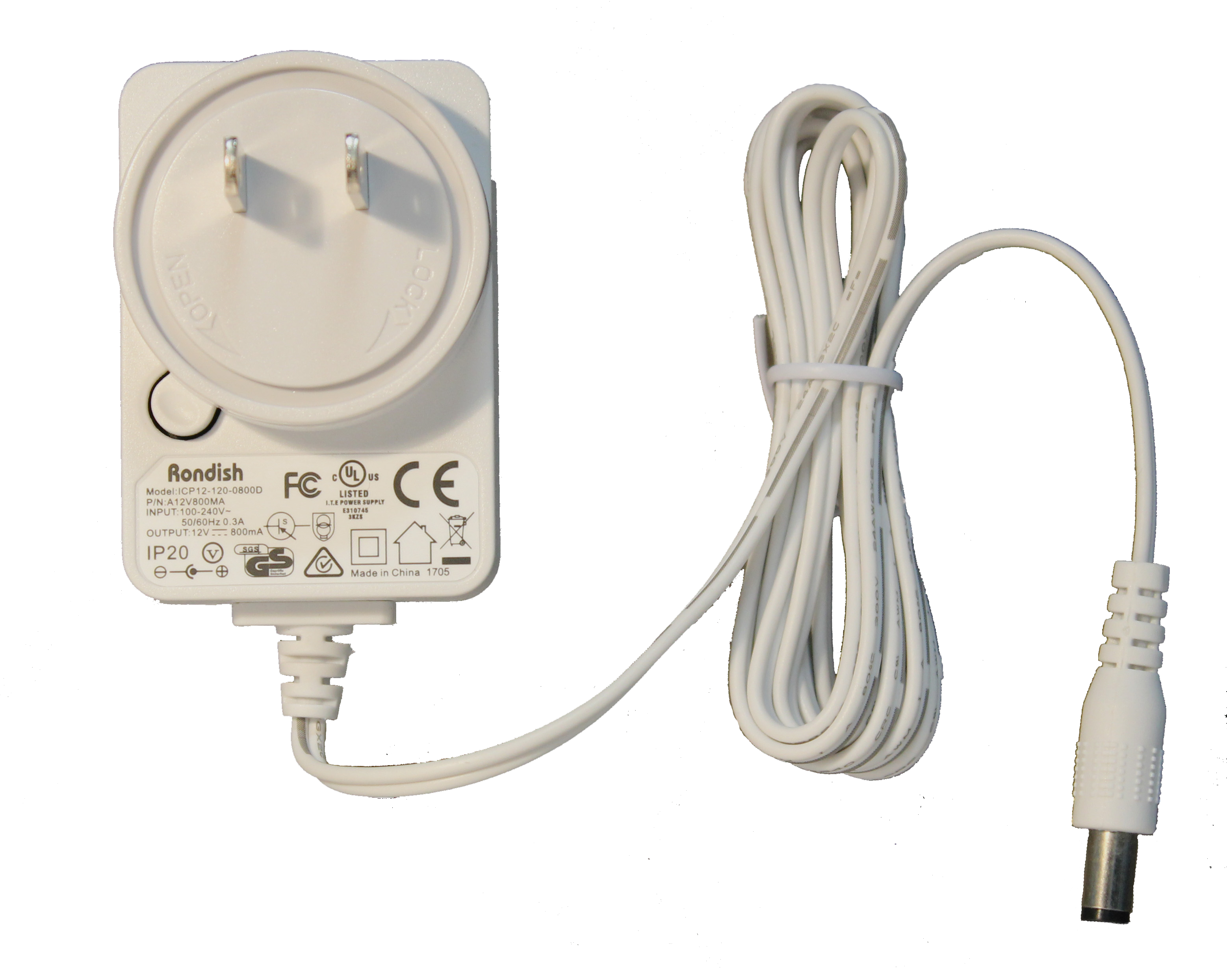
NC570 Receiver Features
Serial connection to NC475
Mounted near NC475
Power cord & back-up battery
Uses dual frequencies to reduce interference
Receives signals on 915 MHz from NC571 Repeaters
Facilitates supervision of transmitters
Includes RJ10 to 9-pin serial cable to connect to server
Surface-mounted
Two replaceable battery back-up options: 4 D-Cell batteries, or rechargeable 6V SLA

Slide 4
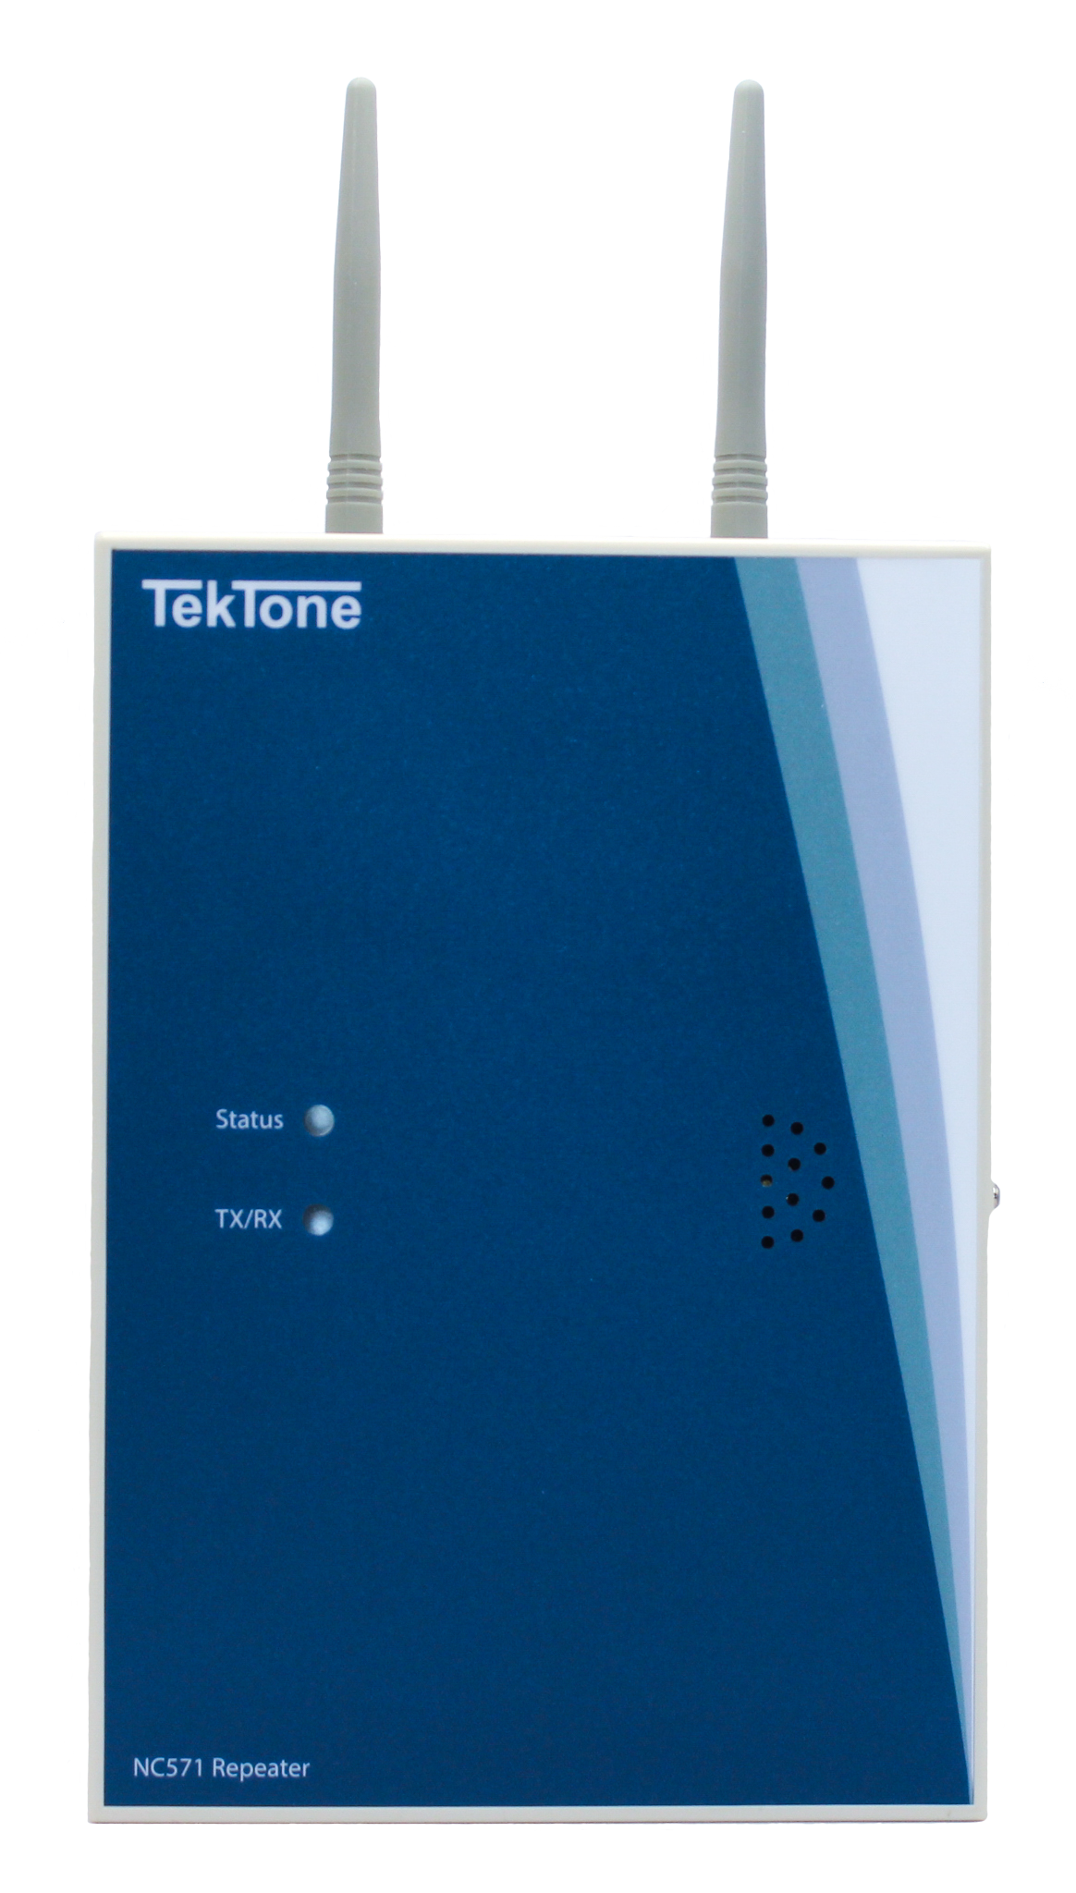
NC571 Repeater Features
Monitors call & fault signals from transmitters in its area
40m radius of coverage
Passes information to receiver
Power cord & back-up battery
Receives signals on 433 MHz from transmitters
Transmits signals on 915 MHz to the NC570 Receiver
Uses dual frequencies to reduce interference
Provides general location of calling transmitters
Surface-mounted
Two replaceable battery back-up options: 4 D-Cell batteries or rechargeable 6V SLA

Slide 5
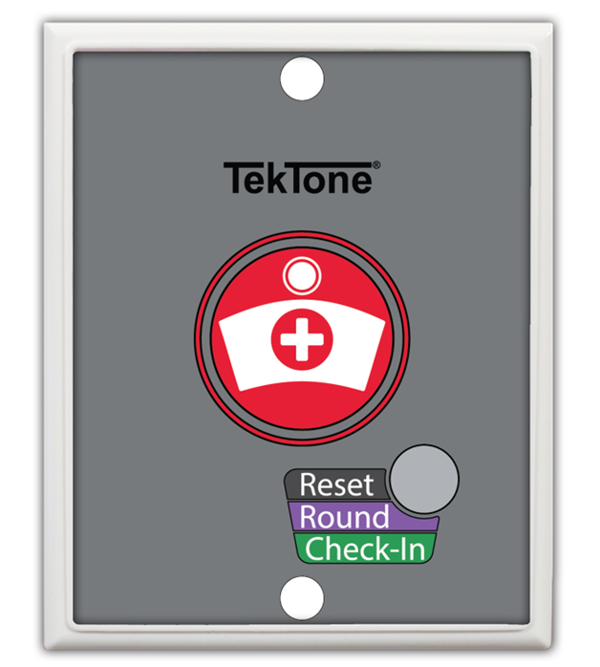
SF572 Pull-Cord Station Features
Wireless call station
Surface mount
Call button, pull-cord, and reset button
Max distance from repeater: 180m
Call and Reset button
Optional pull cord (SF574) included
Reset button supports Rounding and Check-In functions
Includes screws, anchors, and a wall-mount bracket
IP65 water resistant
Long-lasting and replaceable battery
Low battery indication

Slide 6
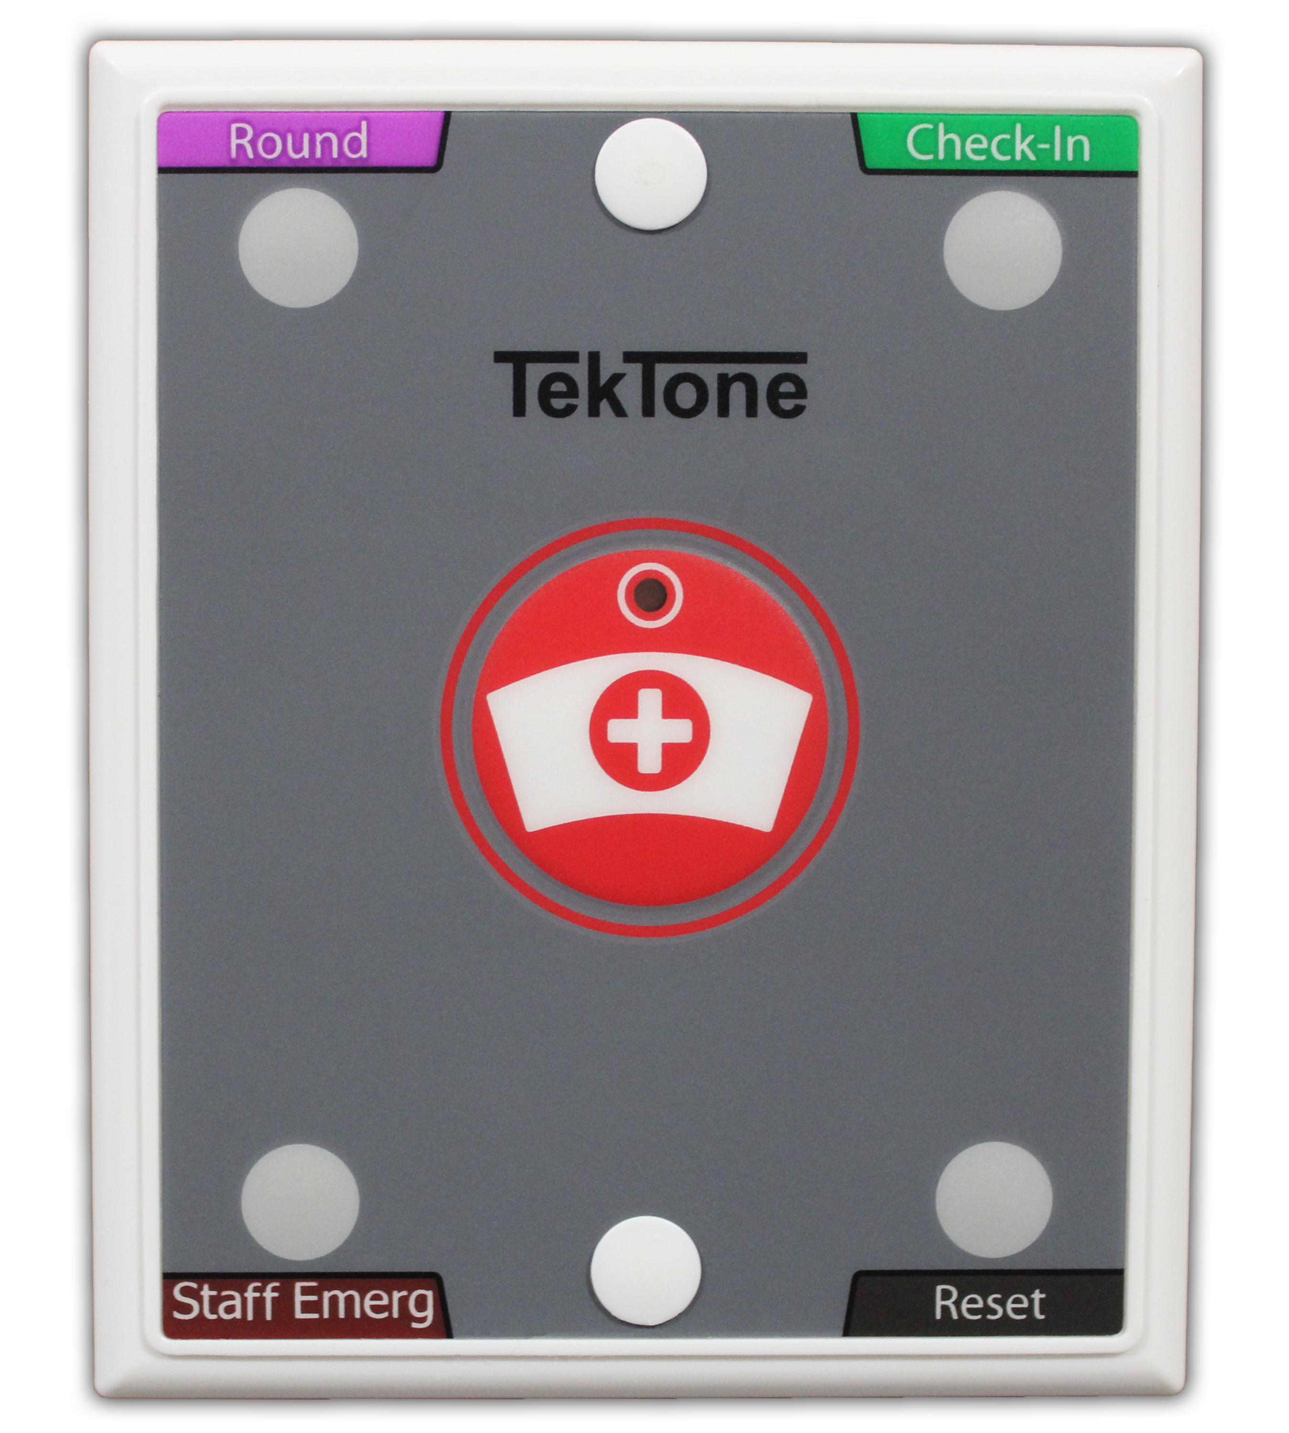
SF573 Single Bed Multifunction Station Features
Max distance from repeater: 180m
Call and Reset button
IP65 water resistant
In addition to the Call button, buttons are provided for Staff Emergency, Check-In, and Rounding
Includes screws, anchors, and a wall-mount bracket
Long-lasting and replaceable battery
Low battery indication
Optional pull cord (SF574) installed

Slide 7
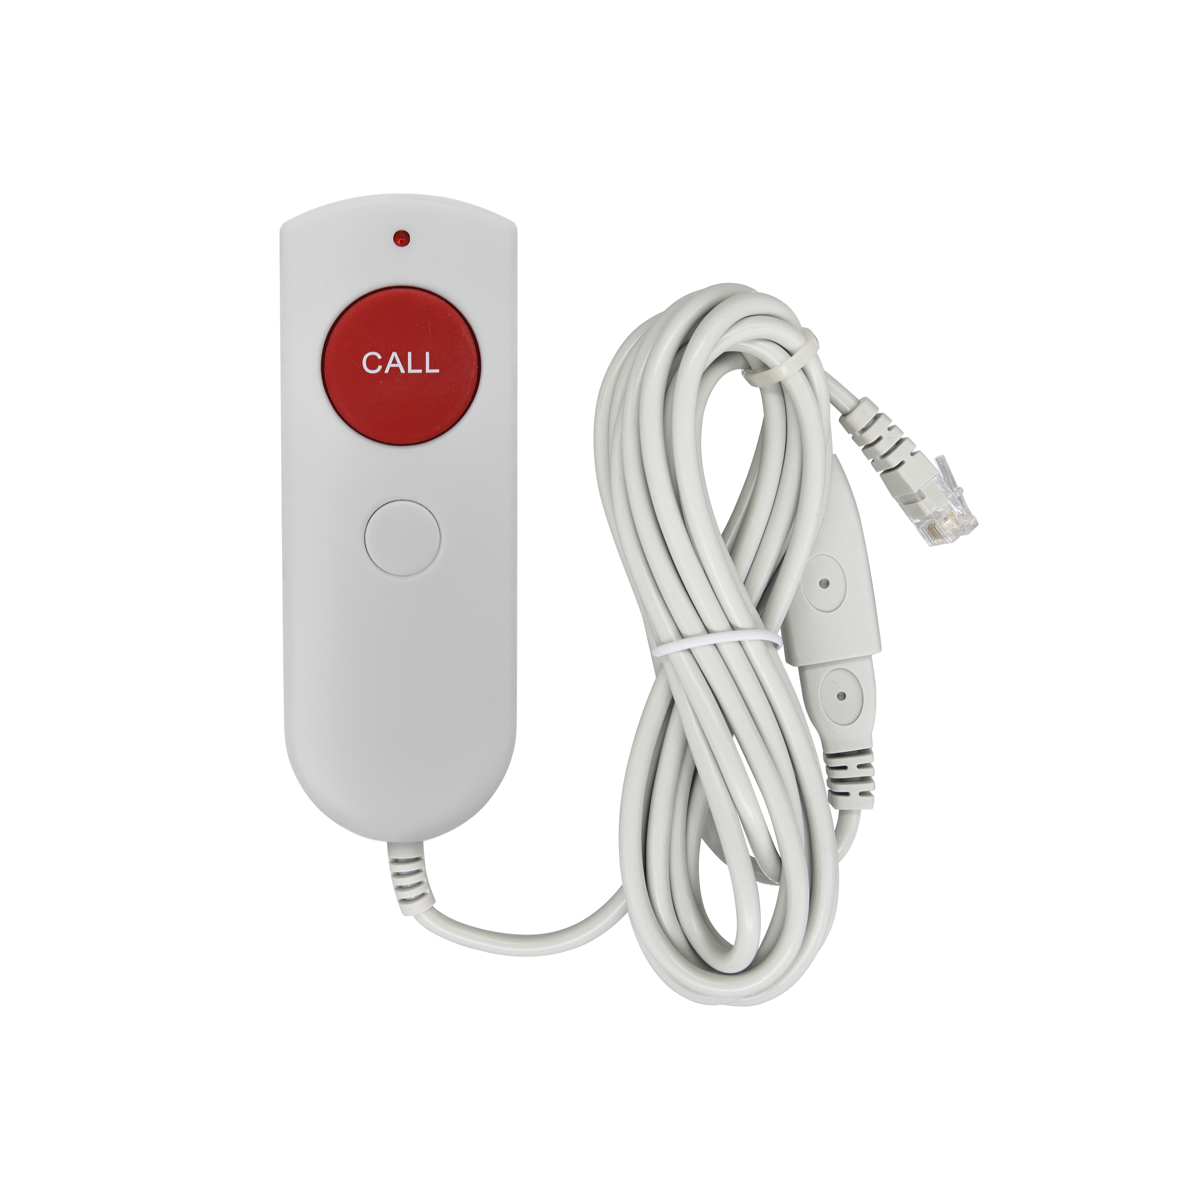
SF574 Call Cord
Connects to SF572 & SF573
Reset call at SF572 & SF573
Large red Call button
Plastic wall-mounted bracket provided
Call assurance LED
Standard cable with USB break point and 4P4C connector
72" cable with 9" “cable-saver” adapter

Slide 8
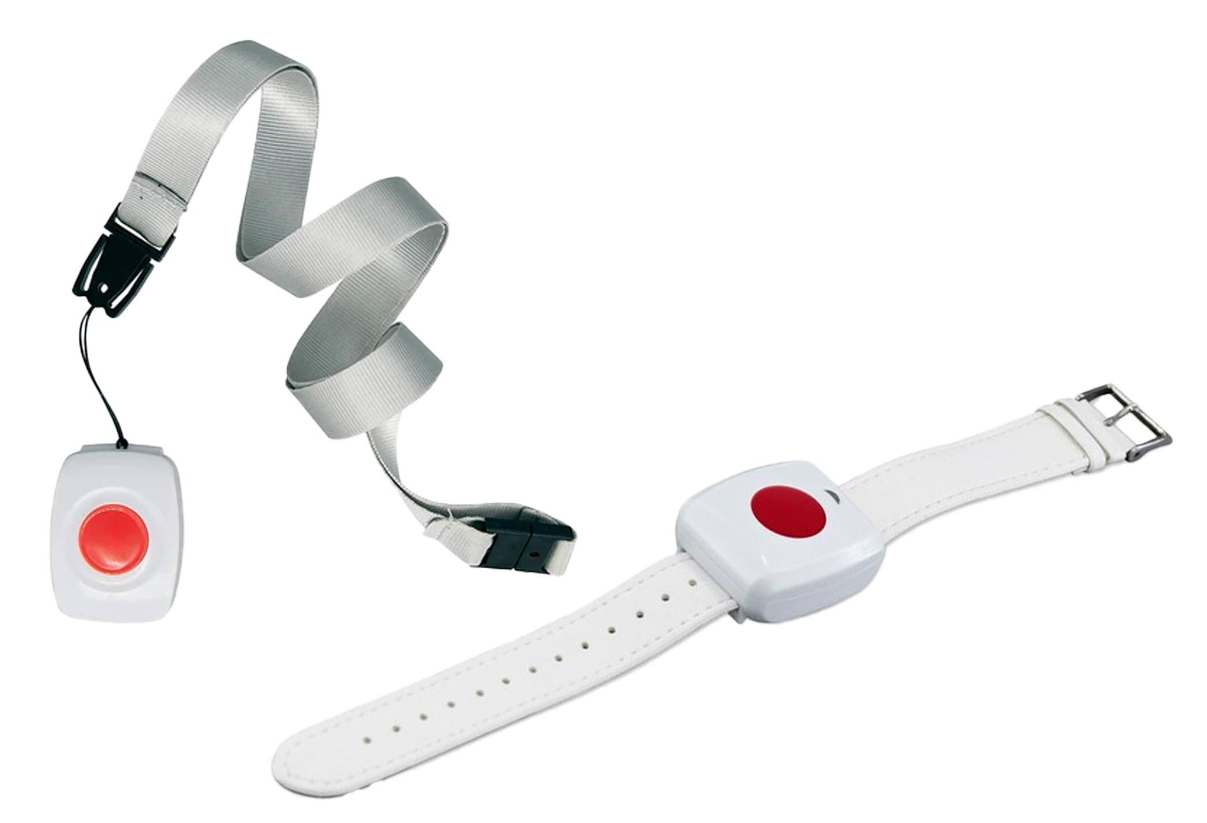
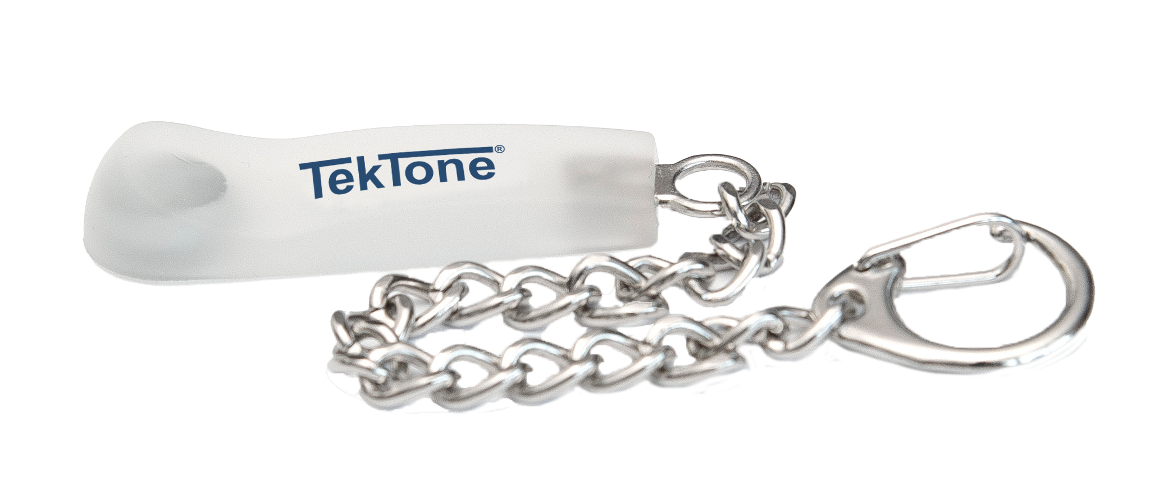
SF570 Pendant Transmitter
Mobile transmitter on lanyard
Repeaters can determine approximate location of pendants
Max distance from repeater: 120m
Large red call button to trigger calls
Red LED for call indication
Includes replaceable BA501 battery
Includes lanyard with anti-ligature point
Optional RP571 wristband
Reset signal can be triggered using magnetic switch
Waterproof to IP67
SF570 with Wristband Option
RP570 Magnet Keychain
Magnet switch to reset SF570 Pendant Transmitter

Slide 9
SS570 Transformer
Supplies 12 VDC to NC570 Receiver and NC571 Repeater
59" (1.5 m) cord length
White plastic

Slide 10
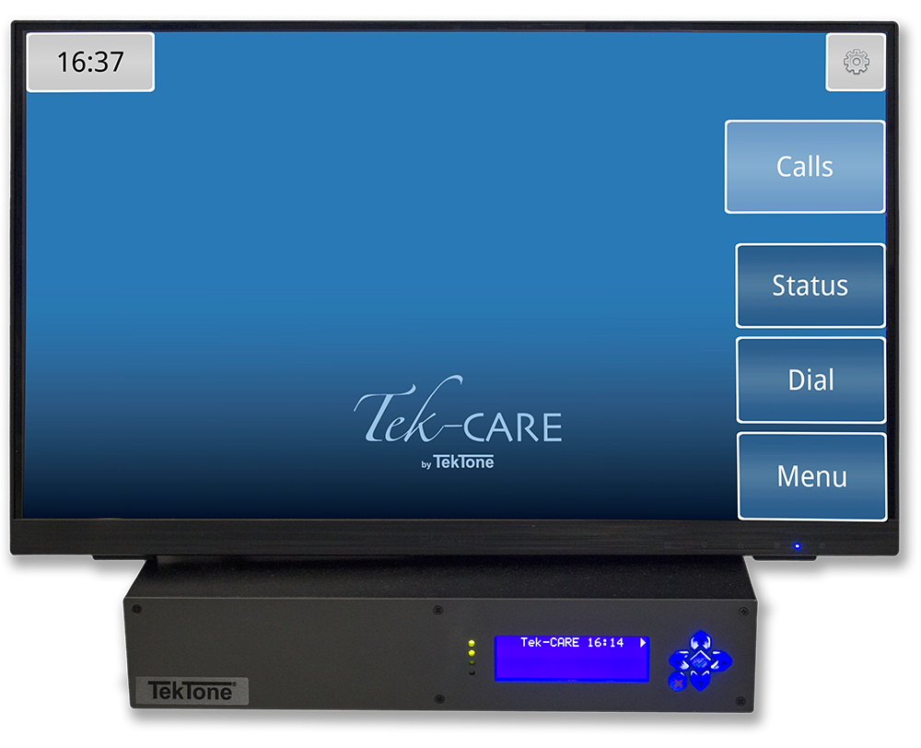
NC475 Tek-CARE Central Equipment
Proprietary nurse call central equipment running the Tek- CARE OS. The Tek-CARE Central Equipment is available in two different variants:
The NC475 is a headless central equipment
The NC475DESK is supplied with a 22" touchscreen monitor (size may vary) and wireless keyboard and mouse
Functions as a tone-visual master station for the Tek-CARE500 and Tek-CARE570 systems
Includes paging software module for automatic and manual pages to staff
Software module options include event monitoring, reporting, Staff App, Apple TV displays, email output, and more
Two network interface ports provide connections to the Tek-CARE Network and facility LAN
Six RS232 serial ports provide connections for a paging transmitter, a central monitoring interface, and Tek-CARE500 and Tek-CARE570 Receivers

Slide 11
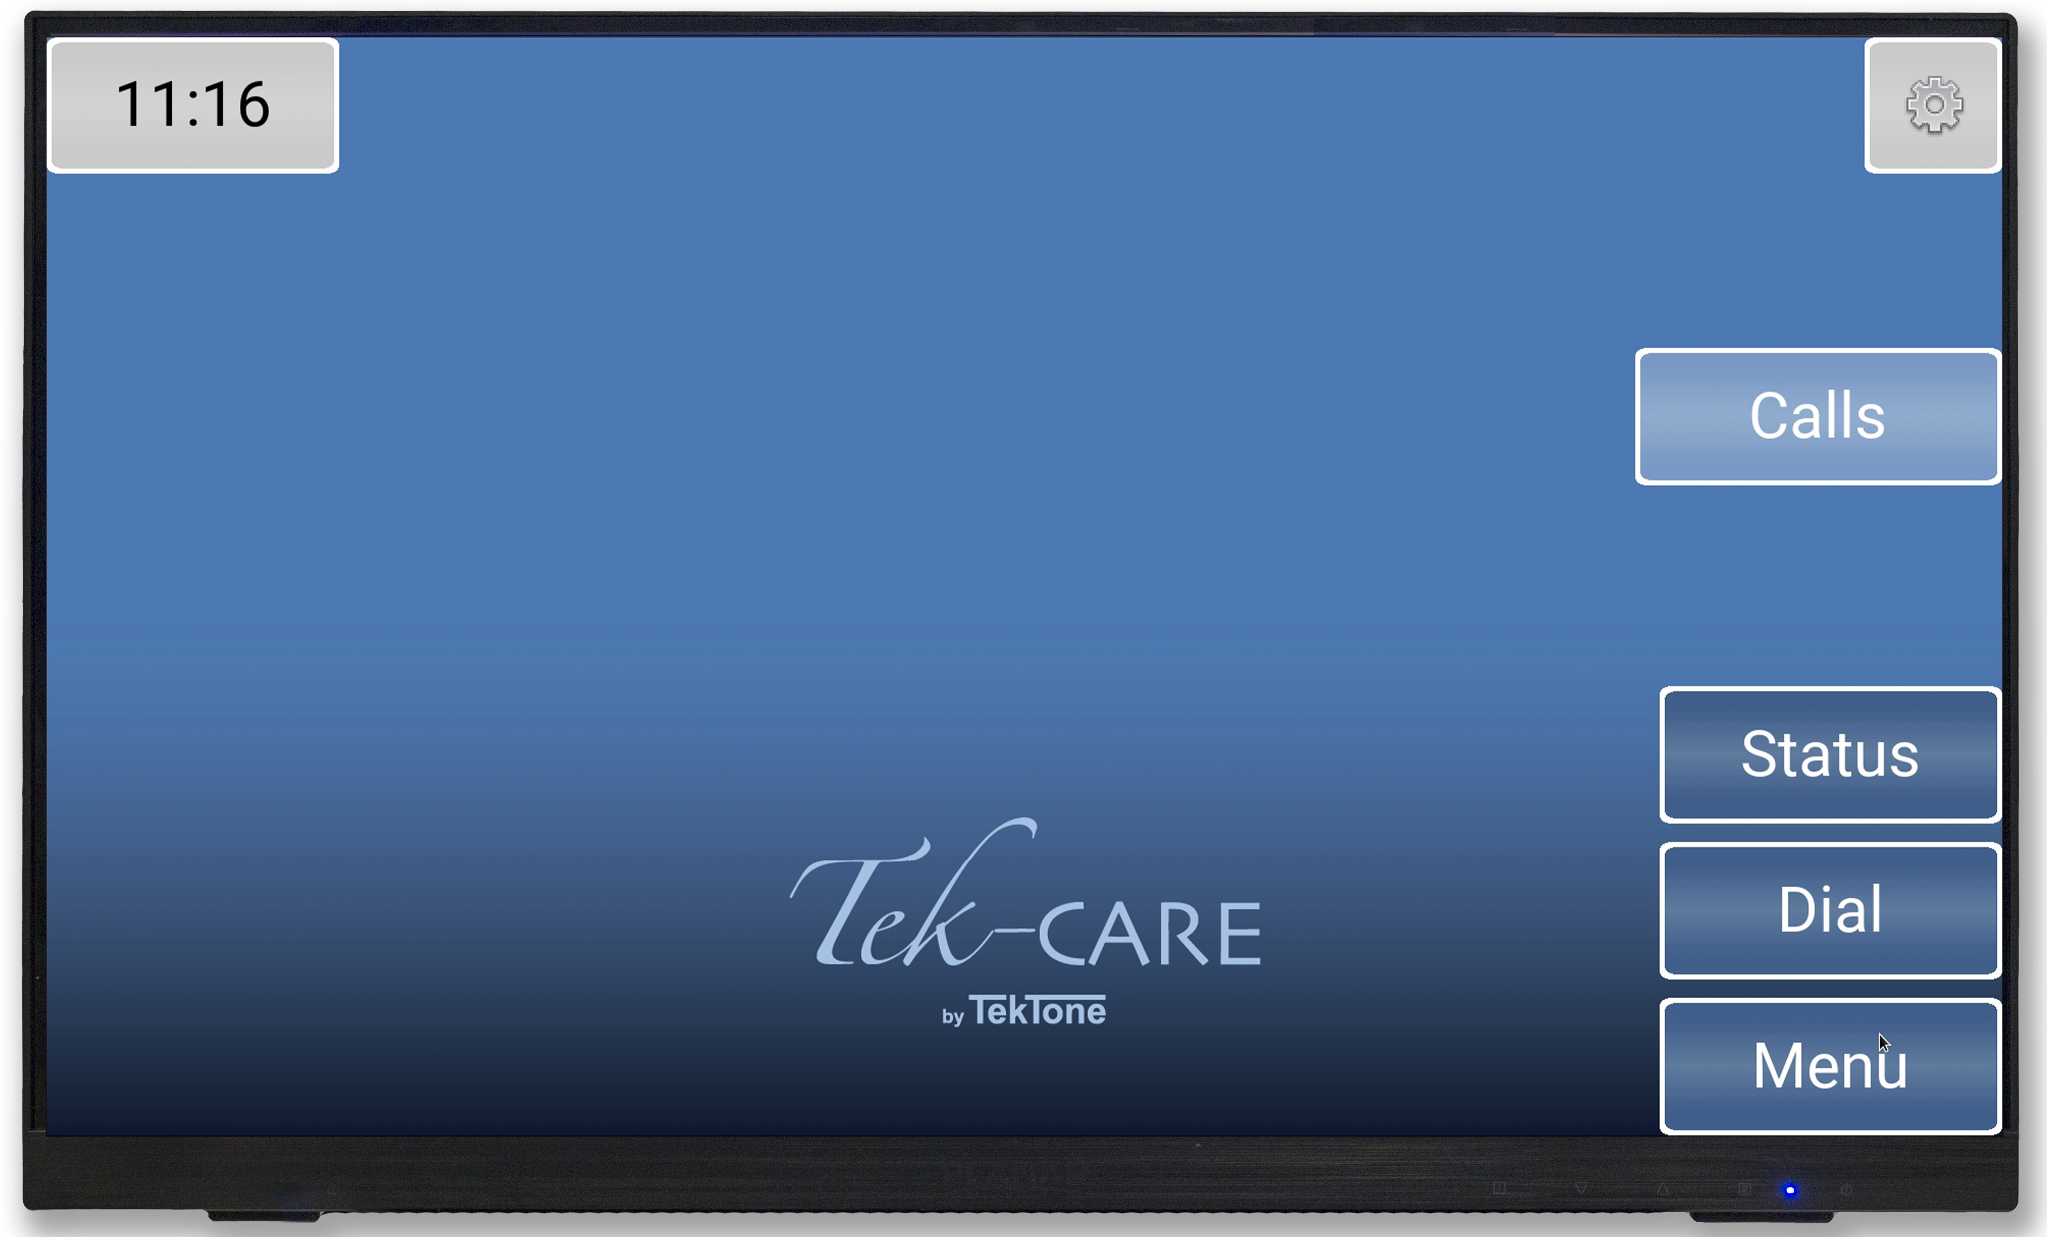
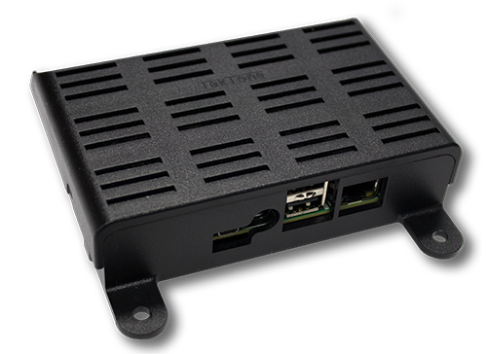
NC403TS Tek-CARE Monitor
Can be placed anywhere in the facility with LAN connectivity
Touchscreen monitor for easy interaction Calls can be filtered and zoned
Can operate as a non-interactive display if only a call display is desired
Optional supervision
NC403TS
NC403NOTS

Slide 12
Key Differences: TC570 vs. TC500
TC570
TC750
Maximum 48 repeaters per receiver (one receiver per NC475)
Maximum 900 transmitters
Receiver only communicates with repeaters
More cost effective
Ideal for smaller single building sites
Easy to replace pendant battery
Must program repeater’s target
No set maximum number of repeaters
Receiver collects signal from transmitters
More expensive
Ideal for larger sites
Replace whole pendant when batteries die
No programming repeaters

Slide 13
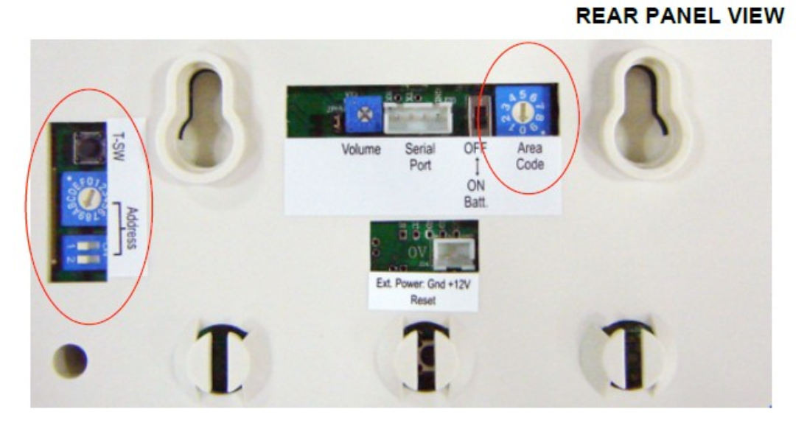
Installation: General Setup
Connect Receiver to NC475
Program Repeaters
Tell the repeater its own address and what to target
Can target either Receiver or other Repeaters
Manual includes link to instructional video for repeater programming

Slide 14
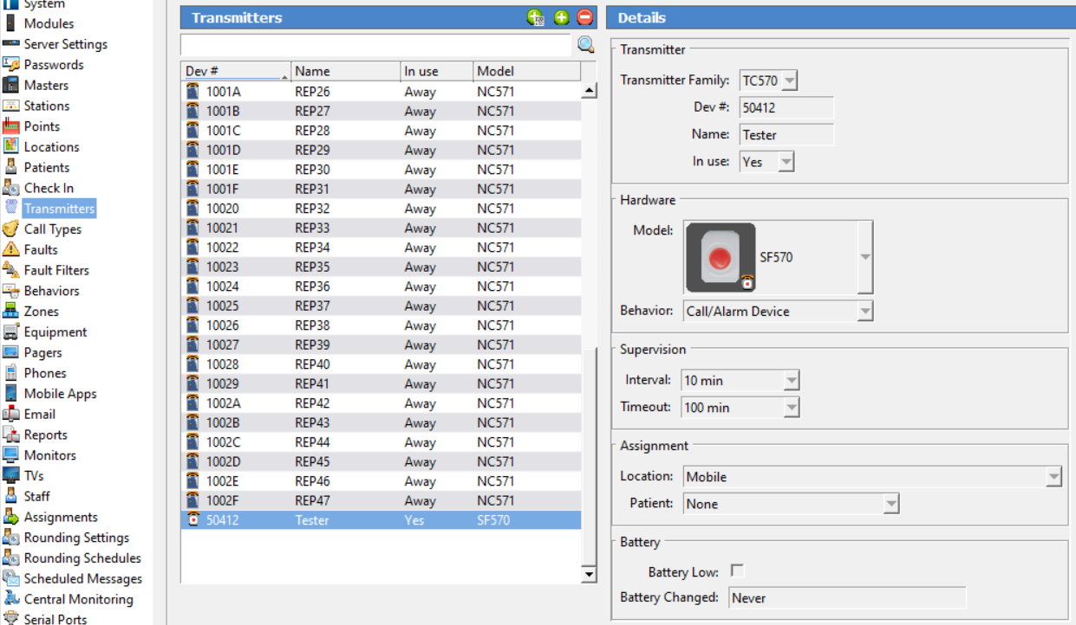
Installation: General Setup

Slide 15
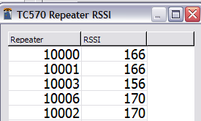
Installation: General Setup
Determine best location for repeaters based on RSSI
Check Repeater’s RSSI values using config tool live (LS454)
RSSI should be over 100
Material of building affects signal strength
ex: drywall allows RF signal to pass better than concrete
This is critical for the system’s effectiveness!

Slide 16
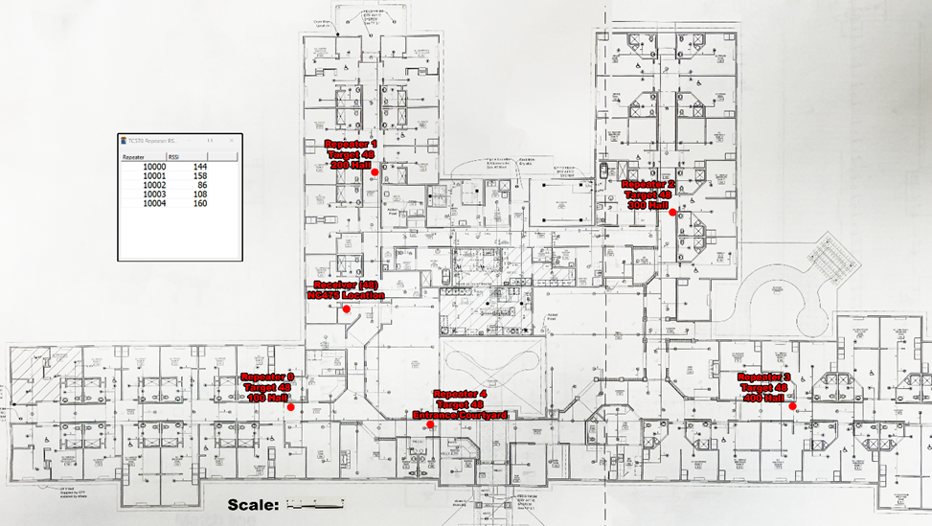
Installation: Layout Examples
60 bed facility, limited release site
1 receiver in middle with 5 repeaters, all targeting receiver

Slide 17
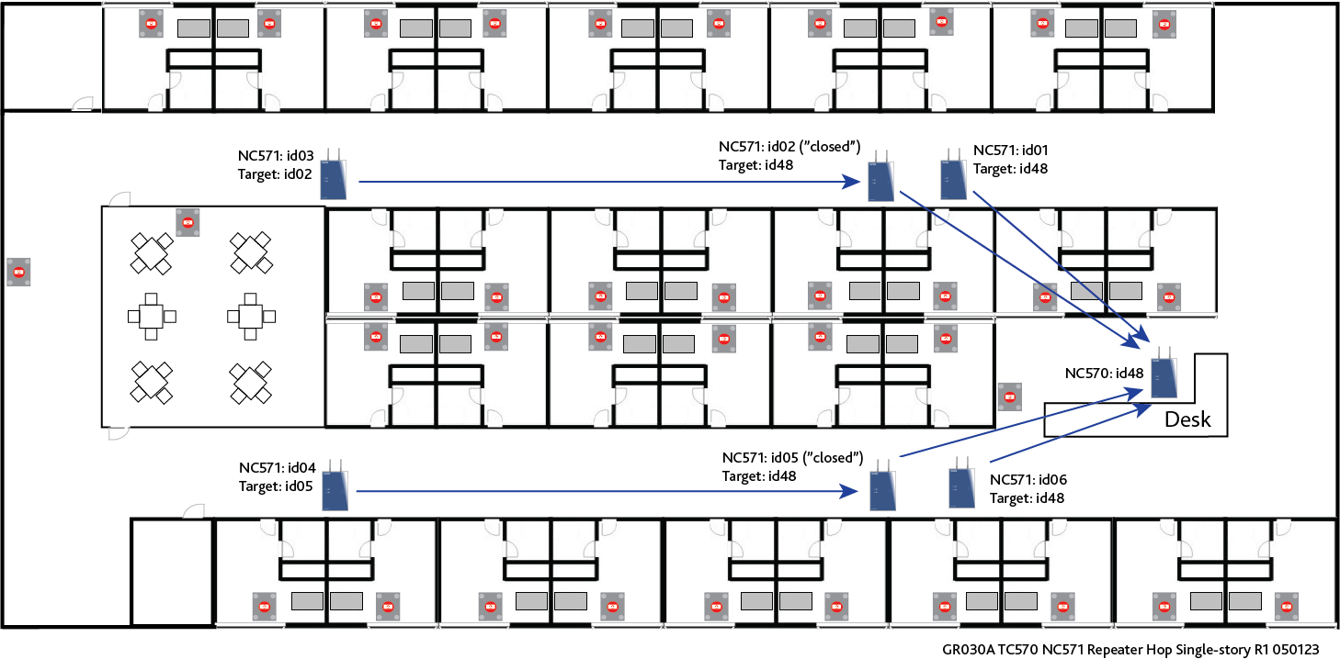
Hop: using an additional repeater to increase distance of the run
This system supports up to 3 hops in a run
A repeater used to hop cannot communicate to transmitters and is considered “closed”

Slide 18
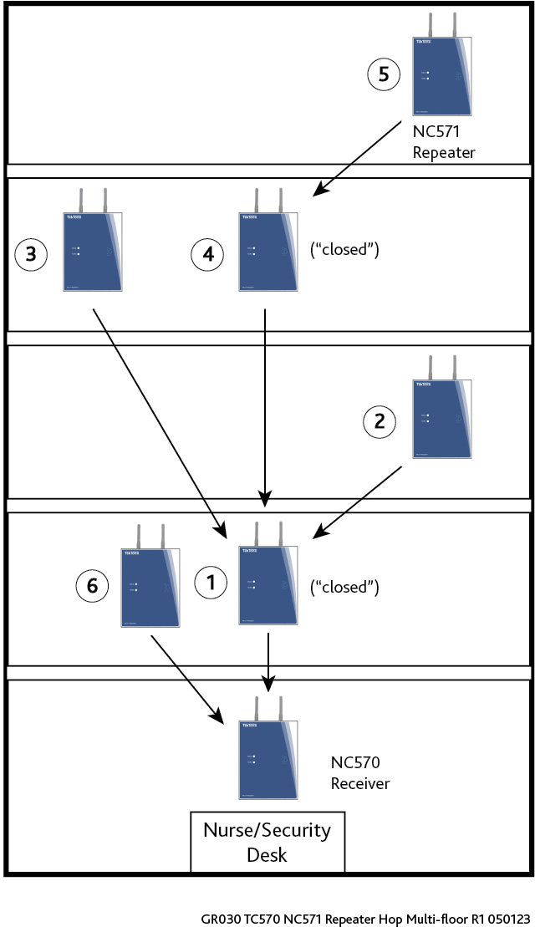
Multi-floor Example
Repeater Directed Hop Example
This example is a five-story building but similar procedure is used on each floor to optimize the coverage.
Up to 3 hops can be used on the system, and using the RSSI readings viewable using the ConfigTool Live Traffic Window, this can be optimized for the best layout.
There may be a bit of trial and error to achieve the best RSSI levels by changing the target address and seeing if the RSSI level is higher or lower.
You will be able to cover large areas and multi-floor buildings using this method to configure the system.
Note: Repeater 1 and 4 are set to forward only repeater traffic (”closed”) while other repeaters receive transmitter traffic (“open”) and send it on.

Slide 19
324 Industrial Park Road
Franklin, NC 28734
www.tektone.com

