Slide 1




Slide 2
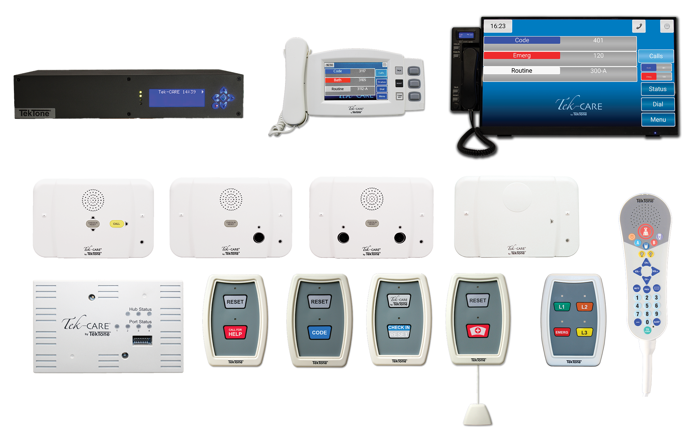

Tek-CARE®3000 Introduction
The Tek-CARE3000 is a supervised, microprocessor-based nurse call system offering two-way audio and visual communication with flexible configuration tools. It supports staff-to-patient and staff-to-staff communication, with a full range of stations and peripherals to meet facility needs. Modular components and simplified wiring allow for easy expansion and integration in both new and existing facilities.

Slide 3

Tek-CARE®3000 Features
Max hubs per system | 150
Max stations per port | 3
Max stations per hub | 12
Max audio connections per hub | 2
Max station run length | 250’
Bed integration | No
Vandal peripheral option | Yes
Station buttons | No
Inputs for ¼” jack | No
Advanced duty station tone | No
Audio paging | No

Slide 4
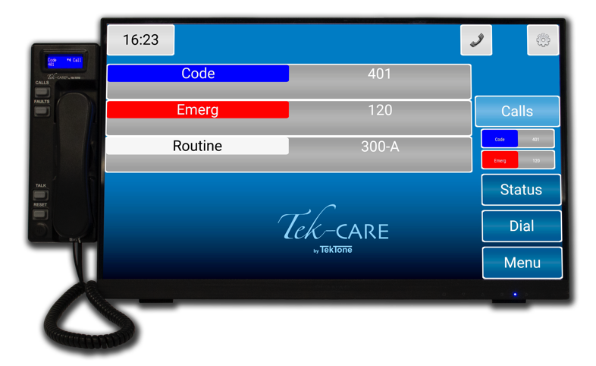
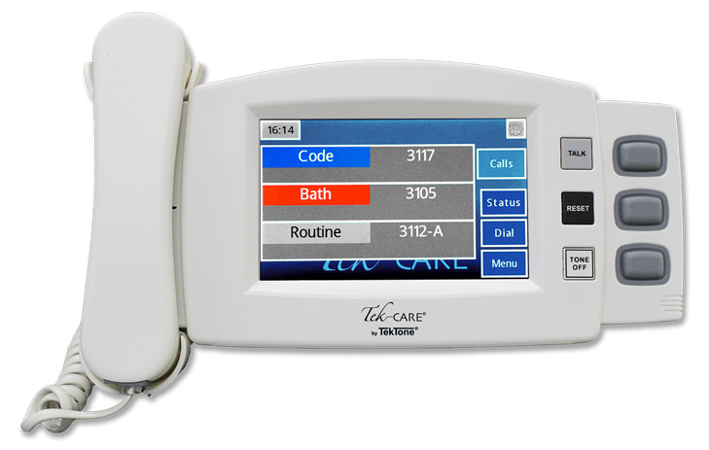
Master Stations
NC404TS
NC415G3
  Easy-to-use interface
  Touchscreen and button controls
  Optional handset kit for more privacy
  Displays up to 3 calls at once
  Dial master stations and rooms
  Small footprint
  Desk- or wall-mount
  Easy-to-use interface
  22” touchscreen
  Full-duplex audio with handset
  Options for list view, icon view and map view
  UL® 1069 and 2560 listed
  Desk- or wall-mount
  Fully supervised

Slide 5
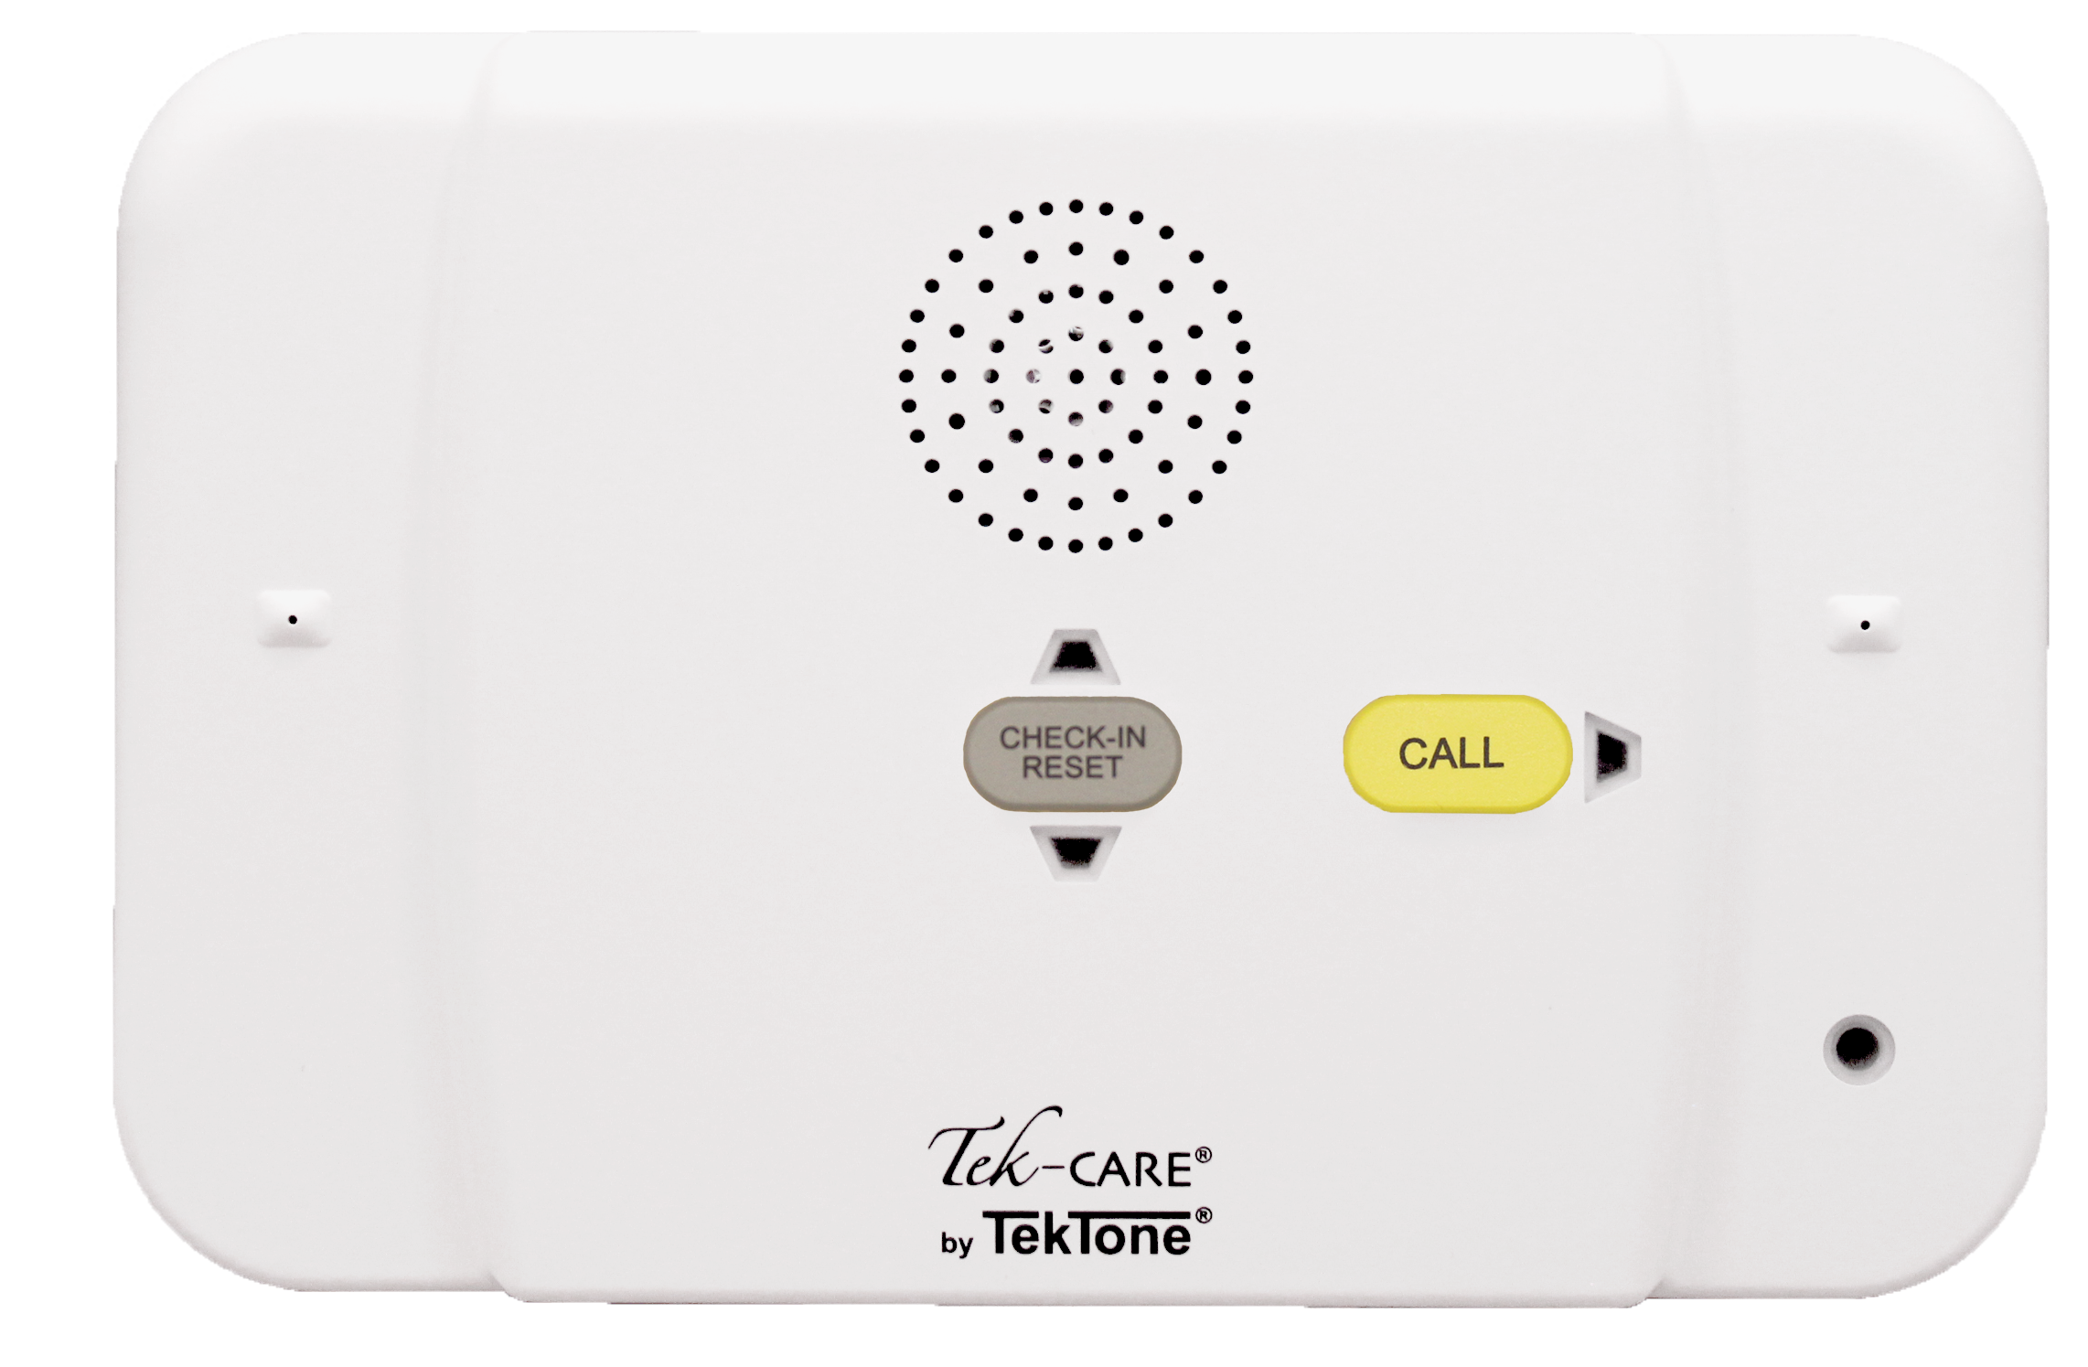
IR330 Staff/Duty Station
Two push buttons: Call and Reset
Tri-color LEDs for call indication
Master call tones for duty annunciation
Program as a Staff or Duty Station
Provides four programmable Dry Contact Outputs
No visible mounting screws
Fully supervised wiring to the station hub

Slide 6
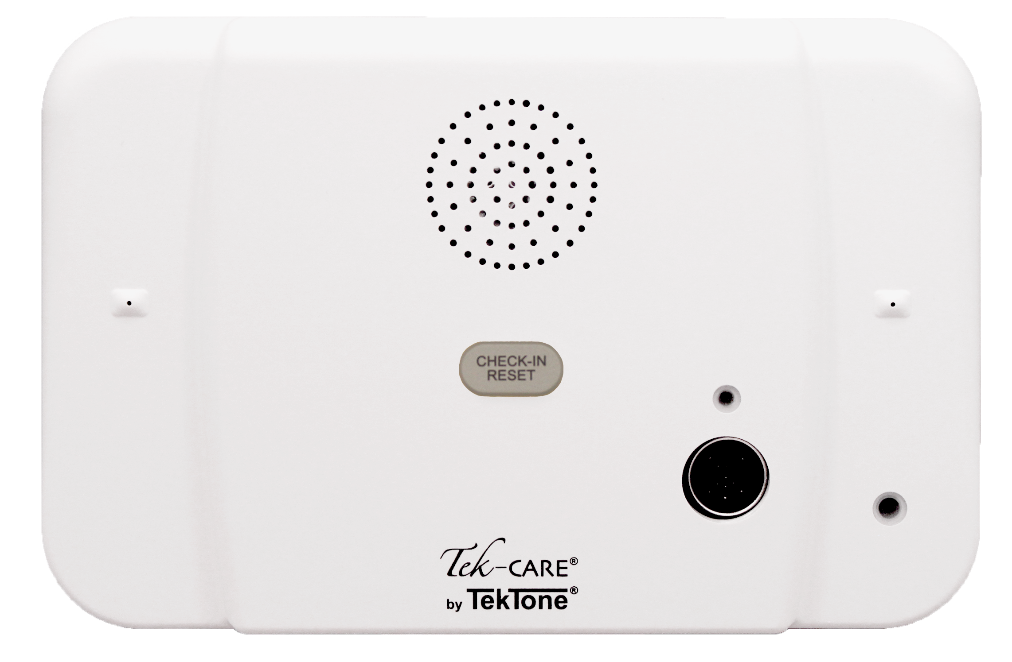
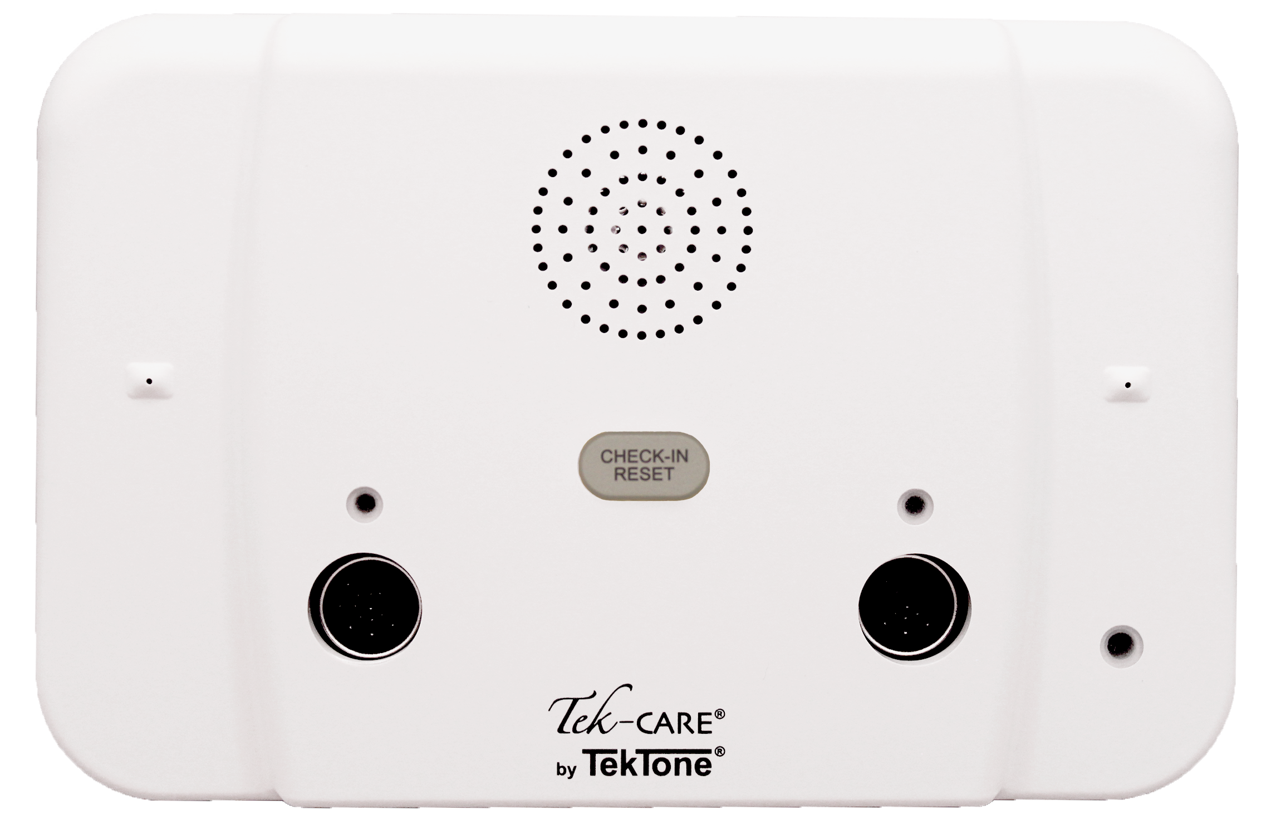
IR331 Single & IR332 Dual Patient Stations
Tri-color LEDs for call indication
One or two jacks for call cords or pillow speakers
Provides interfaces for up to 6 TC120 peripherals, dome light, bed receptacle and control outputs, e.g., light control
No dummy plugs needed to prevent “cord out” call
No visible mounting screws
Fully supervised wiring to the station hub
The IR332 Dual Patient Station has the same specifications and functions as the IR331 but has two DIN jacks for an additional call cord, and 8 N.O. dry contact outputs.

Slide 7
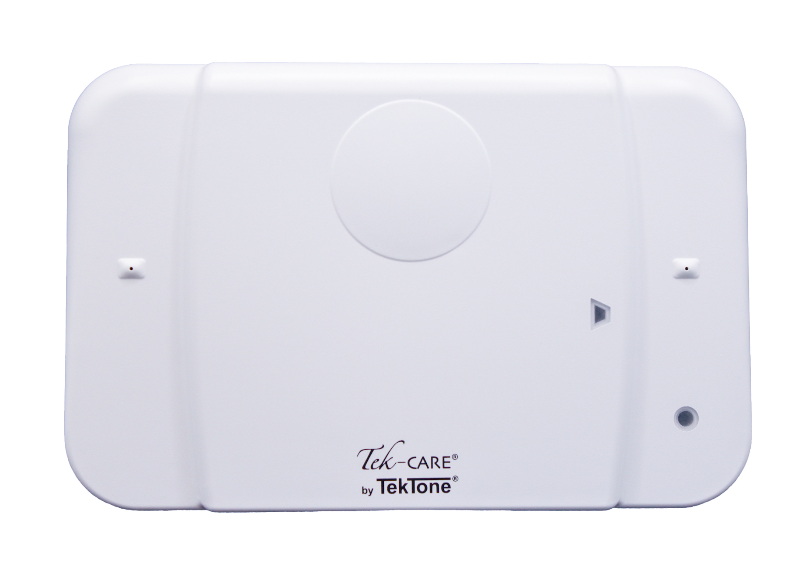
IR434G3 Multipurpose Station
Provides call inputs and dome light output typically for standalone devices
Provides four programmable Dry Contact Outputs
Provides an audio connection in the nurse call system
Supervised emergency and code switches
Fully supervised wiring to the station hub
Simplified wiring with plug-in connectors
No visible mounting screws

Slide 8
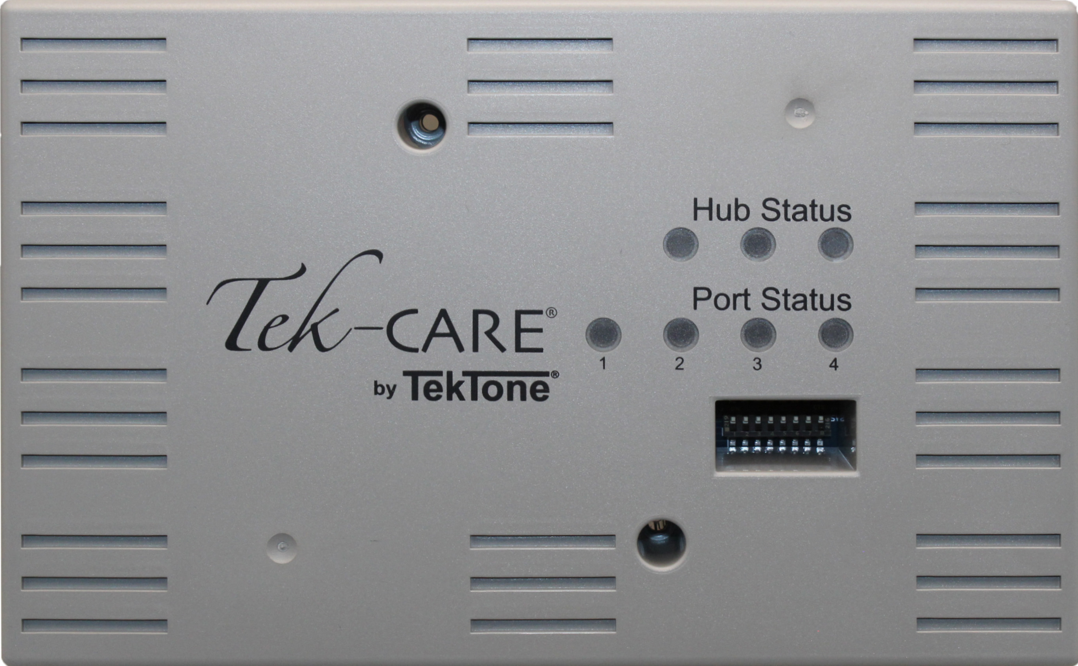
NC331 Tek-CARE Hub
Tek-CARE system capacity of up to 150 Tek-CARE Hubs
Provides four ports to support Master Stations and Room Stations
Supports up to:
  Two Master Station Consoles (NC404TS or NC415G3) or
  One Master and one Room Station port or
  Four Room Station ports
Provides one audio channel per port

Slide 9
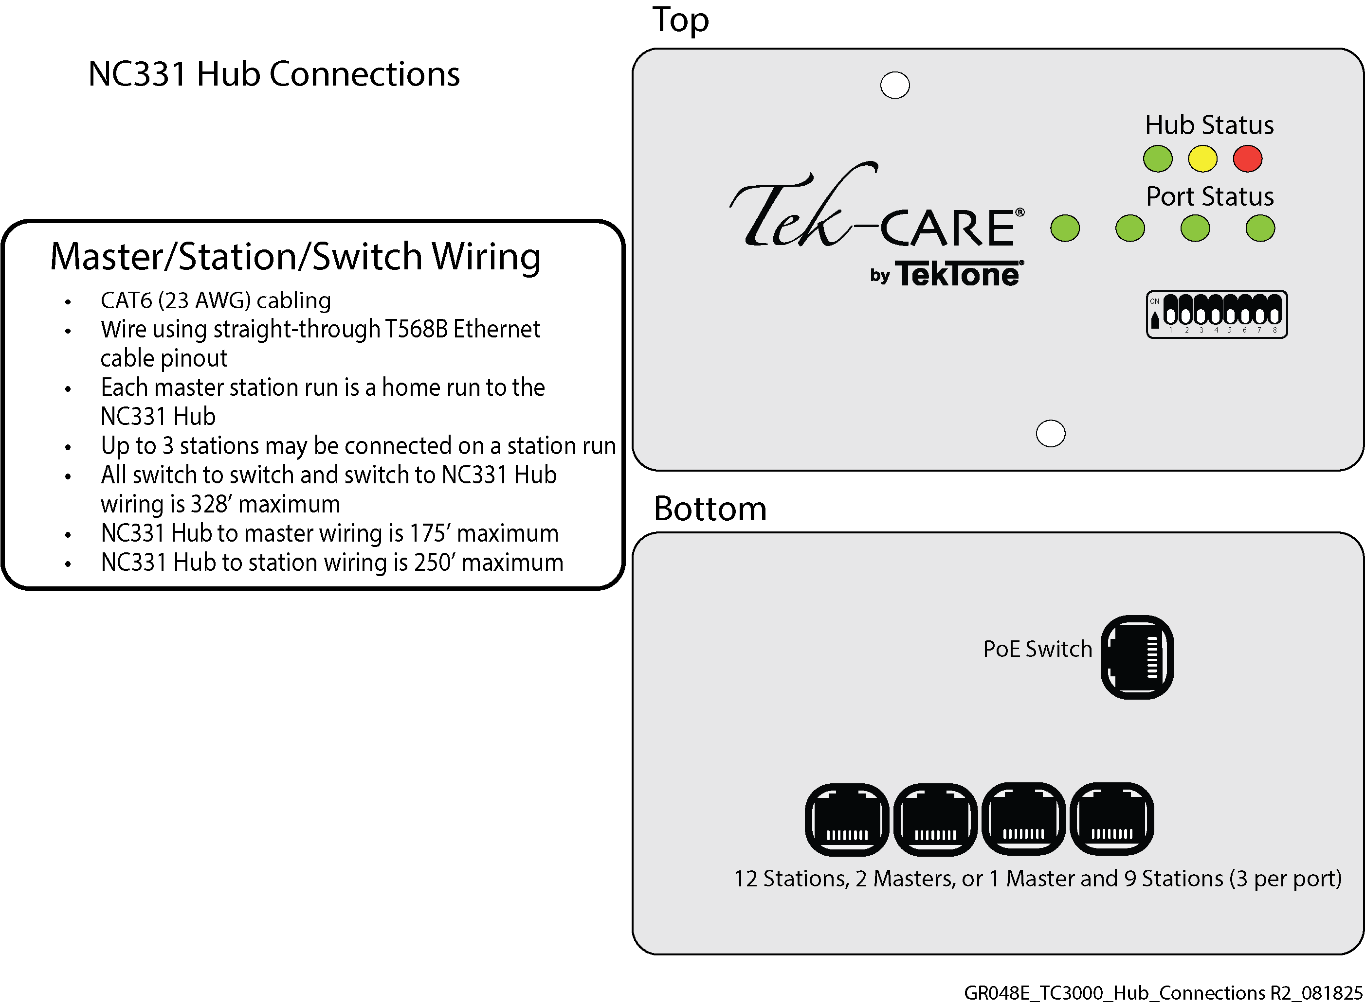
NC331 Hub Connections

Slide 10
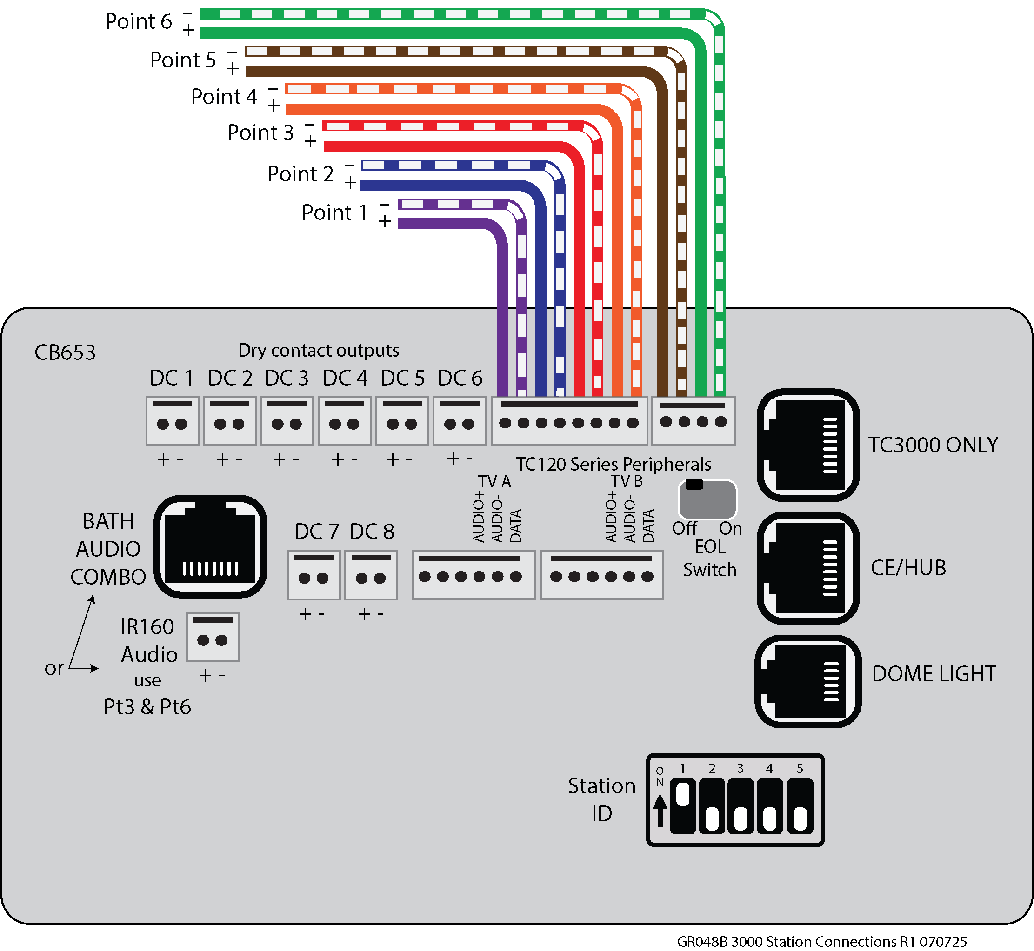

Slide 11
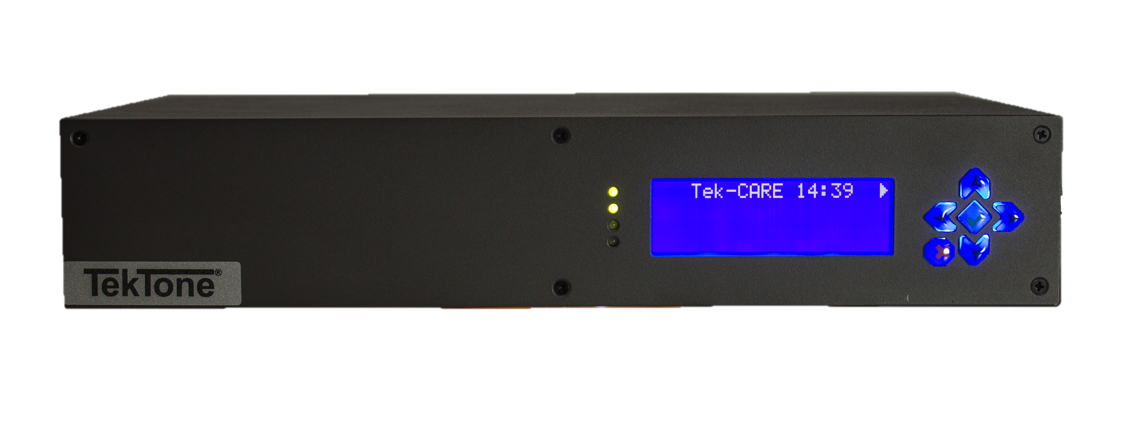
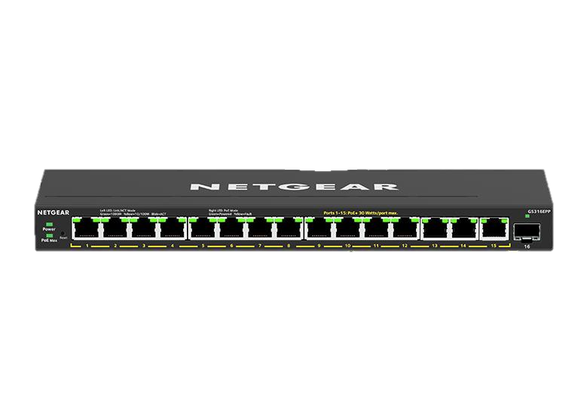
NC475 Tek-CARE Central Equipment
Central Notification Station:
The NC475 Central Equipment with LS500 license processes and displays transmitter call information from the system’s receiver. Many programmable options are available to customize a facility’s system.
The NC475 Central Equipment includes pre-installed
Tek-CARE software. Ordering appropriate licenses such as LS500, central monitoring, reporting and text messaging capabilities will provide the desired features.

Slide 12
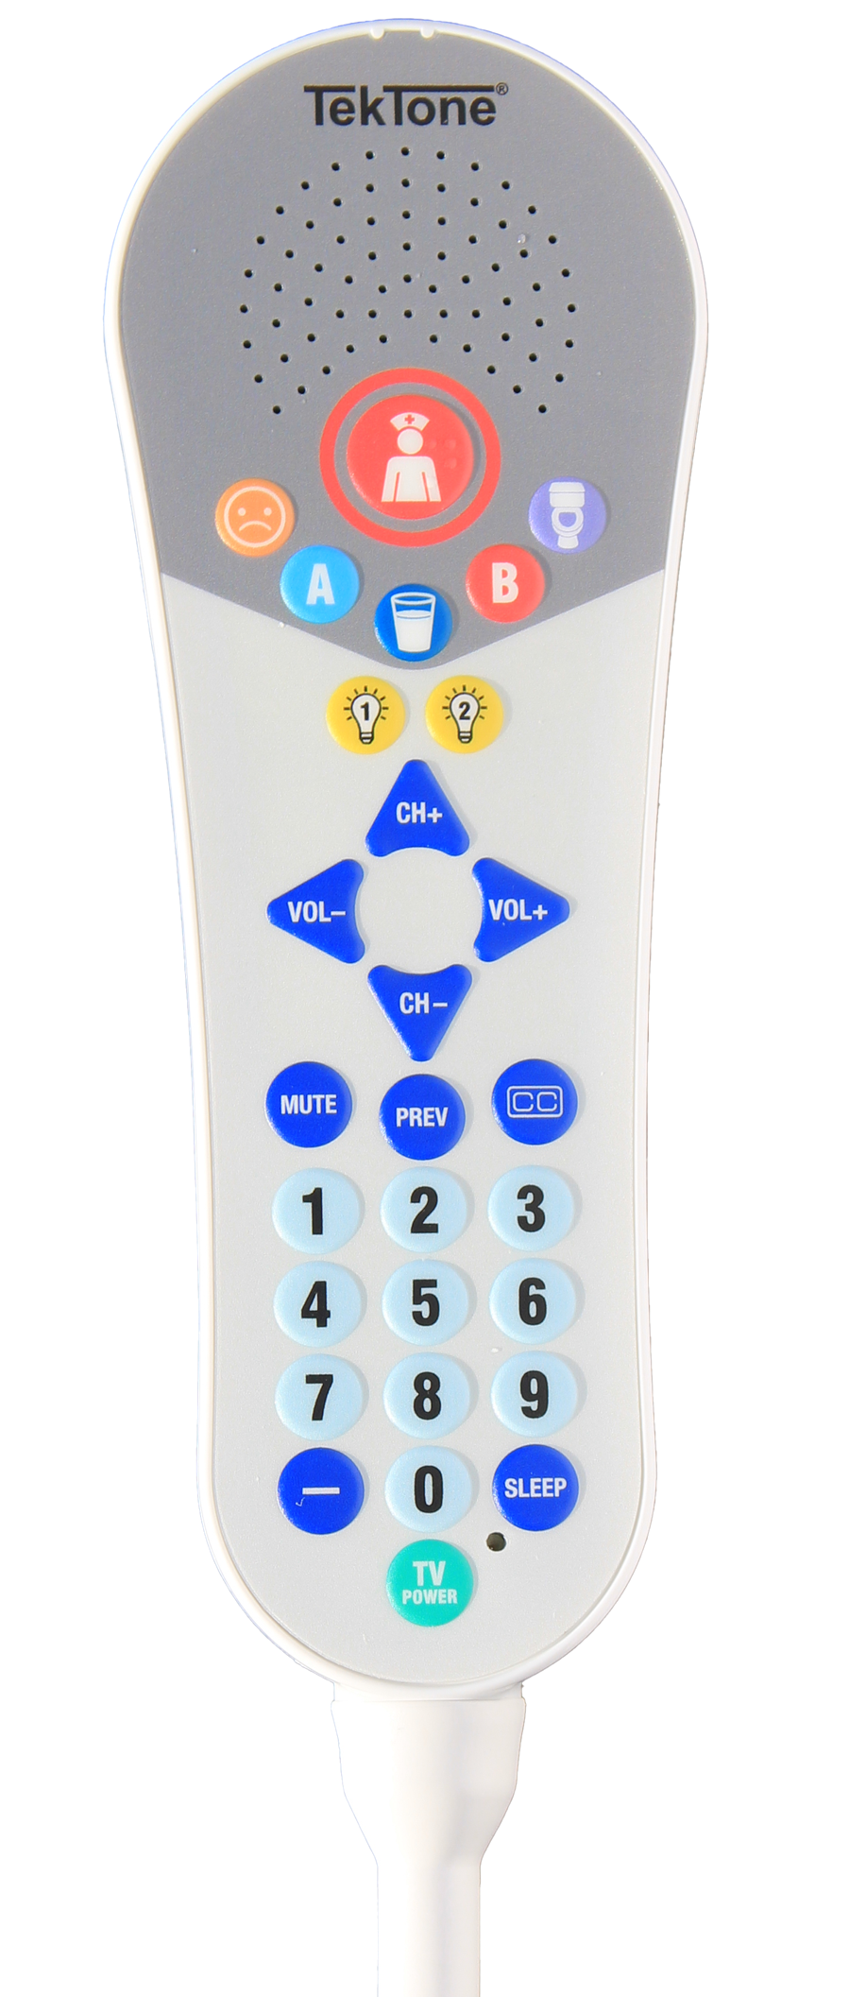
SF431PSG3 Pillow Speaker
Large red nurse call button
Three AUX call buttons for Water, Pain, and Toilet
Four environmental control buttons
8-foot cord with DIN plug and security clip
Provides pillow speaker intercom with built-in microphone, environmental control, and television control
UL®1069 and UL® 2560 Listed
Oxygen safe
Fully sealed for easy cleaning
Flame-retardant (UL®94V-0) high-impact plastic

Slide 13
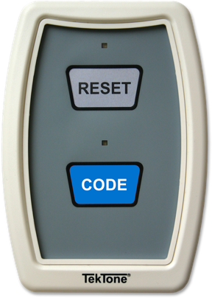
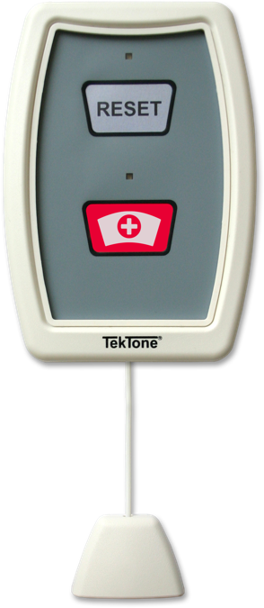
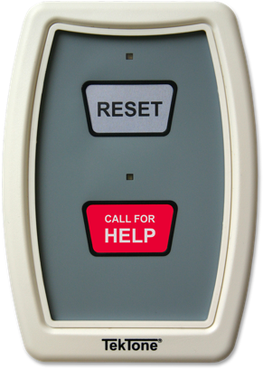
Peripheral Devices
SF123 Customizable 2-Button Pull-Cord Station
  Buttons arrive with standard inserts
  Custom inserts can be created
  Push button or option pull cord available for call placement
  Illuminated faceplate
  Call assurance LED
  Water resistant with optional gasket
  UL® 1069 and UL® 2560 Listed

Slide 14
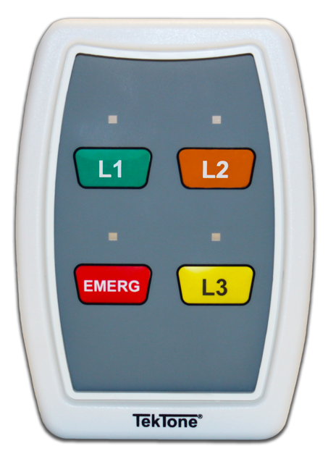
SF124 Staff Peripheral Station
SF124 Staff Peripheral Station with Presence Indication
Buttons arrive with standard inserts
  - L1, L2, EMERG and L3, if so configured
  - Push-button staff presence indication
  - Each buttons corresponds to a different color
  display on dome light
  - CODE and Room RESET calls can also be programmed

Slide 15
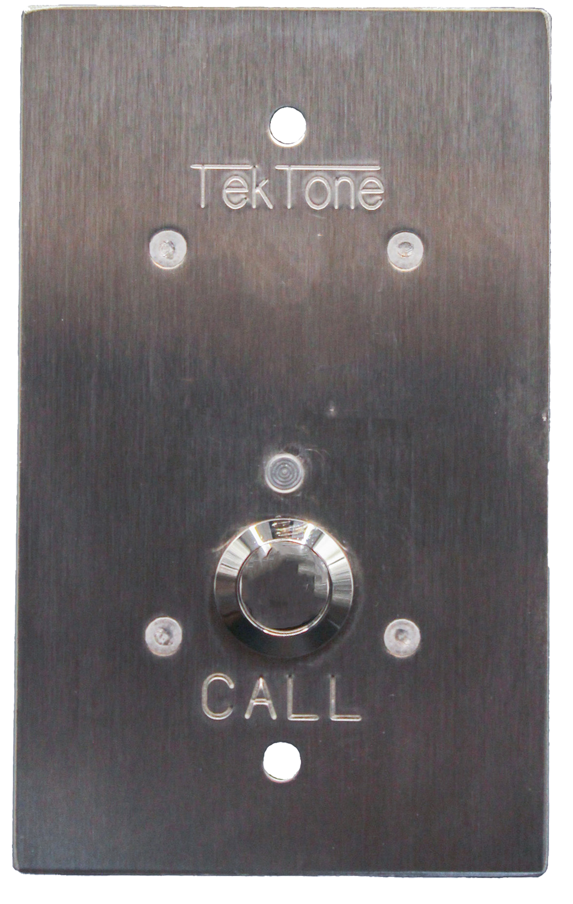
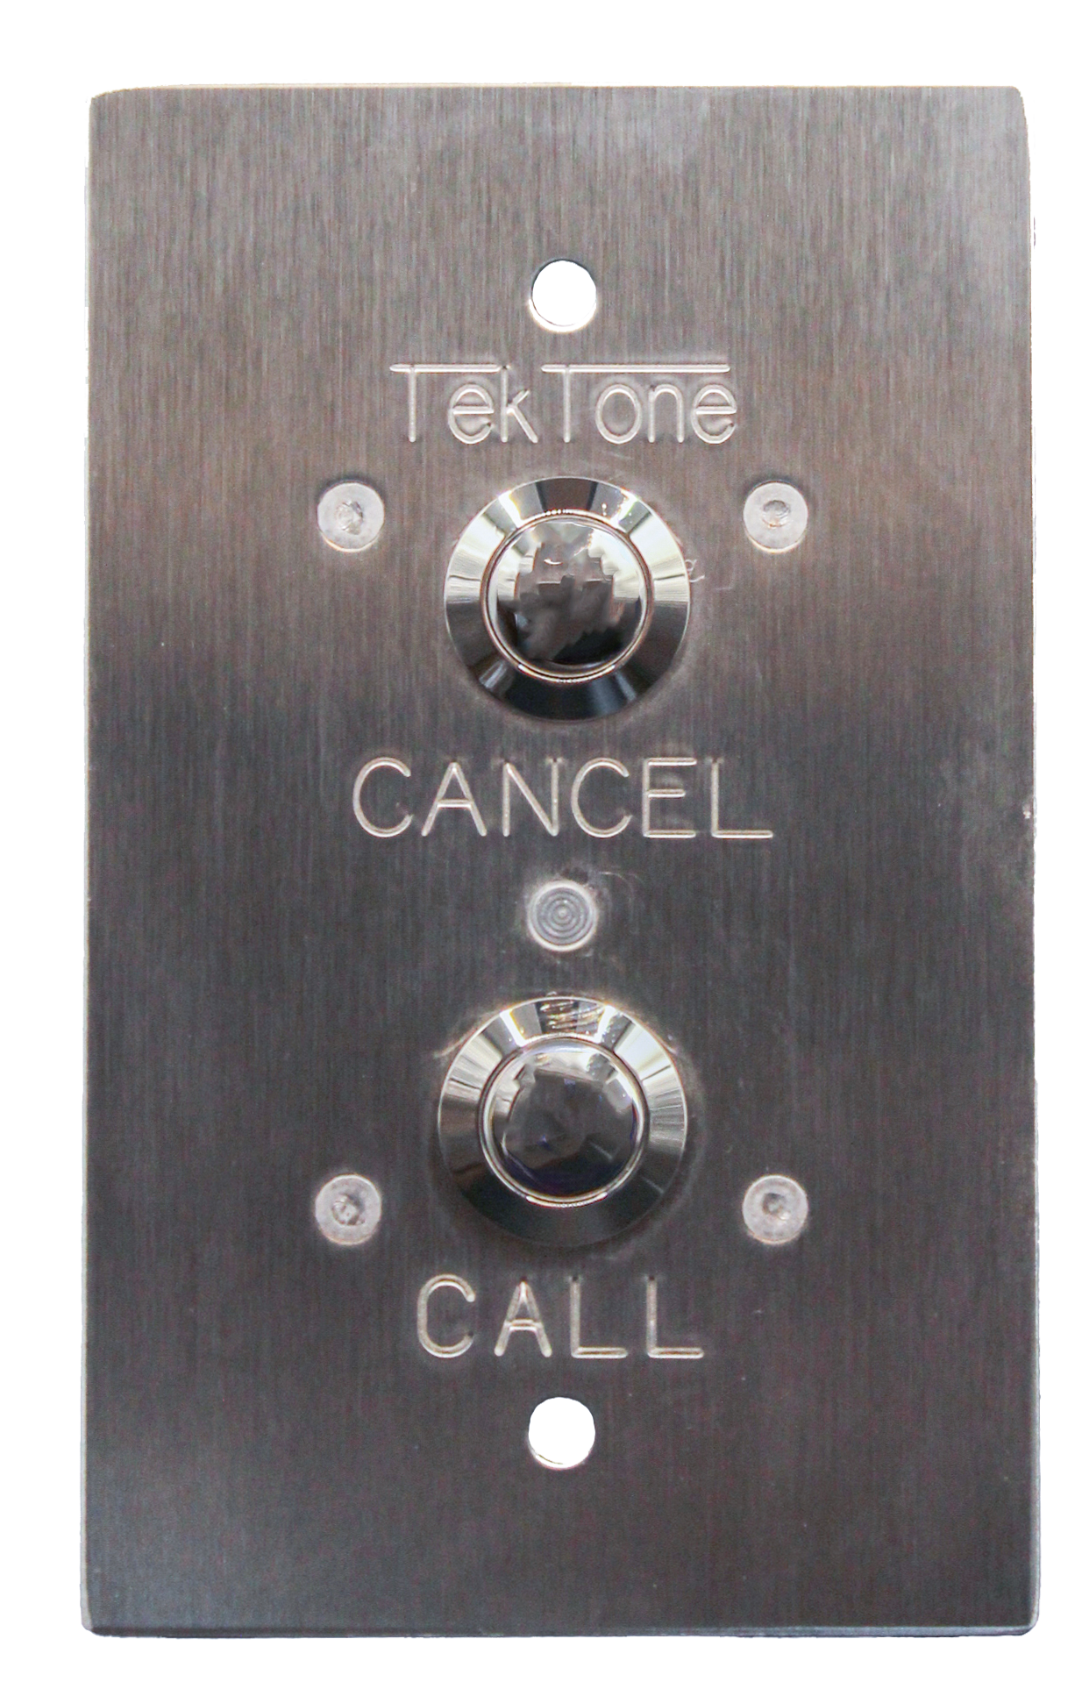
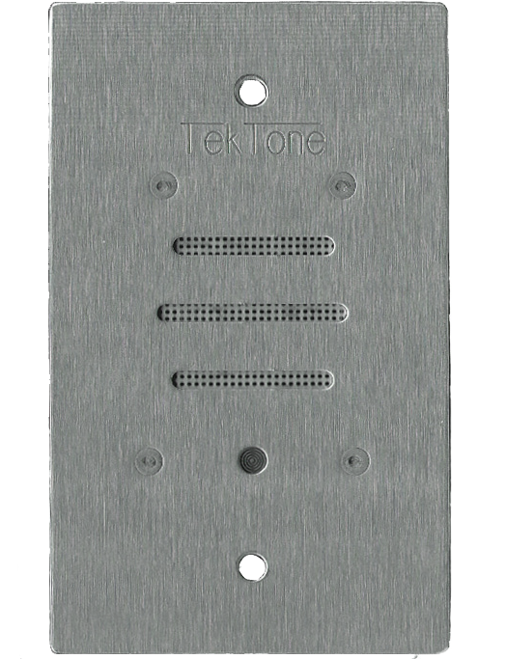
Vandal Peripheral Stations
SF123V and SF123PSY
Hardened version of the SF123. 2-button option for vandal installations, 1-button option for psychiatric station use.
Can be used with any addressable device with SF120-series header connections.
Flush mount, stainless steel construction.
IR160V
Hardened version of the IR160.
Can be used with any addressable device
with SF120-series header connections.
Flush mount, stainless steel construction.

Slide 16
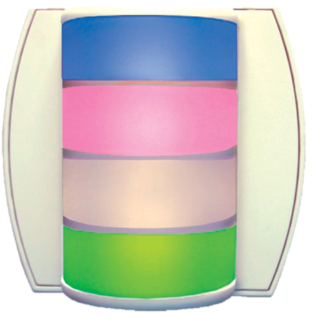
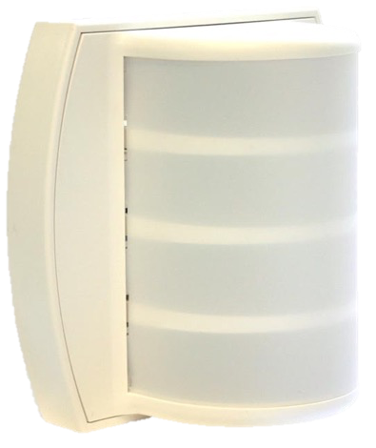
LI484P5 Corridor Light
The LI484P5 Corridor Light multicolor-LED provides visual indications of calls originating from patient, staff, duty, bath, emergency, presence and code call stations.
UL® 1069 Listed and cUL® Listed
Simplified wiring with plug-in connections
No bulb replacement needed
Excellent visibility
Fully supervised wiring to the central equipment

Slide 17
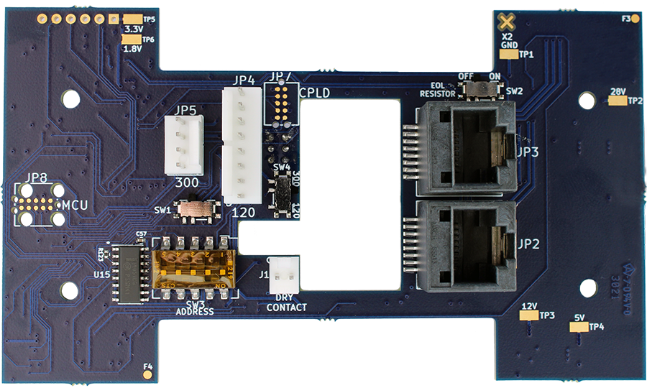
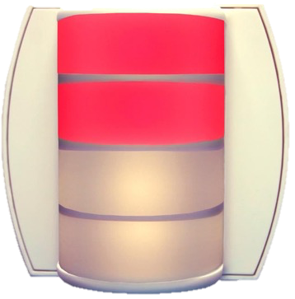
PM424ZP5 Zone Lamp Module
The PM424ZP5 Zone Light Module, when added to an LI484P5 Corridor Light, provides auxiliary visual annunciation for call activity within the zones and call types to which it is assigned. Patient priority and staff presence are indicated by four programmable LEDs.
UL® 1069 Listed and cUL® 1069 Listed
Ability to drive secondary lamp without zone lamp module
Plug-in connections
Inputs for bath and code switches
No bulb replacement needed
Excellent visibility
Supervised connections

Slide 18
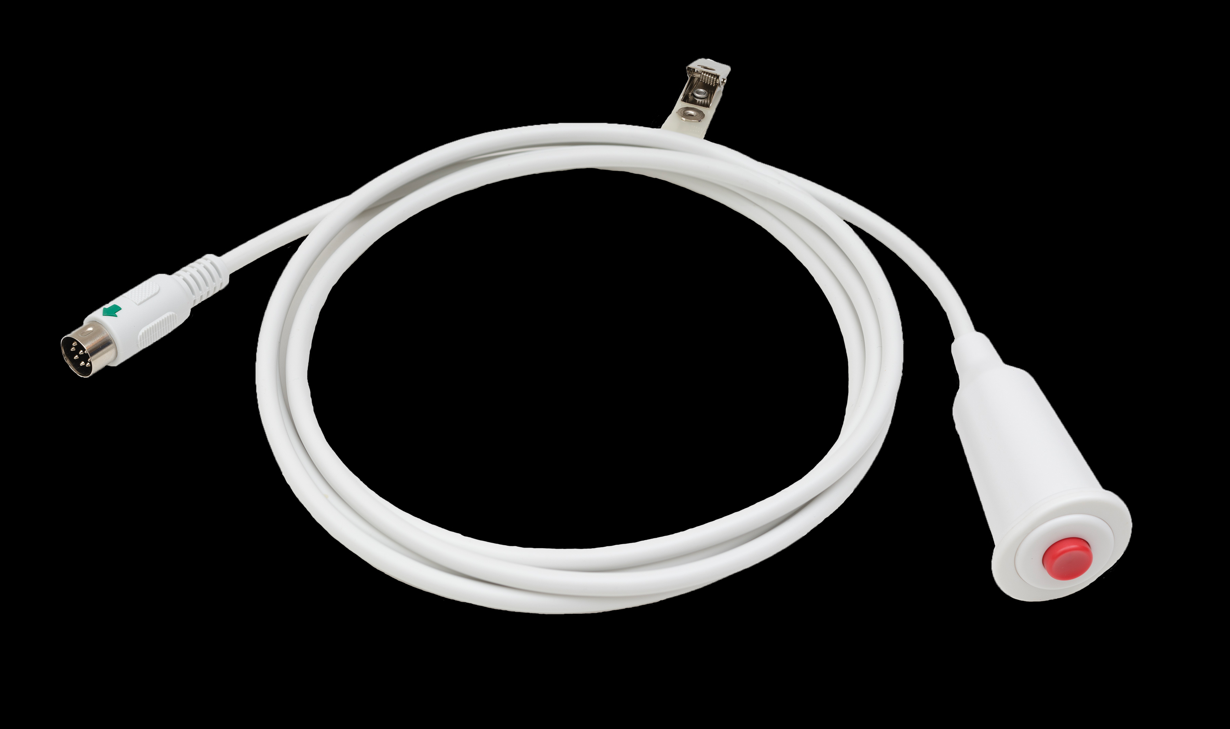
SF401B Call Cord
Used with IR42X-series addressable stations
UL® 1069 Listed
Oxygen Safe
Impact resistant and weatherproof
Bed clips included

Slide 19
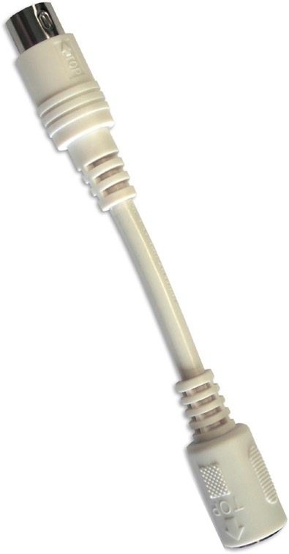
SF401EX Strain Relief Cable
The SF401EX Strain Relief Cable is used to increase the life span of call cords, pillow speakers and room stations.
The cable is placed between the call cord or pillow speaker and the room station. If the call cord or pillow speaker is attached to a bed and then the bed is pulled away, the strain relief cable disconnects. This prevents damage to both the room station and the call cord or pillow speaker.
UL® 1069 Listed
Molded connectors
Clean break-away action
Increases life of call cords, pillow speakers and room stations

Slide 20
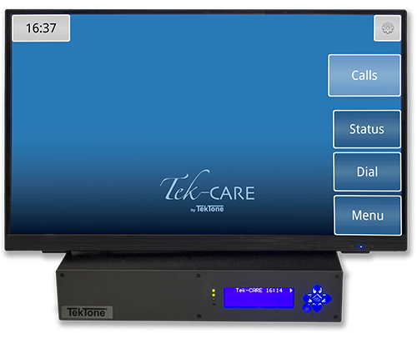
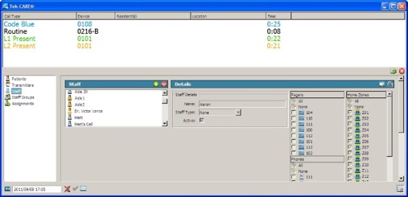
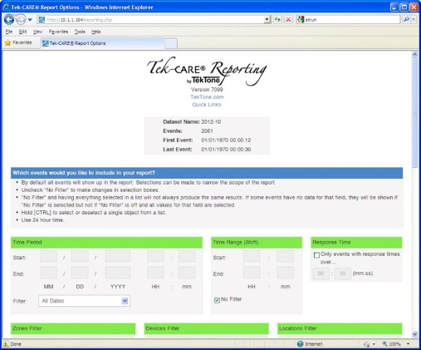
Tek-CARE Central Equipment
The Tek-CARE Central Equipment is the platform for creating integrations with your Tek-CARE system.
The Tek-CARE reporting software can be used to track activity on your Tek-CARE system with easy-to-read reports. Reporting software includes:
Database logging of Nurse Call Activity
HTML-based Reporting Software—accessible via network connection
Back-up, Archive and Restore functions

Slide 21
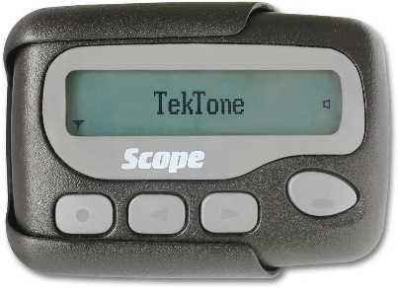
Radio Pocket Paging
Both automatic and manual radio pocket paging options may be added to the system. By associating rooms with staff or zones, pages for incoming calls include the correct room, bed number and call type.
Three levels of pagers can be assigned: primary, secondary and tertiary—ensuring that calls are responded to.

Slide 22
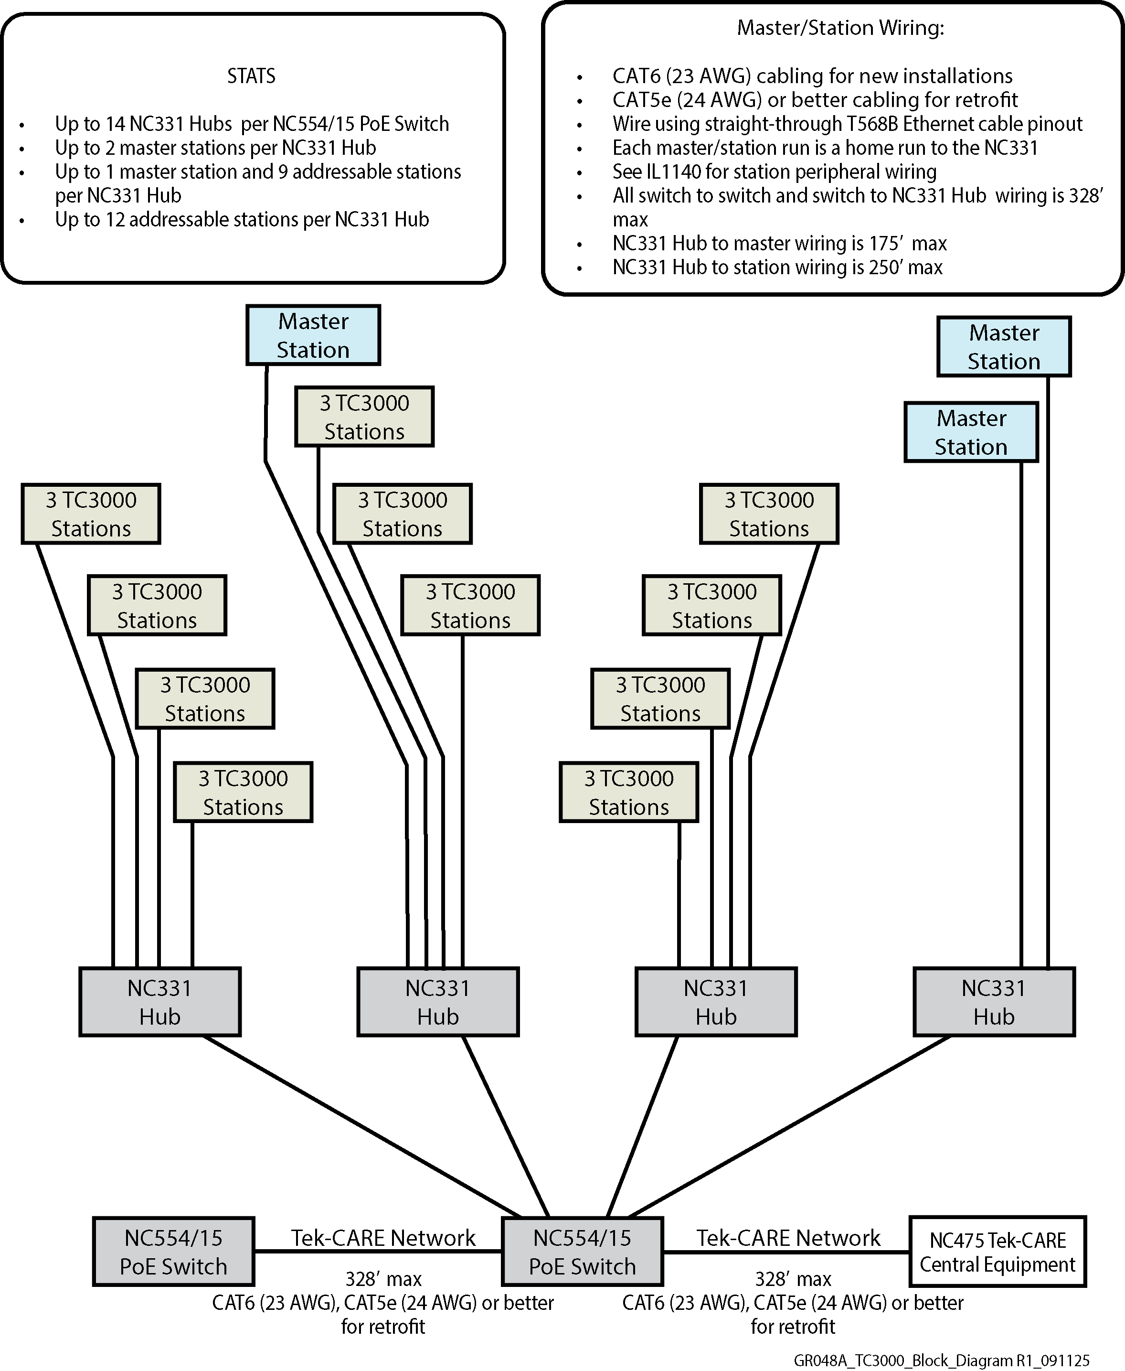
Tek-CARE3000 Wiring with Hubs

Slide 23
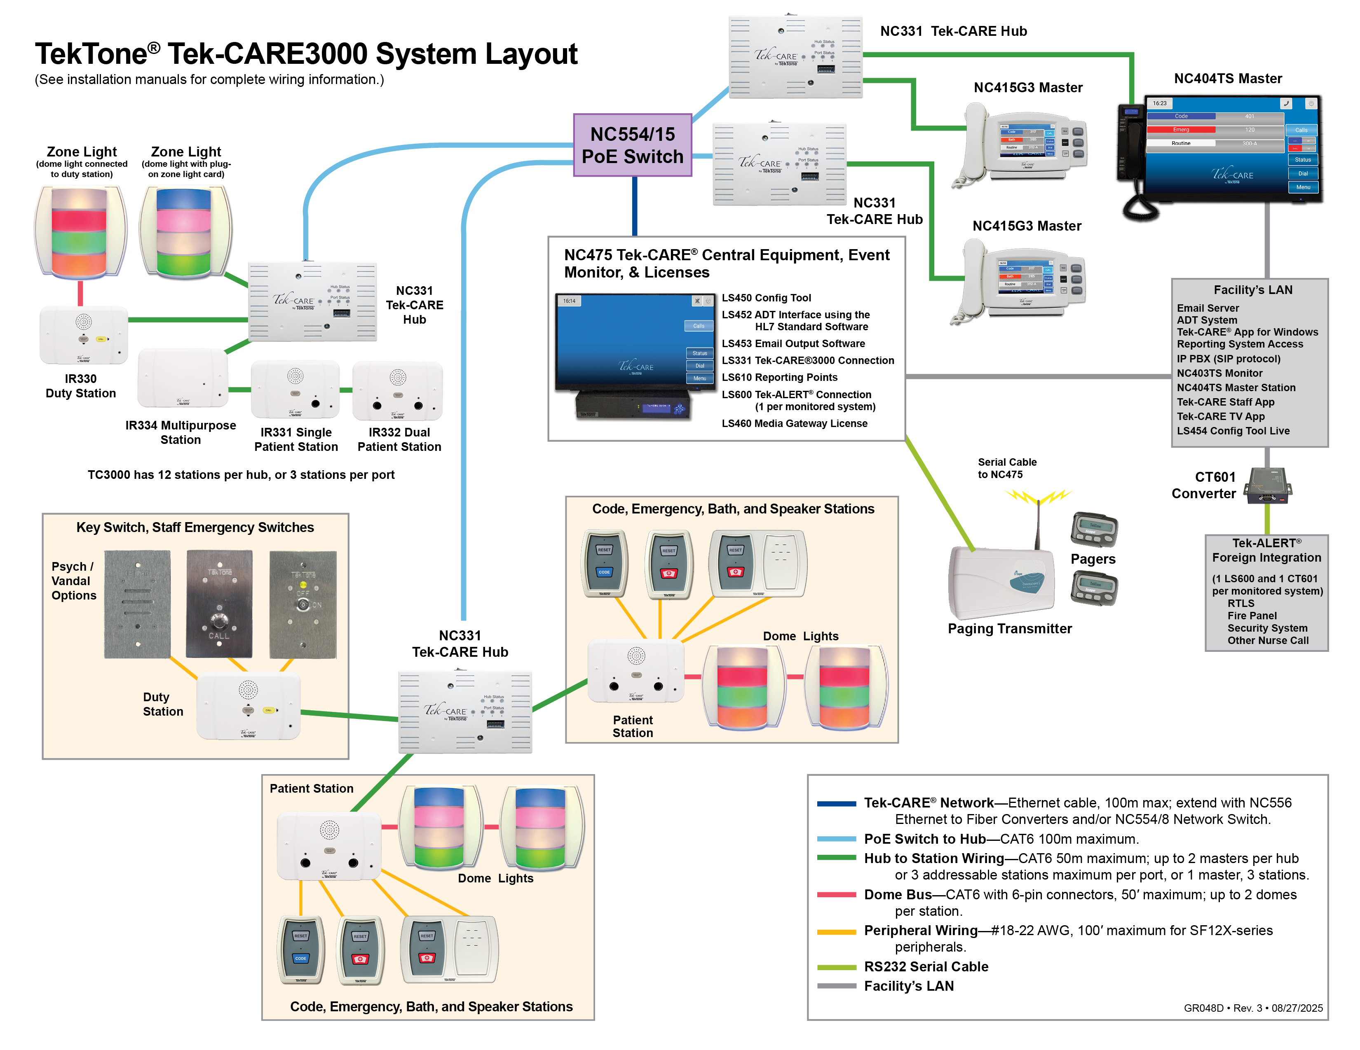

Slide 24
324 Industrial Park Road
Franklin, NC 28734
828.524.9967
www.tektone.com

