Slide 1




Slide 2
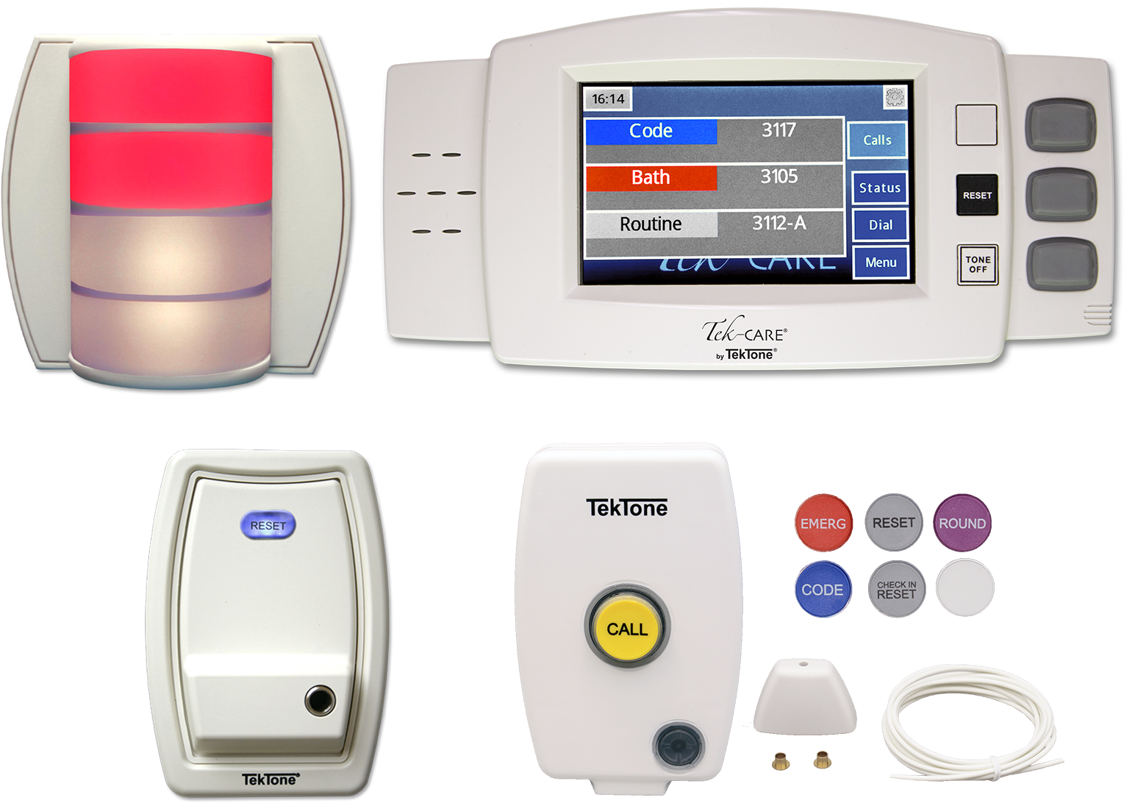

Tek-CARE®120 Introduction
The Tek-CARE®120 Tone-Visual Nurse Call System is a 2-wire system listed to the UL®1069 and 2560 standards by Underwriters Laboratories. The system is designed for a variety of healthcare facilities, such as skilled nursing, senior living, assisted/independent living, urgent care, clinics, and ambulatory surgical centers.

Slide 3

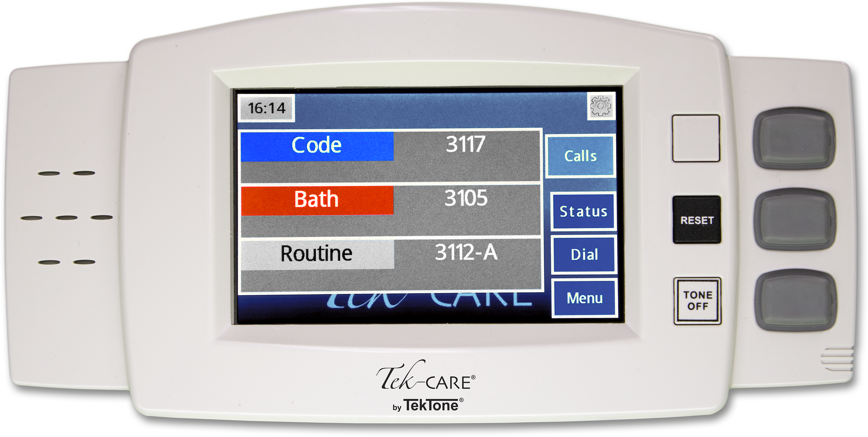
NC415G3 Master Station
  Easy-to-use interface
  Touchscreen and button controls
  Displays up to 3 calls at once
  Small footprint
  Desk- or wall-mount
  Supports one LI484P5 dome light

Slide 4

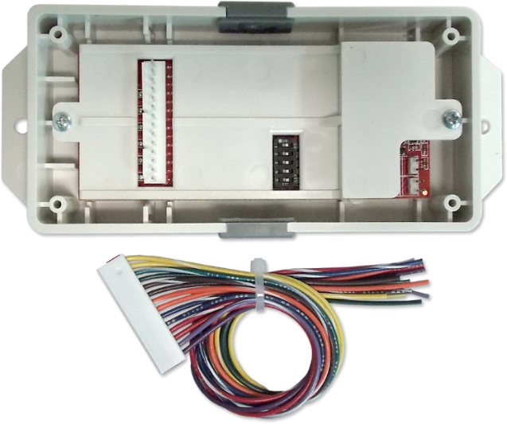
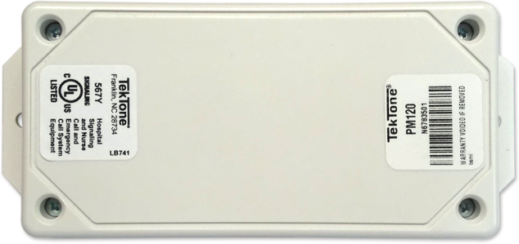
LI122UN Room Controller with Dome Light
Provides visual indication of system calls
White LEDs are selectable for warm or cold hues
Choice of red & white or blue & white LED options
Provides 6 connection points for patient stations, 2-button pull-cord stations, and duty stations
Long lasting LEDs; no bulb replacement required
The PM120 is available if dome light capability isn’t required.

Slide 5
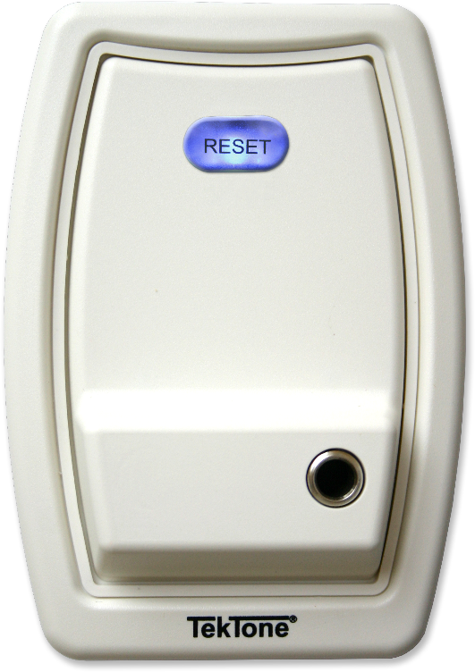
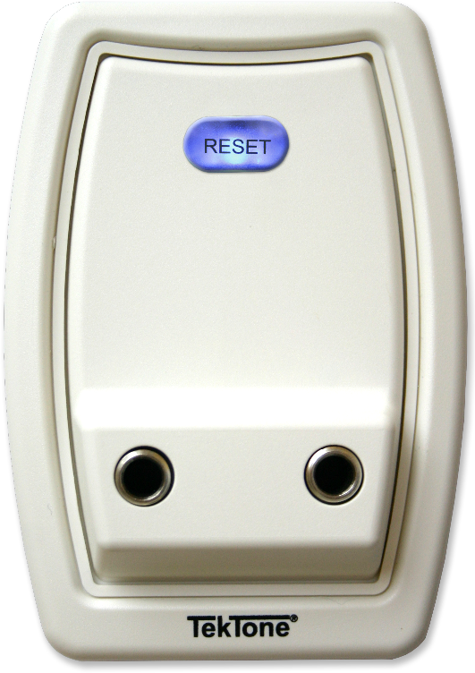
SF121 Single and SF122 Dual Patient Stations
One or two ¼" call cord jacks (push-button and geriatric call cords are available)
Illuminated reset button
Dummy plugs available
Call-assurance LEDs for each call cord jack

Slide 6
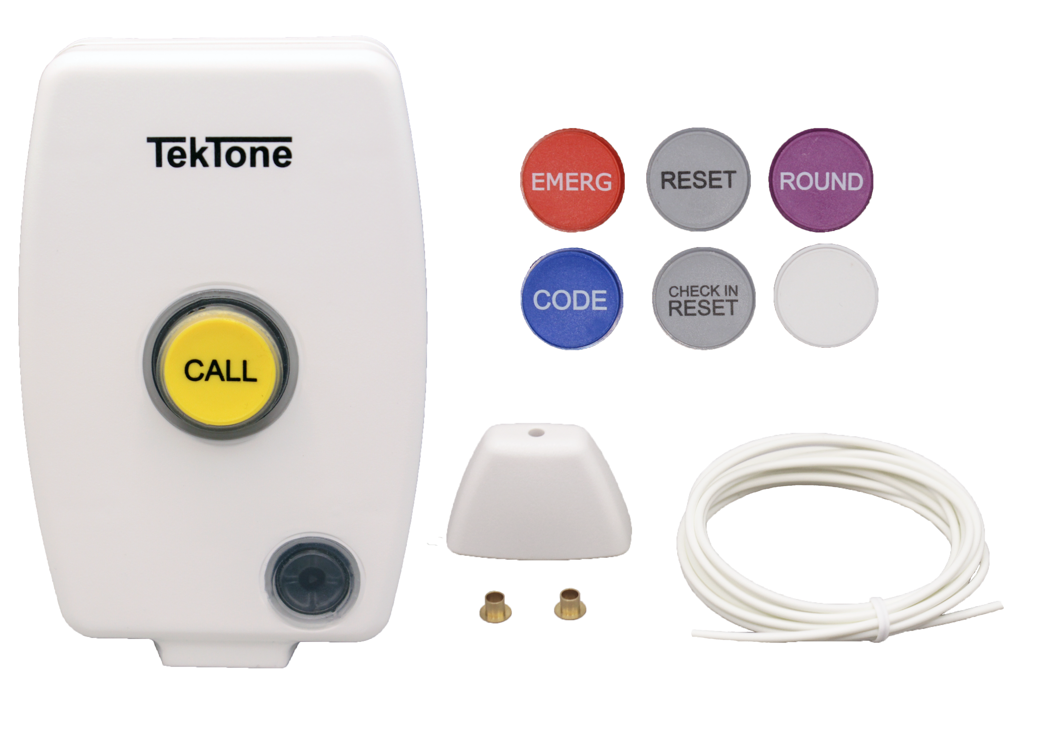
SF133A Water-Resistant Emergency Pull-Cord Station
Use push button or pull cord to place a call
Choose whether to include pull cord during installation
Call assurance LED flashes when call is placed
SF133GK Gasket Kit available for wet or high humidity locations
Assortment of call button caps available to match call types

Slide 7
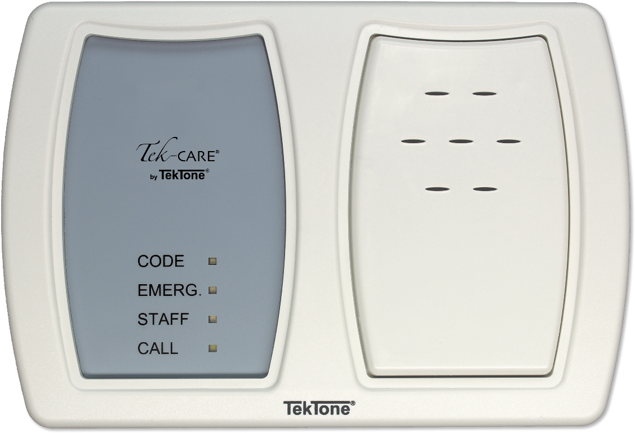
SF125 Duty Station
SF125 Duty Stations are used to annunciate calls in locations where the full functionality of an NC415G3 Master Station is not required.
Call type is indicated by one of four colored LEDs
A call tone sounds for the highest priority call

Slide 8
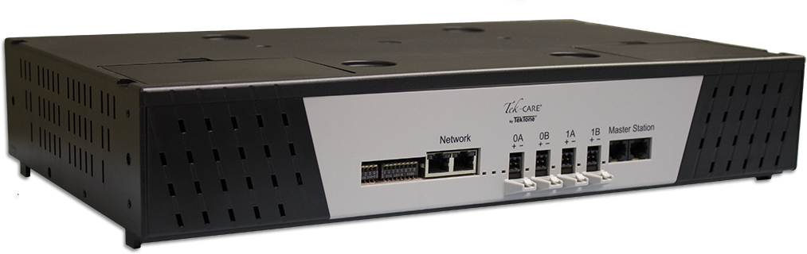
Tek-CARE®120 CE Module
Each NC120 CE module supports up to six NC415G3 or NC404TS master stations, 64 room controllers (4 runs of 16 controllers each), and 16 duty stations (4 duty stations per run)
Network up to 20 NC120 CE modules for up to 120 masters and 1280 room controllers
Stackable shelf mount; 2U rack mount kit included
Programmable using our exclusive Config Tool software via laptop connected to the Tek-CARE® Network

Slide 9
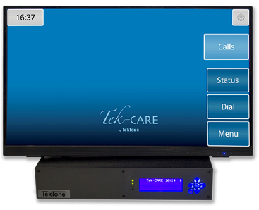
Alert Integration with the Tek-CARE Central Equipment
The Tek-CARE Central Equipment is easily integrated with the TC120, allowing for the addition of features, such as reporting, email output and mobile capabilities.

Slide 10
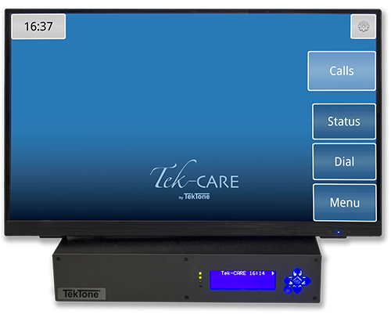
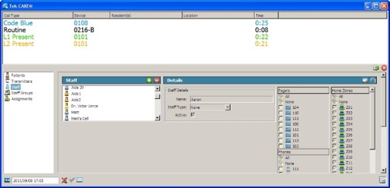
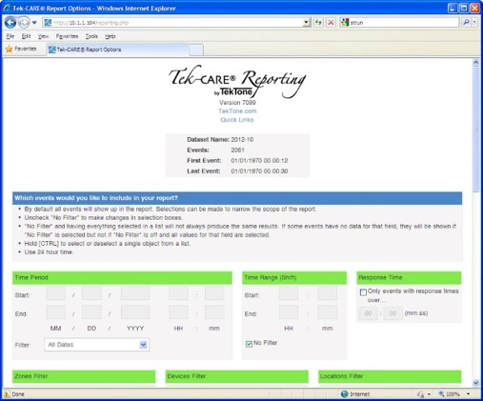
Tek-CARE Central Equipment
The Tek-CARE Central Equipment is the platform for creating integrations with your Tek-CARE system.
The Tek-CARE reporting software can be used to track activity on your Tek-CARE system with easy-to-read reports. Reporting software includes:
Database logging of Nurse Call Activity
HTML-based Reporting Software—accessible via network connection
Back-up, Archive and Restore functions

Slide 11
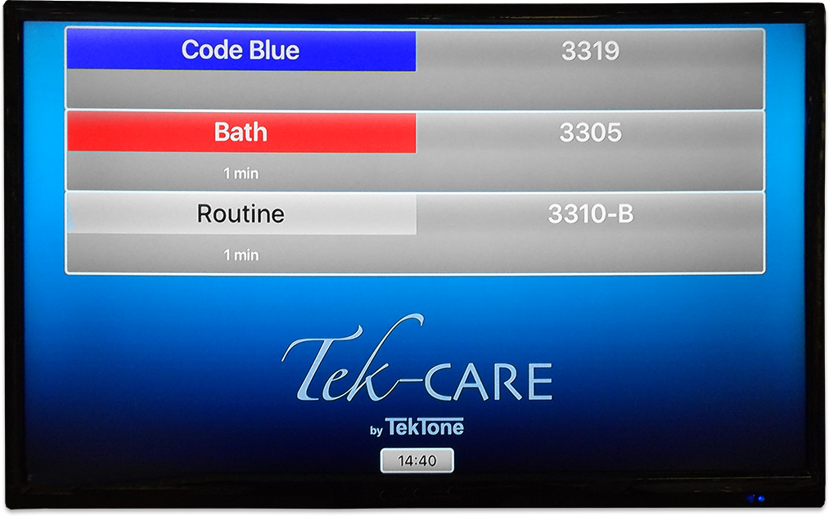
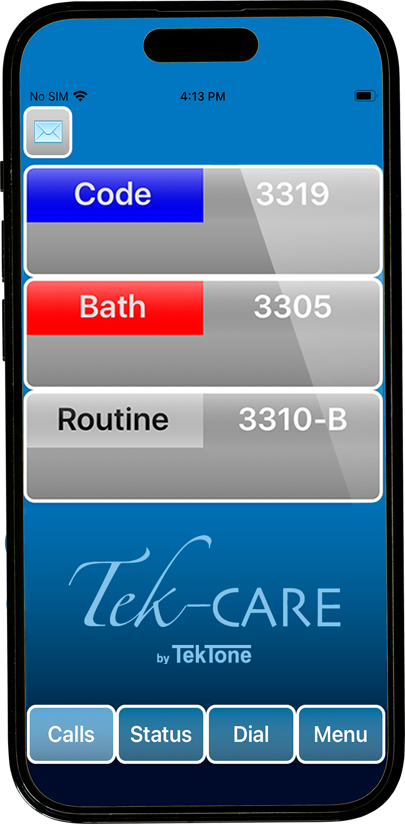
Tek-CARE Mobile App and Tek-CARE TV
The Tek-CARE App can be used to display calls on iOS and Android devices, displaying calls to mobile devices. Tek-CARE TV is available for Apple TV, allowing calls to be displayed on monitors throughout a facility.

Slide 12
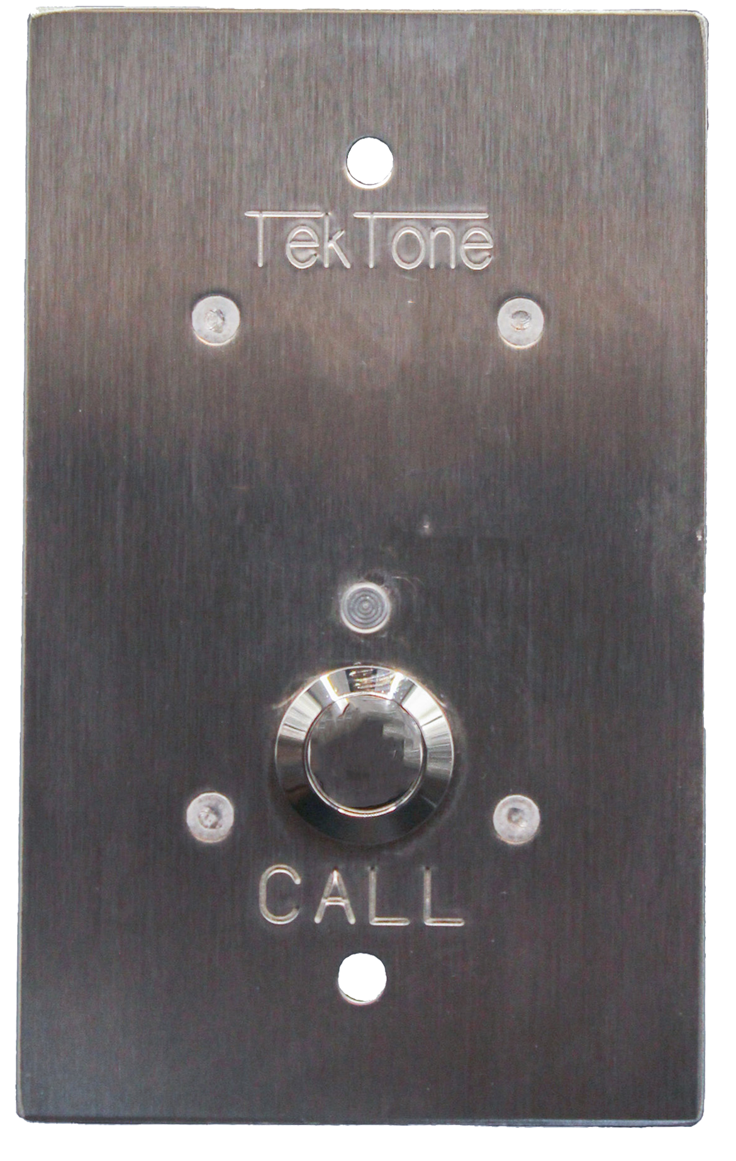
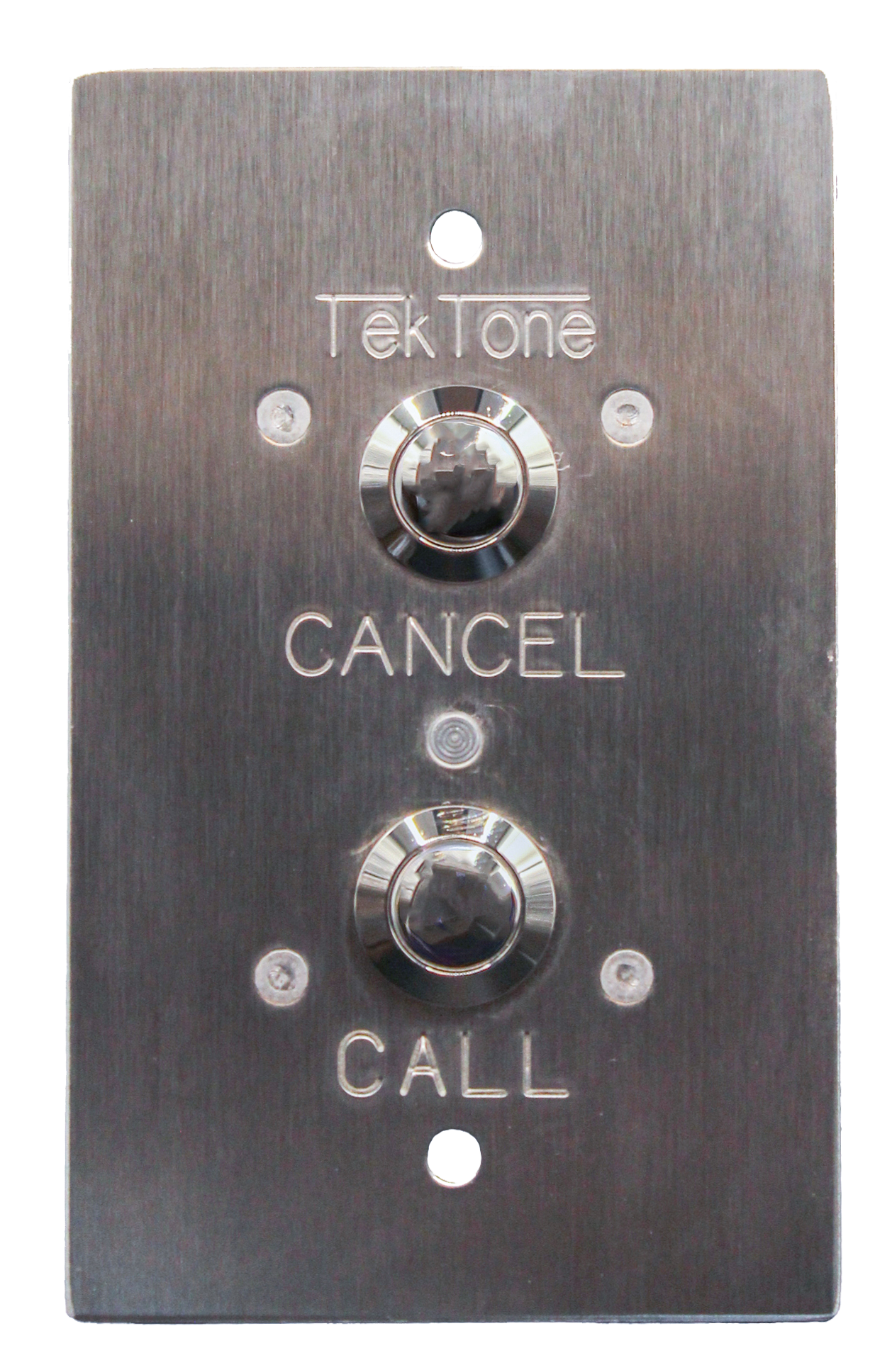
Vandal Resistant SF120-series Peripheral Stations
SF123V and SF123PSY
Hardened version of the original SF123. 2-button option for vandal installations, 1-button option for psychiatric station use
Can be used with any addressable device with SF120-series header connections
Flush mount, stainless steel construction

Slide 13
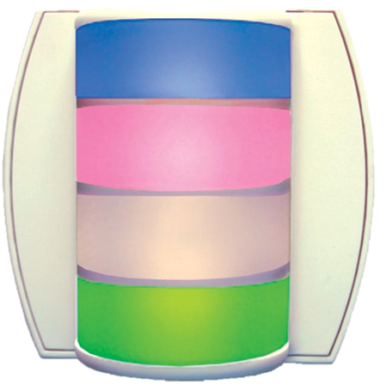
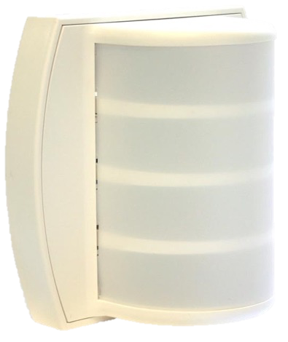
LI484P5 Corridor Light
The LI484P5 Corridor Light multicolor-LED provides visual indications of calls originating from patient, staff, duty, bath, emergency, presence and code call stations.
UL® 1069 Listed and cUL® Listed
Simplified wiring with plug-in connections
No bulb replacement needed
Excellent visibility
Fully supervised wiring to the central equipment
One LI484P5 corridor light may be connected to the NC415G3

Slide 14
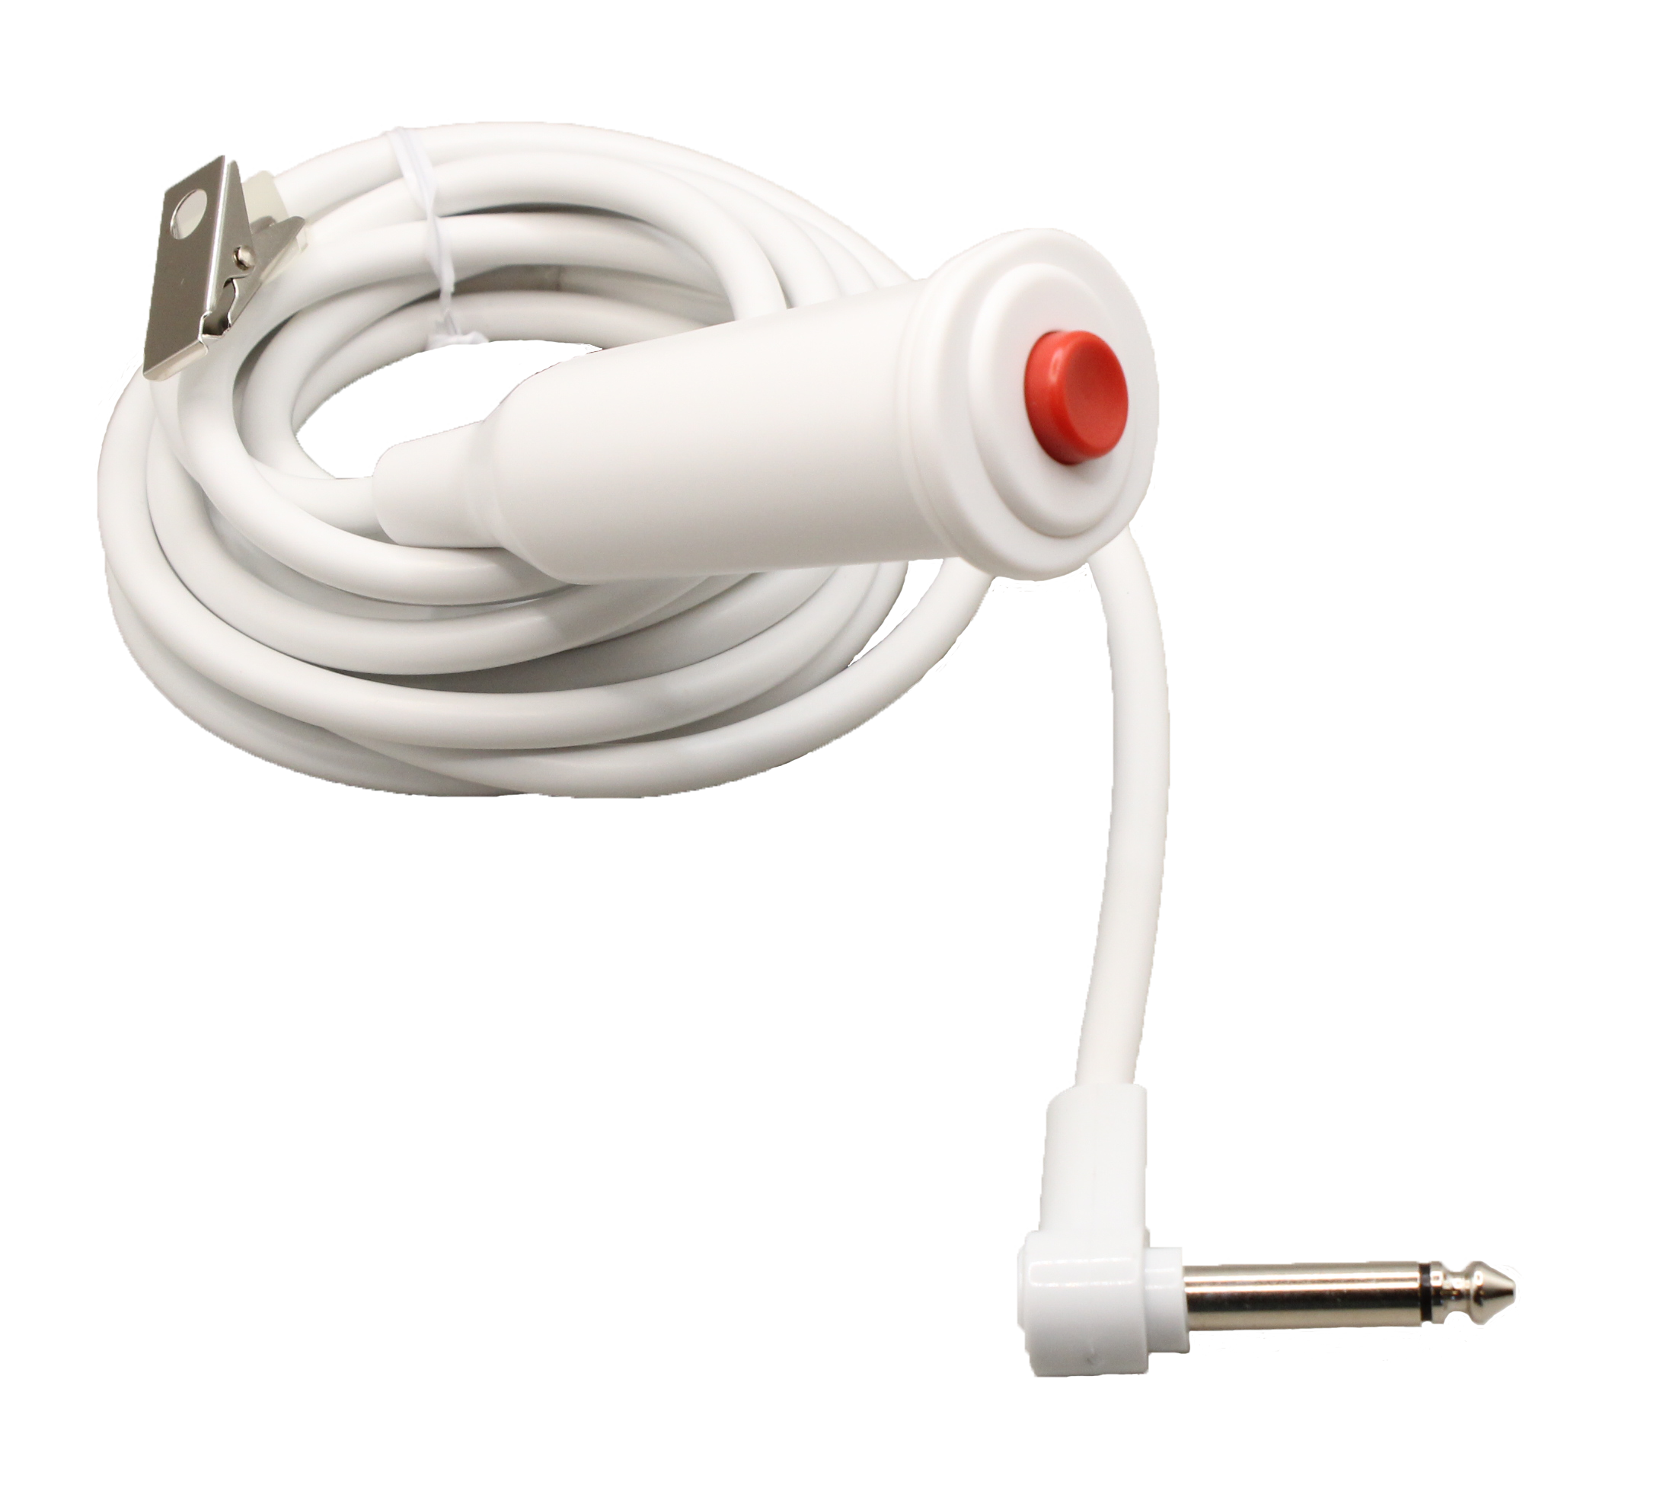
SF301B Call Cord
Tactile push-button call cord
  - Call button makes an audible and tactile click for assurance of activation
UL® 1069 Listed
Oxygen-safe
Impact-resistant and waterproof
Small, lightweight pendant fits comfortably in hand
Bed clips included

Slide 15
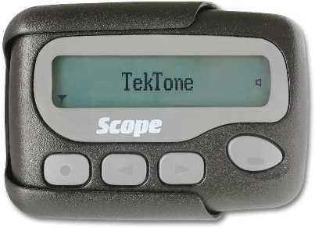
Radio Pocket Paging
Both automatic and manual radio pocket paging options may be added to the system. By associating rooms with staff or zones, pages for incoming calls include the correct room, bed number and call type.
Three levels of pagers can be assigned: primary, secondary and tertiary—ensuring that calls are responded to.

Slide 16
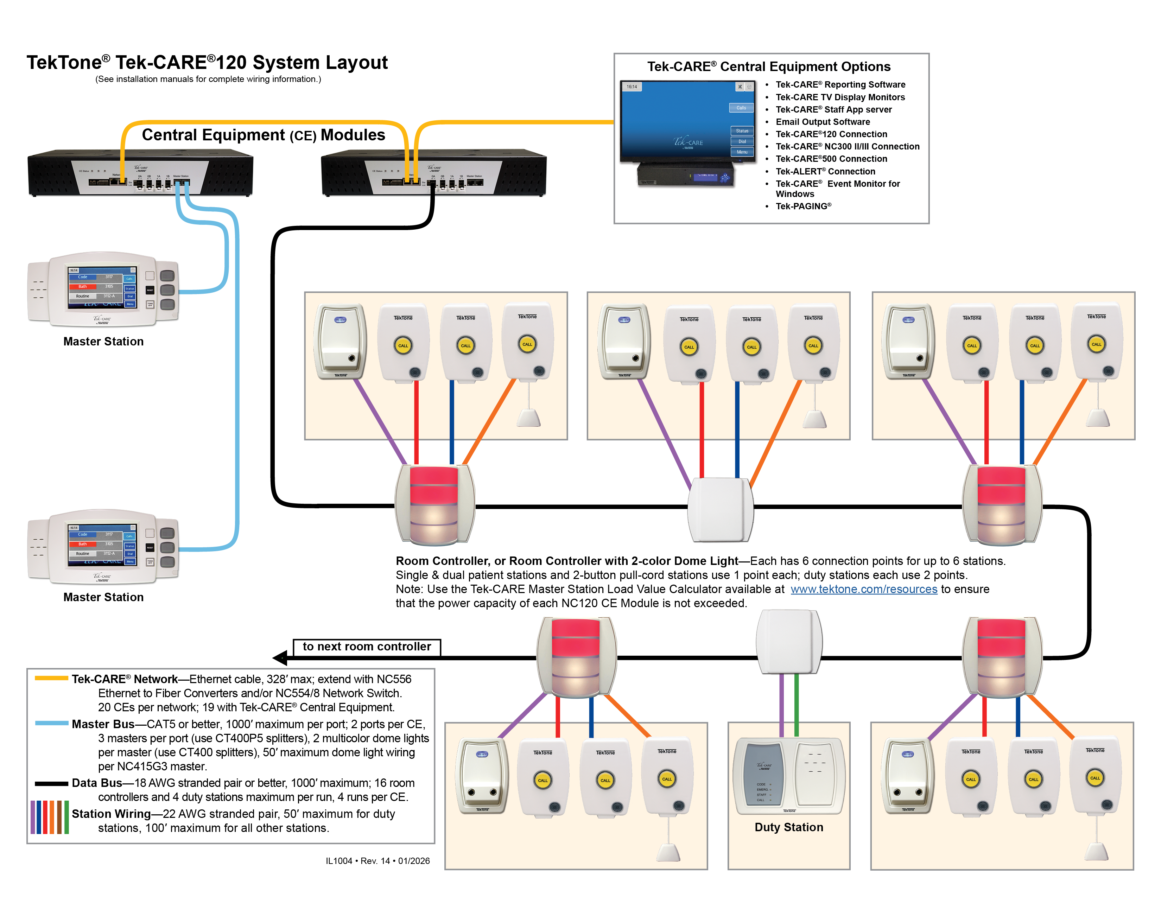

Slide 17
324 Industrial Park Road
Franklin, NC 28734
828.524.9967
www.tektone.com

